Slide 1

Mount Saint Mary’s University “Ecclesia” Program Presents:
Living Word: Scriptures of the 2021 Liturgical Year
Lectionary Readings for the Sundays of Advent
Fr. Felix Just, S.J., Ph.D.
Living Word Catholic Biblical Ministries
http://catholic-resources.org

Slide 2
Welcome to “Living Word”!
Zoom Webinars Series co-sponsored by:
  “Ecclesia” Program of Mount Saint Mary’s University, LA
    Gail Gresser, Director of Campus Ministry
    “Serving those who serve the Church”
  “Living Word Catholic Biblical Ministries,” Los Angeles
    New name for Fr. Felix’s adult faith-formation programs
Welcome to All, especially :
  Prior “Ecclesia” program participants
  Pilgrims from 2011-2019 pilgrimages
  Catholic Bible Institute of Southern Arizona
  Catholic Bible Institutes in L.A. & San Bernardino & Orange
  Members of EOHSJ, Serra Club, Loyola Institute
  Parishioners from St. Monica, Santa Monica, CA
  Other NEW folks, here for the first time!

Slide 3
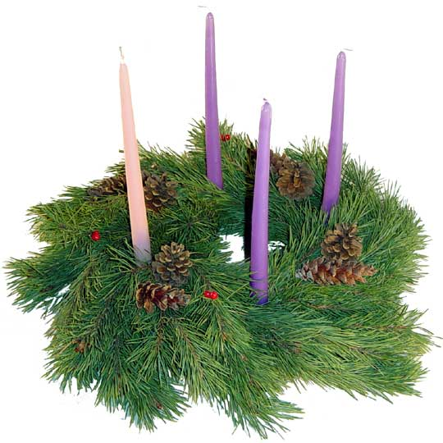
Opening Prayer
O God, the day draws near when the glory of your Son will make radiant the night of the waiting world.
May the lure of greed not impede us from the joy which moves the hearts of those who seek him.
May the darkness not blind us to the vision of wisdom which fills the minds of those who find him.
We ask this in the name of Jesus, our Savior and Lord. Amen.

Slide 4
“Living Word” Webinar Series
Zoom Webinars on the Catholic Lectionary for Mass
  Saturdays, 9:00 a.m. – 12:30 p.m. (Pacific Time)
  Open to the Public (feel free to invite others)
  FREE (but donations appreciated)
Monthly, from Nov. 2020 to April 2021
  Nov. 21, 2020 – Readings of Advent
  Dec. 19, 2020 – Readings of the Christmas Season
  Jan. 9, 2021 – Gospel of Mark (Liturgical Year B)
  Feb. 13, 2021 – Readings of Lent
  March 27, 2021 – Readings of Holy Week & Triduum
  April 10, 2021 – Readings of the Easter Season

Slide 5
Lectionary Readings
Basic Questions of This Year’s Webinar Series:
WHICH biblical texts are read at Catholic Masses?
  Seasons: Advent; Christmas; Lent; Easter; Ordinary Time
  Sundays/Feasts: 1st Reading, Psalm, 2nd Reading, Alleluia, Gospel
  Weekdays: 1st Reading, Psalm, Alleluia, Gospel
WHY were the assigned readings chosen?
  Brief “Rationale” in Lectionary’s “Introduction” (in printed editions)
    Chap. 2 in 1969 edition; or Chap. 5 in 1981 edition.
    Season by season; first Sundays/Feasts, then Weekdays
For charts, handouts, more info, see my website:
http://catholic-resources.org/Lectionary/
  Also has the full text of the 1981 “Introduction”

Slide 6
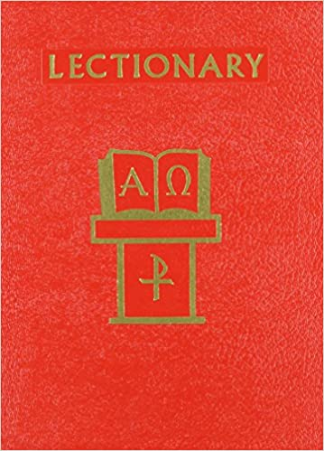
Liturgical Season of ADVENT
Outline of Today’s Webinar:
  Advent: Intro & Overview of Sundays, Years ABC
  Advent Sundays: Readings for 2020: Year B
  Advent Weekdays: Readings used each year
  Ten minute breaks after each part.
Lectionary for Mass Website:
  http://catholic-resources.org/Lectionary

Slide 7
Introduction:
Let’s start with the Gospels of the 1st Sunday of Advent
Year A: Matt 24:37-44
Year B: Mark 13:33-37
Year C: Luke 21:25-28, 34-36
Biblical or Lectionary Texts:
Your Own Bibles
Handouts that I emailed you
Slides from this PPT on your screen
https://bible.usccb.org/readings/calendar

Slide 8
Personal Preparation Suggestion
Use the “Mark-Up Method”
Get a paper copy of the scripture readings:
  Use a missalette (Give Us This Day, Magnificat, Living With Christ, etc.)
  Or go to http://USCCB.org & print out the readings,
  Or photocopy pages from a published Lectionary.
Then underline and write some notes:
  In each reading, highlight KEY WORDS and IMAGES
  that JUMP OUT at you (either inspiring or disturbing you)!
TIP: It’s also good to read & discuss texts & themes with other people:
  Consider FOUR Advent Sundays together.
  Consider whole Christmas SEASON together.

Slide 9
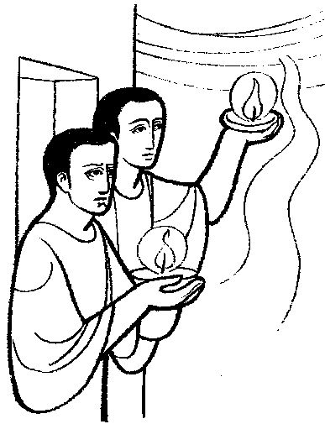
1st Advent, Year B –
Mark 13:33-37
Jesus said to his disciples:
“Be watchful! Be alert!
You do not know when the time will come.
It is like a man traveling abroad.
He leaves home and places his servants in charge,
each with his own work,
and orders the gatekeeper to be on the watch.
Watch, therefore;
you do not know when the Lord of the house is coming,
whether in the evening, or at midnight,
or at cockcrow, or in the morning.
May he not come suddenly and find you sleeping.
What I say to you, I say to all: ‘Watch!’ ”

Slide 10
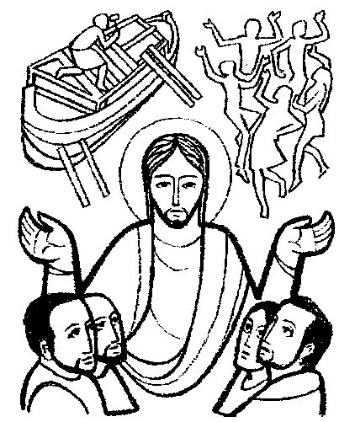
1st Advent, Year A –
Matt 24:37-44
Jesus said to his disciples:
“As it was in the days of Noah,
so it will be at the coming of the Son of Man.
In those days before the flood,
they were eating and drinking, marrying and giving in marriage,
up to the day that Noah entered the ark.
They did not know until the flood came and carried them all away.
So will it be also at the coming of the Son of Man.
Two men will be out in the field; one will be taken, and one will be left.
Two women will be grinding at the mill; one will be taken, and one will be left.
Therefore, stay awake!
For you do not know on which day your Lord will come.
Be sure of this: if the master of the house
had known the hour of night when the thief was coming,
he would have stayed awake and not let his house be broken into.
So too, you also must be prepared,
for at an hour you do not expect, the Son of Man will come.”

Slide 11
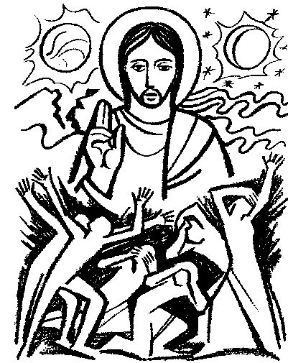
1st Advent, Year C –
Luke 21:25-28, 34-36
Jesus said to his disciples:
“There will be signs in the sun, the moon, and the stars,
and on earth nations will be in dismay, (cf. Joel 2,3,4)
perplexed by the roaring of the sea and the waves.
People will die of fright in anticipation of what is coming upon the world,
for the powers of the heavens will be shaken. (Hag 2)
And then they will see the Son of Man
coming in a cloud with power and great glory. (Dan 7)
But when these signs begin to happen,
stand erect and raise your heads because your redemption is at hand.
Beware that your hearts do not become drowsy
from carousing and drunkenness and the anxieties of daily life,
and that day catch you by surprise like a trap.
For that day will assault everyone who lives on the face of the earth.
Be vigilant at all times and pray that you have the strength
to escape the tribulations that are imminent
and to stand before the Son of Man.”

Slide 12

1st Sunday of Advent
Why such “apocalyptic” Gospel readings?
  Day of the Lord?
  Coming of the Son of Man?
  End of the World?
November Readings already “apocalyptic”
  Esp. 31st to 34th Sunday
  “Christ the King” – final Judgment!
Coming? End? WHEN?
  WHAT IS “TIME”?

Slide 13
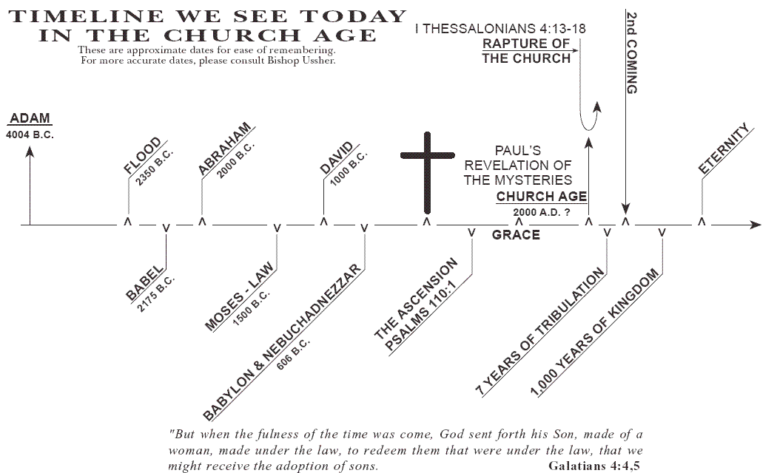
Concepts of “TIME”
Modern/Secular: LINEAR
  Time-LINE: Past → Present → Future
    Counting Years? Growing Older? Nearing the “End”?
    Also used by biblical fundamentalists

Slide 14

Concepts of “TIME”
Biblical/Liturgical: CYCLICAL
  Year: Earth revolves around the Sun
    When does a “year” begin? Jan. 1? March 25? ~Nov. 27?
  Month: Moon revolves around the Earth
    When is “New Moon”? When is “Full Moon”? (lunar vs. solar calendars)
  Four Seasons in Nature:
    Spring, Summer, Fall, Winter (which is “first”?)
    Annual Holidays: Easter, Thanksgiving; July 4, Dec. 25

Slide 15
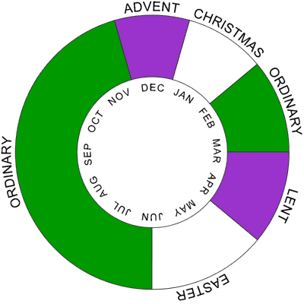
Christian Liturgical Year
Based on Life of Jesus:
  Advent
  CHRISTMAS
  Ordinary Time I
    After Epiphany/Baptism
  Lent
  EASTER
  Ordinary Time II
    After Pentecost
Some Confusions:
  Fitting ~33 years of his life into each calendar year today.

Slide 16
What is “Advent”?
Latin adveniens/adventus = “coming, arrival”
The COMING of the Lord
  But When? WHICH “Coming”?
  “First Coming”: Christmas – Jesus born in humility (past)
  “Second Coming”: Judgment – Jesus returns in glory (future)
For which “Coming” do we prepare in Advent?
BOTH!
  Prepare to celebrate First Coming (Incarnation) – past event
  Prepare for the Second Coming (Parousia) – future expectation
Also a Third sense of “Coming” = TODAY / DAILY!
  Letting Jesus come into our hearts, lives, families, communities – present life

Slide 17
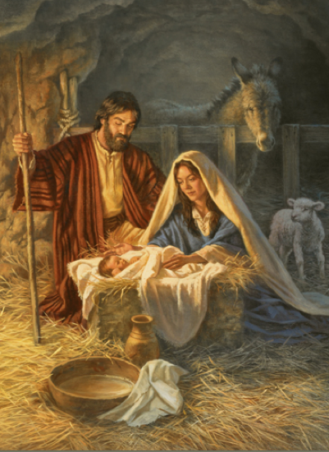
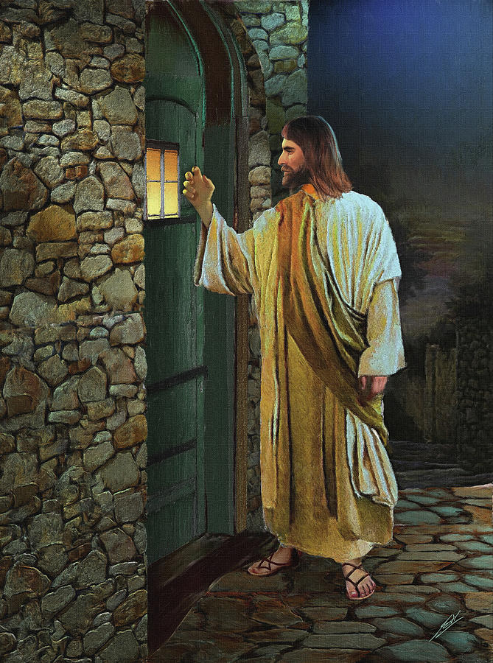
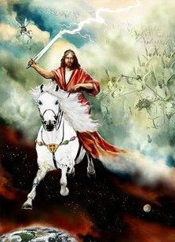
HOW Does Jesus Come?
Past Present Future

Slide 18
Two Main Parts of Advent
Early Advent – looking to the future
  Focus on our preparing for the Lord’s SECOND COMING.
  Just as Jesus fulfilled OT hopes for God’s coming.
Later Advent – recalling the past
  Preparing to celebrate the FIRST COMING of the Lord.
  Recalling the birth of baby Jesus 2000 years ago.
Christmas – living in the present
  Celebrating liturgies with the world-wide Church.
  Celebrating with family & friends: gifts, meals, greetings

Slide 19
Advent Overview – Years A/B/C
New Liturgical Year Begins:
1st Sunday: Nov. 27 – Dec. 3
  ?weekday, Nov. 30 – St. Andrew
2nd Sunday: Dec. 4-10
  ?weekday, Dec. 8 – Immaculate Conception
3rd Sunday: Dec. 11-17
  ?weekday, Dec. 12 – Our Lady of Guadalupe
  ?weekday, Dec. 17 – begin “O Antiphons”
4th Sunday: Dec. 18-24
  ?weekdays, Dec. 24-25 – Christmas Eve/Day

Slide 20
Catholic Lectionary for Mass
https://catholic-resources.org/Lectionary/
  Large section of my website
    Explains both pre-Vatican II and post-Vatican II Lectionaries
    Other websites have “Revised Common Lectionary” (mainline Protestants)
  Charts of Readings for each Liturgical Season
    Advent, Christmas, Lent, Easter, Ordinary Time, Saints, Rituals, etc.
    Study the tables either horizontally or vertically.
Connections between readings
  Horizontal: Connect the various readings used on one day.
    See the “headings” above each reading in a printed Lectionary
  Vertical: Consider all the readings of one type per season.
    All the Gospels of Advent, all the first readings of Easter, etc.

Slide 21


Lectionary Structure: Sundays
Three-Year Cycle:
  Matthew (2020)
  Mark (2021)
  Luke (2022)
Three Main Readings:
  OT Reading
  + Responsorial Psalm
  NT Epistles
  + Gospel Acclamation
  NT Gospel

Slide 22

Lectionary Structure: Weekdays
Two Main Readings:
  First Reading (NT/OT)
  + Responsorial Psalm
  Gospel
Two-Year Cycle:
  Odd Years (vol. 2)
  Even Years (vol. 3)
  Only applies to Ordinary Time
  Same readings each year for Advent, Xmas, Lent, Easter

Slide 23
Advent, CHRISTMAS, Epiphany
Advent – Season of preparation & waiting
  begins 4 Sundays before Christmas (rarely 4 full weeks)
CHRISTMAS – Birth/Nativity of Jesus
  Christmas Eve & Day – Dec. 24/25
    Four Masses: Vigil, Midnight, Dawn, Day
  Special Feasts during Christmas Season:
    St. Stephen, St. John Evangelist, Holy Innocents, etc.
  Christmas Octave, Jan. 1: Mary / Naming Jesus / World Peace
Epiphany – Coming of the Magi (Matt 2)
  Jan. 6 (trad.); or moved to closest Sunday: Jan. 2-8
Baptism of the Lord – Christmas Season ends

Slide 24
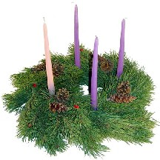
How Long Is Advent?
Not Always Four Weeks!
  Starts Four Sundays before Christmas.
    Christmas is always Dec. 25, but the weekday varies!
Thus Advent is between 3 and 4 weeks long.
  If Christmas is a Sunday:
    First Sunday of Advent is Nov. 27
    Fourth Sunday of Advent is Dec. 18
  If Christmas is a Monday:
    First Sunday of Advent is Dec. 3
    Fourth Sunday of Advent is Dec. 24
Detailed Charts:
  https://catholic-resources.org/Lectionary/Overview-Advent.htm
    Affects weekdays of Advent more than Sundays – unless Sunday is Christmas Eve!

Slide 25
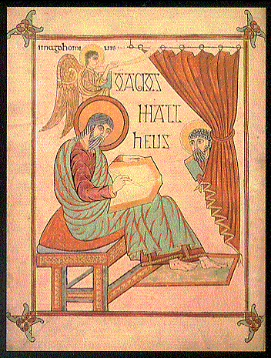
Advent, Year A – MATTHEW
Year A | First Reading | Second Reading | Gospel Reading
First Sunday | Isaiah 2:1-5 | Romans 13:11-14 | Matthew 24:37-44
Second Sunday | Isaiah 11:1-10 | Romans 15:4-9 | Matthew 3:1-12
Third Sunday | Isaiah 35:1-6a, 10 | James 5:7-10 | Matthew 11:2-11
Fourth Sunday | Isaiah 7:10-14 | Romans 1:1-7 | Matthew 1:18-24

Slide 26
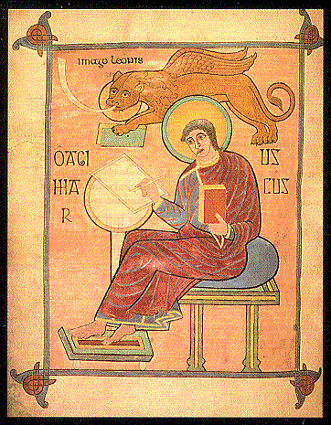
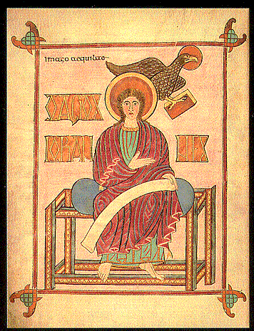
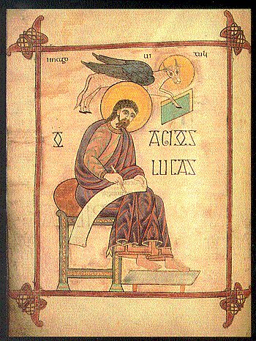
Year B – MARK and…
Year B | First Reading | Second Reading | Gospel Reading
First Sunday | Isaiah 63:16b-17,19b; 64:2-7 | 1 Corinthians 1:3-9 | Mark 13:33-37
Second Sunday | Isaiah 40:1-5, 9-11 | 2 Peter 3:8-14 | Mark 1:1-8
Third Sunday | Isaiah 61:1-2a, 10-11 | 1 Thess 5:16-24 | John 1:6-8, 19-28
Fourth Sunday | 2 Samuel 7:1-5,8b-12,14a,16 | Romans 16:25-27 | Luke 1:26-38

Slide 27
Year C – LUKE
Year C | First Reading | Second Reading | Gospel Reading
First Sunday | Jeremiah 33:14-16 | 1 Thess 3:12–4:2 | Luke 21:25-28, 34-36
Second Sunday | Baruch 5:1-9 | Philippians 1:4-6, 8-11 | Luke 3:1-6
Third Sunday | Zephaniah 3:14-18a | Philippians 4:4-7 | Luke 3:10-18
Fourth Sunday | Micah 5:1-4a | Hebrews 10:5-10 | Luke 1:39-45

Slide 28
Advent Overview
Lectionary for Mass, "Introduction," chap. 5, par. 93:
“Each Gospel reading has a distinctive theme:
the Lord's coming at the end of time (1st Sunday of Advent),
John the Baptist (2nd and 3rd Sunday), and the events that prepared immediately for the Lord's birth (4th Sunday).
The Old Testament readings are prophecies about the Messiah and the Messianic age, especially from the Book of Isaiah.
The readings from an Apostle contain exhortations and proclamations, in keeping with the different themes of Advent.”

Slide 29
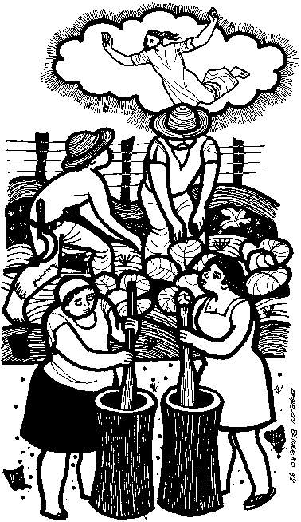
1st Sunday of Advent – Year A
1st Reading: Isaiah 2:1-5
  “The Lord will gather all nations into the eternal peace of the kingdom of God.”
Responsorial: Psalm 122:1-9
  “Let us go rejoicing to the house of the Lord.”
2nd Reading: Romans 13:11-14
  “Our salvation is nearer.”
Alleluia:
  “Show us, Lord, your love; and grant us your salvation.”
Gospel: Matthew 24:37-44
  “Stay awake, that you may be prepared!”

Slide 30
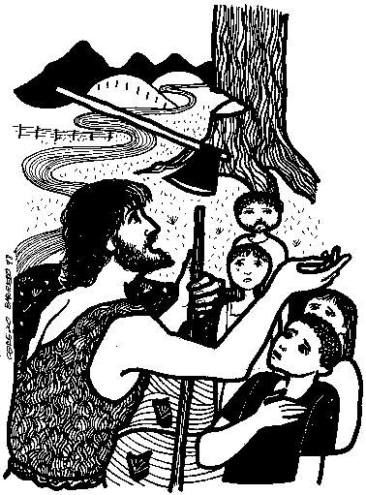
2nd Sunday of Advent – Year A
1st Reading: Isaiah 11:1-10
  “He shall judge the poor with justice.”
Responsorial: Psalm 72:1-17 (partial)
  “Justice shall flourish in his time, and fullness of peace for ever.”
2nd Reading: Romans 15:4-9
  “Christ saves everyone.”
Alleluia:
  “Prepare the way of the Lord, make straight his paths:
  all flesh shall see the salvation of God.”
Gospel: Matthew 3:1-12
  “Repent, for the kingdom of heaven is at hand!”

Slide 31
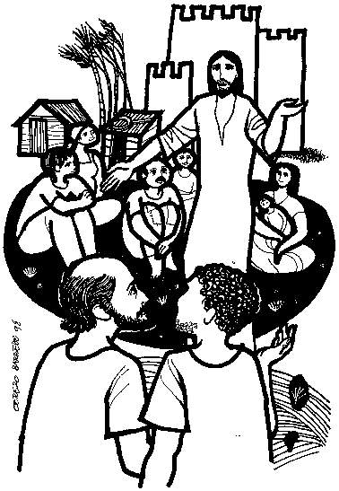
3rd Sunday of Advent – Year A
1st Reading: Isaiah 35:1-6a, 10
  “God himself will come to save us.”
Responsorial: Psalm 146:6-10
  “Lord, come and save us.”
2nd Reading: James 5:7-10
  “Make your hearts firm, because the coming of the Lord is at hand.”
Alleluia:
  “The Spirit of the Lord is upon me,
  because he has anointed me
  to bring glad tidings to the poor.”
Gospel: Matthew 11:2-11
  “Are you the one who is to come
  or should we look for another?”

Slide 32
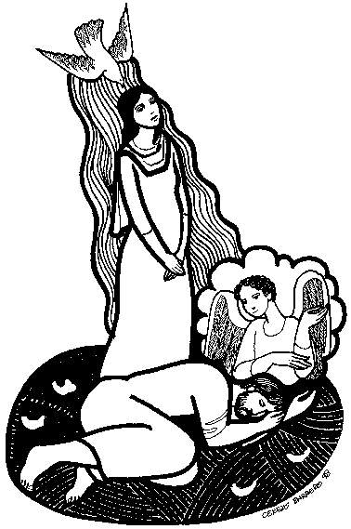
4th Sunday of Advent – Year A
1st Reading: Isaiah 7:10-14
  “Behold, the virgin shall conceive.”
Responsorial: Psalm 24:1-6
  “Let the Lord enter; he is king of glory.”
2nd Reading: Romans 1:1-7
  “Jesus Christ, descended from David, is the Son of God.”
Alleluia:
  “The virgin shall conceive, and bear a son,
  and they shall name him Emmanuel.”
Gospel: Matthew 1:18-24
  “Jesus will be born of Mary,
  the betrothed of Joseph, a son of David.”

Slide 33
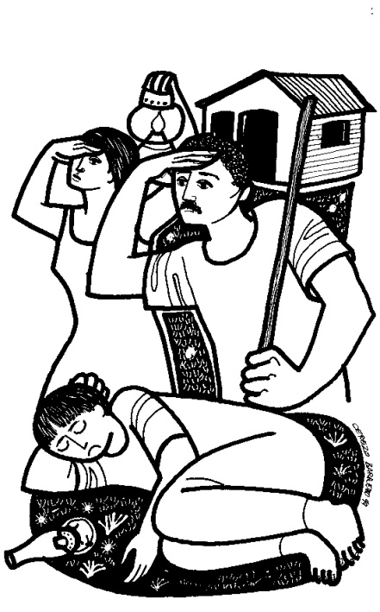
1st Sunday of Advent – Year B
1st Reading: Isa 63:16b-17, 19b; 64:2-7
  “Oh, that you would rend the heavens and come down!”
Responsorial: Psalm 80:2-3, 15-16, 18-19
  “Lord, make us turn to you; let us see your face and we shall be saved.”
2nd Reading: 1 Cor 1:3-9
  “We wait for the revelation of our Lord Jesus Christ.”
Alleluia:
  “Show us, Lord, your love; and grant us your salvation.”
Gospel: Mark 13:33-37
  “Be watchful! You do not know when
  the Lord of the House is coming.”

Slide 34
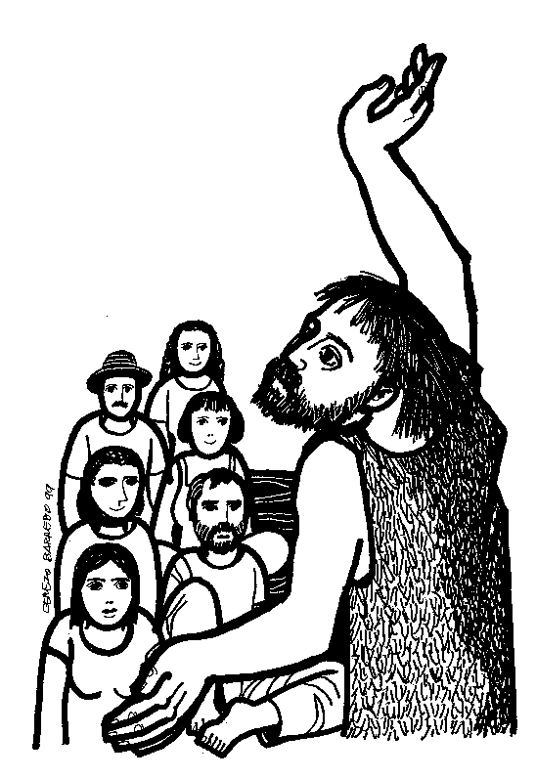
2nd Sunday of Advent – Year B
1st Reading: Isaiah 40:1-5, 9-11
  “Prepare the way of the Lord.”
Responsorial: Psalm 85:9-14
  “Lord, let us see your kindness, and grant us your salvation.”
2nd Reading: 2 Peter 3:8-14
  “We await new heavens and a new earth.”
Alleluia:
  “Prepare the way of the Lord, make straight his paths:
  All flesh shall see the salvation of God.”
Gospel: Mark 1:1-8
  “Make straight the paths of the Lord.”

Slide 35
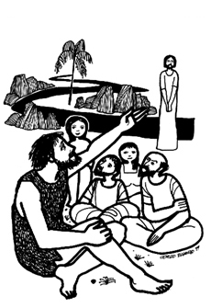
3rd Sunday of Advent – Year B
1st Reading: Isaiah 61:1-2a, 10-11
  “I rejoice heartily in the Lord.”
Responsorial: Luke 1:46-50, 53-54
  “My soul rejoices in my God.”
2nd Reading: 1 Thessalonians 5:16-24
  “May you entirely, spirit, soul and body,
  be preserved blameless for the coming of our Lord Jesus Christ.”
Alleluia:
  “The Spirit of the Lord is upon me,
  because he has anointed me to bring glad tidings to the poor.”
Gospel: JOHN 1:6-8, 19-28
  “There is one among you whom you do not recognize.”

Slide 36
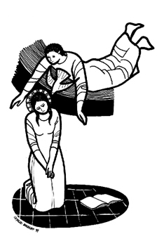
4th Sunday of Advent – Year B
1st Reading: 2 Samuel 7:1-5, 8b-12, 14a, 16
  “The kingdom of David shall endure for ever before the Lord.”
Responsorial: Psalm 89:2-5, 27+29
  “For ever I will sing the goodness of the Lord.”
2nd Reading: Romans 16:25-27
  “The mystery kept secret for long ages has now been manifested.”
Alleluia:
  “Behold, I am the handmaid of the Lord.
  May it be done to me according to your word.”
Gospel: LUKE 1:26-38 –
The Annunciation
  “Behold, you will conceive in your womb and bear a son.”

Slide 37
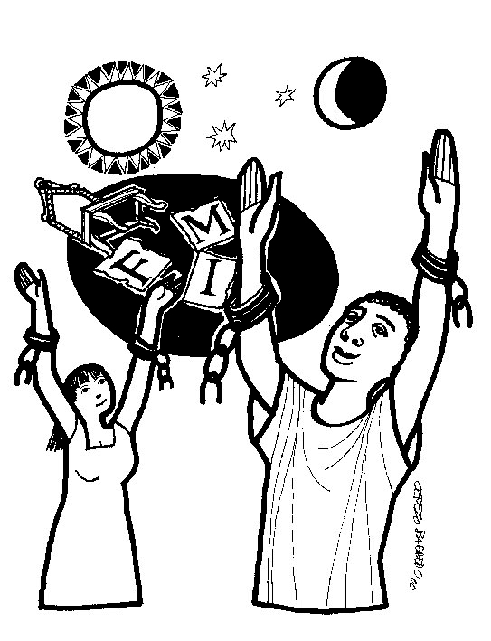
1st Sunday of Advent – Year C
1st Reading: Jeremiah 33:14-16
  “I will raise up for David a just shoot.”
Responsorial: Psalm 25:4-5, 8-9, 10+14
  “To you, O Lord, I lift my soul.”
2nd Reading: 1 Thessalonians 3:12–4:2
  “May the Lord strengthen your hearts at the coming of our Lord Jesus.”
Alleluia:
  “Show us, Lord, your love; and grant us your salvation.”
Gospel: Luke 21:25-28, 34-36
  “Your redemption is at hand.”

Slide 38
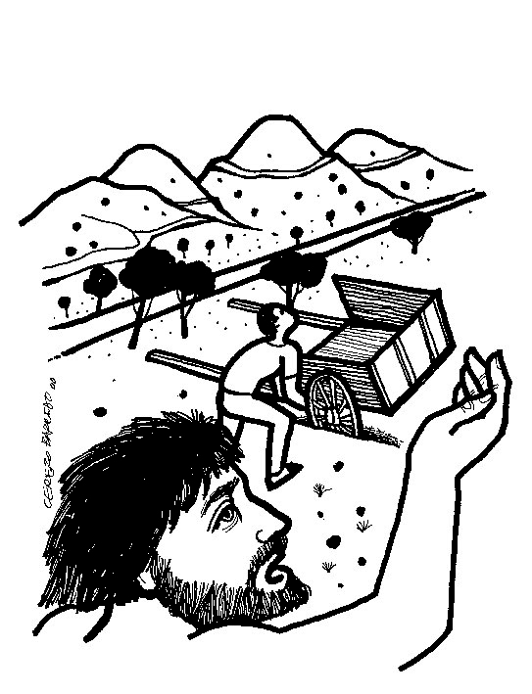
2nd Sunday of Advent – Year C
1st Reading: Baruch 5:1-9
  “Jerusalem, God will show your splendor.”
Responsorial: Psalm 126:1-6
  “The Lord has done great things for us; we are filled with joy.”
2nd Reading: Philippians 1:4-6, 8-11
  “Show yourselves pure and blameless for the day of Christ.”
Alleluia:
  “Prepare the way of the Lord, make straight his paths:
  all flesh shall see the salvation of God.”
Gospel: Luke 3:1-6
  “All flesh shall see the salvation of God.”

Slide 39
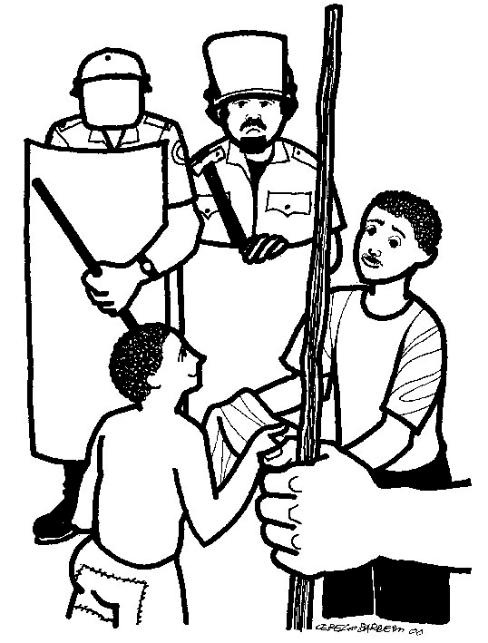
3rd Sunday of Advent – Year C
1st Reading: Zephaniah 3:14-18a
  “The Lord will rejoice over you with gladness.”
Responsorial: Isaiah 12:2-6
  “Cry out with joy and gladness:
  for among you is the great and Holy One of Israel.”
2nd Reading: Philippians 4:4-7
  “The Lord is near.”
Alleluia:
  “The Spirit of the Lord is upon me,
  because he has anointed me
  to bring glad tidings to the poor.”
Gospel: Luke 3:10-18
  “What should we do?”

Slide 40
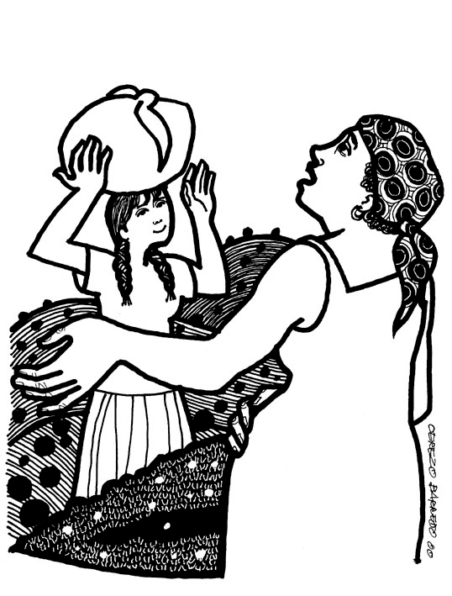
4th Sunday of Advent – Year C
1st Reading: Micah 5:1-4a
  “From you shall come forth the ruler of Israel”
Responsorial: Psalm 80:2-3, 15-16, 18-19
  “Lord, make us turn to you; let us see your face and we shall be saved”
2nd Reading: Hebrews 10:5-10
  “Behold, I come to do your will.”
Alleluia:
  “Behold, I am the handmaid of the Lord.
  May it be done to me according to your word.”
Gospel: Luke 1:39-45
– The Visitation
  “And how does this happen to me,
  that the mother of my Lord should come to me?”

Slide 41
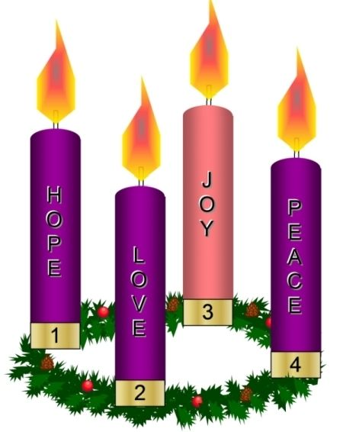
Another Tradition
Some Christians have a theme for each week:
  Hope
  Love
  Joy
  Peace
Catholic Tradition calls the
Third Sunday Gaudete – meaning “Rejoice”

Slide 42

Questions & Break
Questions?
  Please “raise your hands” (electronically)
  Or open your mic
Break
  We will continue in 10 minutes.

Slide 43
Another Approach: Seasonal Overviews
Consider all Advent readings of one type together:
All the First Readings (OT Prophets)
All the Responsorial “Psalms and Canticles”
All the Second Readings (NT Epistles)
All the Gospels (incl. the “Alleluia Verse”)
This corresponds to using my tables vertically.
Further choice: ABC, or 1234?
  A1, A2, A3, A4 / B1, B2, B3, B4 / C1, C2, C3, C4
  A1, B1, C1 / A2, B2, C2 / A3, B3, C3 / A4, B4, C4

Slide 44
1st Readings: Messiah & Messianic Age
Year A
  Isaiah 2:1-5
  Isaiah 11:1-10
  Isaiah 35:1-6a, 10
  Isaiah 7:10-14
Year B
  Isaiah 63:16b-17,19b; 64:2-7
  Isaiah 40:1-5, 9-11
  Isaiah 61:1-2a, 10-11
  2 Samuel 7:1-5,8b-12,14a,16
Year C
  Jeremiah 33:14-16
  Baruch 5:1-9
  Zephaniah 3:14-18a
  Micah 5:1-4a

Slide 45
Responsorial Psalms (& Canticles)
Year A
  Ps 122:1-2, 3-4a, 4b-5, 6-7, 8-9
  Ps 72:1-2, 7-8, 12-13, 17
  Ps 146:6c-7, 8-9a, 9b-10
  Ps 24:1-2, 3-4, 5-6
Year B
  Ps 80:2-3, 15-16, 18-19
  Ps 85:9ab+10, 11-12, 13-14
  Luke 1:46-48, 49-50, 53-54
  Ps 89:2-3, 4-5, 27+29
Year C
  Ps 25:4-5, 8-9, 10+14
  Ps 126:1-2a, 2b-3, 4-5, 6
  Isa 12:2-3, 4bcd, 5-6
  Ps 80:2-3, 15-16, 18-19

Slide 46
2nd Rdgs: Exhortations & Proclamations
Year A
  Romans 13:11-14
  Romans 15:4-9
  James 5:7-10
  Romans 1:1-7
Year B
  1 Corinthians 1:3-9
  2 Peter 3:8-14
  1 Thessalonians 5:16-24
  Romans 16:25-27
Year C
  1 Thessalonians 3:12–4:2
  Philippians 1:4-6, 8-11
  Philippians 4:4-7
  Hebrews 10:5-10

Slide 47
Alleluia Verses
1st Sunday
  Years ABC – Ps 85:8
2nd Sunday
  Years ABC – Luke 3:4+6
3rd Sunday
  Years ABC – Isa 61:1 (cited in Lk 4:18)
4th Sunday
  Year A – Matt 1:23
  Years BC – Luke 1:38
Note: The same “Alleluia Verses” are used each year on the Sundays of Advent
(no difference between years A, B, C), except for the 4th Sunday.

Slide 48
Gospel Readings:
Year A
  Matthew 24:37-44 < Eschatological Sermon
  Matthew 3:1-12 – John the Baptist’s preaching
  Matthew 11:2-11 – more about John the Baptist
  Matthew 1:18-24 – Joseph’s Dreams
Year B
  Mark 13:33-37 < Eschatological Sermon
  Mark 1:1-8 – John the Baptist’s preaching
  John 1:6-8, 19-28 – more about John the Baptist
  Luke 1:26-38 – Annunciation
Year C
  Luke 21:25-28, 34-36 < Eschatological Sermon
  Luke 3:1-6 – John the Baptist’s preaching
  Luke 3:10-18 – more from John the Baptist
  Luke 1:39-45 – Visitation (Mary to Elizabeth)

Slide 49
Year B – FIRST Readings & Psalms
Recall “Rationale” in Lectionary Intro (chap. 5, par. 93)
  “The Old Testament readings are prophecies
  about the Messiah and the Messianic age,
  especially from the Book of Isaiah.”
  What does this mean? Let’s unpack it!
Messiah
  Heb. Mashiah = Gk. Christos = “Anointed One”
  A human leader, chosen by God, for a special role to help people.
  Expectations: Royal, Military, Priestly, Prophetic?
Messianic Age
  What life will be like when the Messiah comes:
  No more war, disease, sin, violence, death…
  Reign of peace, justice, harmony, plenty, life…

Slide 50
1st Advent, Year B – Isa 63:16b-17; 64:2-7
You, LORD, are our father, / our redeemer you are named forever.
Why do you let us wander, O LORD, from your ways,
and harden our hearts so that we fear you not?
Return for the sake of your servants, / the tribes of your heritage.
Oh, that you would rend the heavens and come down,
with the mountains quaking before you,
while you wrought awesome deeds we could not hope for,
such as they had not heard of from of old.
No ear has ever heard, no eye ever seen, any God but you
doing such deeds for those who wait for him.
Would that you might meet us doing right, / that we were mindful of you in our ways!
Behold, you are angry, and we are sinful; / all of us have become like unclean people,
all our good deeds are like polluted rags;
we have all withered like leaves, / and our guilt carries us away like the wind.
There is none who calls upon your name, / who rouses himself to cling to you;
for you have hidden your face from us / and have delivered us up to our guilt.
Yet, O LORD, you are our father; / we are the clay and you the potter:
we are all the work of your hands.

Slide 51
1st Advent, Year B – Psalm 80: 2-3, 15-16, 18-19
R: Lord, make us turn to you; let us see your face and we shall be saved.
O shepherd of Israel, hearken,
from your throne upon the cherubim, shine forth.
Rouse your power, and come to save us. (Resp.)
Once again, O LORD of hosts,
look down from heaven, and see;
take care of this vine, and protect what your right hand has planted
the son of man whom you yourself made strong. (Resp.)
May your help be with the man of your right hand,
with the son of man whom you yourself made strong.
Then we will no more withdraw from you;
give us new life, and we will call upon your name. (Resp.)

Slide 52
2nd Advent, Year B – Isaiah 40:1-5, 9-11
Comfort, give comfort to my people, says your God.
Speak tenderly to Jerusalem, and proclaim to her
that her service is at an end, her guilt is expiated;
indeed, she has received from the hand of the LORD double for all her sins.
A voice cries out:
In the desert prepare the way of the LORD!
Make straight in the wasteland a highway for our God!
Every valley shall be filled in, / every mountain and hill shall be made low;
the rugged land shall be made a plain, / the rough country, a broad valley.
Then the glory of the LORD shall be revealed, / and all people shall see it together;
for the mouth of the LORD has spoken.
Go up on to a high mountain, / Zion, herald of glad tidings;
cry out at the top of your voice, / Jerusalem, herald of good news!
Fear not to cry out and say to the cities of Judah: / Here is your God!
Here comes with power the Lord GOD, who rules by his strong arm;
here is his reward with him, his recompense before him.
Like a shepherd he feeds his flock; in his arms he gathers the lambs,
carrying them in his bosom, and leading the ewes with care.

Slide 53
2nd Advent, Year B – Ps 85: 9-14
R. Lord, let us see your kindness, and grant us your salvation.
I will hear what God proclaims;
the LORD—for he proclaims peace to his people.
Near indeed is his salvation to those who fear him,
glory dwelling in our land. (Ref.)
Kindness and truth shall meet;
justice and peace shall kiss.
Truth shall spring out of the earth,
and justice shall look down from heaven. (Ref.)
The LORD himself will give his benefits;
our land shall yield its increase.
Justice shall walk before him,
and prepare the way of his steps. (Ref.)

Slide 54
3rd Advent, Year B – Isaiah 61:1-2a, 10-11
The spirit of the Lord GOD is upon me,
because the LORD has anointed me;
he has sent me to bring glad tidings to the poor,
to heal the brokenhearted,
to proclaim liberty to the captives
and release to the prisoners,
to announce a year of favor from the LORD
and a day of vindication by our God. (v. 2b)
I rejoice heartily in the LORD,
in my God is the joy of my soul;
for he has clothed me with a robe of salvation
and wrapped me in a mantle of justice,
like a bridegroom adorned with a diadem,
like a bride bedecked with her jewels.
As the earth brings forth its plants,
and a garden makes its growth spring up,
so will the Lord GOD make justice and praise
spring up before all the nations.

Slide 55
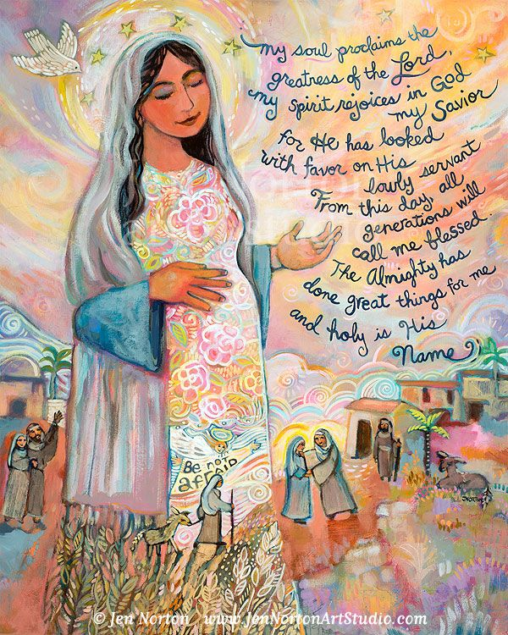
3rd Advent, Year B – Luke 1:46-48, 49-50, 53-54
R. My soul rejoices in my God.
My soul proclaims the greatness of the Lord;
my spirit rejoices in God my Savior,
for he has looked upon his lowly servant.
From this day all generations will call me blessed:
(Ref.)
the Almighty has done great things for me,
and holy is his Name.
He has mercy on those who fear him
in every generation.
(Ref.)
He has filled the hungry with good things,
and the rich he has sent away empty.
He has come to the help of his servant Israel
for he has remembered his promise of mercy,
(Ref.)

Slide 56
4th Advent, Year B – 2 Samuel 7:1-5, 8b-12, 14a, 16
When King David was settled in his palace, and the LORD had given him rest
from his enemies on every side, he said to Nathan the prophet,
“Here I am living in a house of cedar, while the ark of God dwells in a tent!”
Nathan answered the king, “Go, do whatever you have in mind, for the LORD is with you.”
But that night the LORD spoke to Nathan and said: “Go, tell my servant David,
‘Thus says the LORD: Should you build me a house to dwell in?’
“It was I who took you from the pasture and from the care of the flock
to be commander of my people Israel.
I have been with you wherever you went, and I have destroyed all your enemies before you.
And I will make you famous like the great ones of the earth. I will fix a place for my people Israel;
I will plant them so that they may dwell in their place without further disturbance.
Neither shall the wicked continue to afflict them as they did of old,
since the time I first appointed judges over my people Israel.
I will give you rest from all your enemies.
The LORD also reveals to you that he will establish a house for you.
And when your time comes and you rest with your ancestors,
I will raise up your heir after you, sprung from your loins, and I will make his kingdom firm.
I will be a father to him, and he shall be a son to me.
Your house and your kingdom shall endure forever before me;
your throne shall stand firm forever.”

Slide 57
4th Advent, Year B – Psalm 89: 2-3, 4-5, 27+29
R. For ever I will sing the goodness of the Lord.
The promises of the LORD I will sing forever;
in all generations my mouth shall proclaim your faithfulness.
For you have said, “My kindness is established forever”;
in heaven you have confirmed your faithfulness. (Ref.)
“I have made a covenant with my chosen one,
I have sworn to David my servant:
Forever will I confirm your posterity
and establish your throne for all generations.” (Ref.)
“He shall say of me, ‘You are my father,
my God, the Rock, my savior.’
Forever I will maintain my kindness toward him,
and my covenant with him stands firm.” (Ref.)

Slide 58
Year B – SECOND Readings
Recall “Rationale” in Lectionary Intro (chap. 5, par. 93):
  “The readings from an Apostle contain exhortations and proclamations, in keeping with the different themes of Advent.”
  Let’s unpack this!
What are “exhortations”?
  ACTION-oriented: commands, orders
  “Do this! Do that!” or “Don’t do this! Don’t do that!”
What are “proclamations”?
  KNOWLEDGE-oriented: news, information, content
What are “the different themes of Advent”?
  Consider this as we read the following texts.

Slide 59
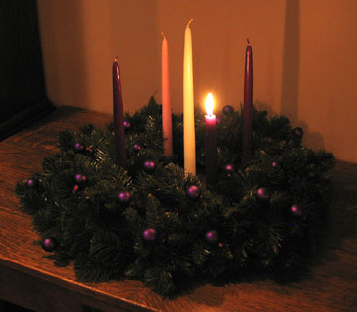
1st Advent, Year B – 1 Cor 1:3-9
Brothers and sisters:
Grace to you and peace from God our Father and the Lord Jesus Christ.
I give thanks to my God always on your account
for the grace of God bestowed on you in Christ Jesus,
that in him you were enriched in every way,
with all discourse and all knowledge,
as the testimony to Christ was confirmed among you,
so that you are not lacking in any spiritual gift
as you wait for the revelation of our Lord Jesus Christ.
He will keep you firm to the end,
irreproachable on the day of our Lord Jesus Christ.
God is faithful, and by him you were called to fellowship with his Son,
Jesus Christ our Lord.
[Greeting & Thanksgiving at start
of Paul’s First Letter to Corinthians.]

Slide 60
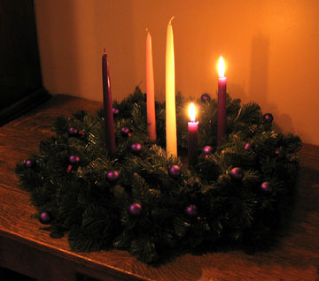
2nd Advent, Year B – 2 Peter 3:8-14
Do not ignore this one fact, beloved,
that with the Lord one day is like a thousand years
and a thousand years like one day.
The Lord does not delay his promise, as some regard “delay,”
but he is patient with you,
not wishing that any should perish
but that all should come to repentance.
But the day of the Lord will come like a thief,
and then the heavens will pass away with a mighty roar
and the elements will be dissolved by fire,
and the earth and everything done on it will be found out.
Since everything is to be dissolved in this way,
what sort of persons ought you to be,
conducting yourselves in holiness and devotion,
waiting for and hastening the coming of the day of God,
because of which the heavens will be dissolved in flames
and the elements melted by fire.
But according to his promise
we await new heavens and a new earth
in which righteousness dwells.
Therefore, beloved, since you await these things,
be eager to be found without spot or blemish before him, at peace.

Slide 61
Conclusion, not read: 2 Peter 3:15-18
¹⁵ And consider the patience of our Lord as salvation, as our beloved brother Paul, according to the wisdom given to him, also wrote to you,
¹⁶ speaking of these things as he does in all his letters. In them there are some things hard to understand that the ignorant and unstable distort to their own destruction, just as they do the other scriptures.
¹⁷ Therefore, beloved, since you are forewarned, be on your guard not to be led into the error of the unprincipled and to fall from your own stability.
¹⁸ But grow in grace and in the knowledge of our Lord and savior Jesus Christ. To him be glory now and to the day of eternity. [Amen.]

Slide 62
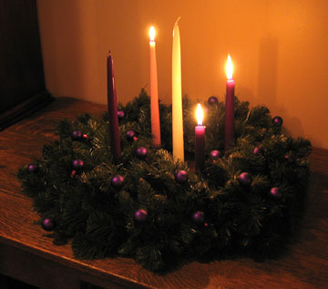
3rd Advent, Year B – 1 Thess 5:16-24
Brothers and sisters:
Rejoice always. Pray without ceasing.
In all circumstances give thanks,
for this is the will of God for you in Christ Jesus.
Do not quench the Spirit.
Do not despise prophetic utterances.
Test everything; retain what is good.
Refrain from every kind of evil.
May the God of peace make you perfectly holy
and may you entirely, spirit, soul, and body,
be preserved blameless for the coming of our Lord Jesus Christ.
The one who calls you is faithful,
and he will also accomplish it.

Slide 63
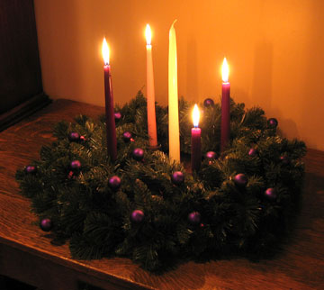
4th Advent, Year B – Romans 16:25-27
Brothers and sisters:
To him who can strengthen you,
according to my gospel and the proclamation of Jesus Christ,
according to the revelation of the mystery kept secret for long ages,
but now manifested through the prophetic writings and,
according to the command of the eternal God,
made known to all nations to bring about the obedience of faith,
to the only wise God, through Jesus Christ
be glory forever and ever. Amen.
[Last three verses of Paul’s Letter:
Paul’s concluding “doxology” prayer.]

Slide 64
Themes of Advent ?
Both PREPARING and WAITING
Both DARKNESS and LIGHT
Both TURMOIL and PEACE
Both LONGING and JOY
Both ABSENCE and PRESENCE
Both ANTICIPATION and PATIENCE
Other?

Slide 65

Alleluia Verses
1st Sunday – Years ABC:
  “Show us Lord, your love;
  and grant us your salvation.” (Ps 85:5)
2nd Sunday – Years ABC:
  “Prepare the way of the Lord, make straight his paths:
  all flesh shall see the salvation of God.” (Lk 3:4, 6)
3rd Sunday – Years ABC:
  “The Spirit of the Lord is upon me, because he has anointed me
  to bring glad tidings to the poor.” (Isa 61:1; cited in Lk 4:18)

Slide 66

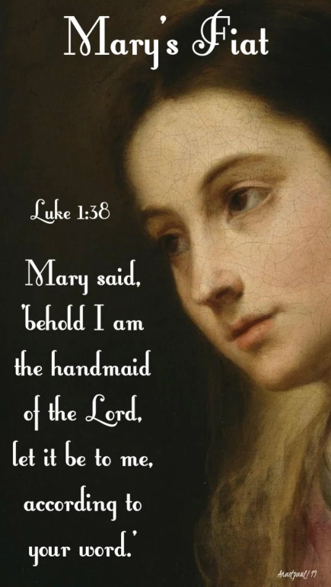
Alleluia Verses
4th Sunday – Year A:
  “The virgin shall conceive, and bear a son,
  and they shall name him Emmanuel.” (Matt 1:23)
4th Sunday – Years BC:
  “Behold, I am the handmaid of the Lord.
  May it be done to me according to your word.”
  (Luke 1:38)

Slide 67
Questions & Break
Questions?
  Please “raise your hands” (electronically)
  Or open your mic
Break
  We will continue in 10 minutes.

Slide 68
Year B – GOSPEL Readings
Recall “Rationale” in Lectionary Intro (chap. 5, par. 93):
  “Each Gospel reading has a distinctive theme: the Lord's coming at the end of time (1st Sunday of Advent), John the Baptist (2nd and 3rd Sunday), and the events that prepared immediately for the Lord's birth (4th Sunday).
  Lord’s Coming at the end of time
  John the Baptist – esp. preaching repentance
  John the Baptist – esp. preaching about “the coming one”
  Before Jesus’ Birth: Matt 1:1-25 & Luke 1:1-79
Year B Gospels:
  Mark 13:33-37
  Mark 1:1-8
  JOHN 1:6-8, 19-28 - why not Mark?
  LUKE 1:39-45 - why not Mark?

Slide 69
1st Sun. Advent, B –
Mark 13:33-37
Jesus said to his disciples: “Be watchful! Be alert!
You do not know when the time will come.
It is like a man traveling abroad.
He leaves home and places his servants in charge,
each with his own work,
and orders the gatekeeper to be on the watch.
Watch, therefore;
you do not know when the Lord
of the house is coming,
whether in the evening, or at midnight,
or at cockcrow, or in the morning.
May he not come suddenly and find you sleeping.
What I say to you, I say to all: ‘Watch!’ ”

Slide 70
Mark 13:1-37 (FJ’s Website)
Double Introduction (13:1-4):
  A) Jesus and a disciple dialogue about the present grandeur and the future destruction of the Temple (13:1-2)
  B) Jesus' closest disciples ask him privately: When? And what will be the signs of the end? (13:3-4)
Jesus' Warnings about Trials and Tribulations on Earth (13:5-23):
  Take heed: let no one lead you astray (13:5-6)
    Wars, earthquakes and famines will come, but the end is not yet (13:7-8)
  Take heed: you will be arrested and put on trial, so you can bear testimony (13:9-11)
    You will be hated and put to death, even by family members; but whoever endures will be saved (13:12-13)
  Let the reader understand: When you see the desolating sacrilege, everyone must flee (13:14-18)
    Tribulations will be greater than ever before, but God has shortened those days for the sake of the elect (13:19-20)
  Take heed: Don't be led astray by false messiahs and false prophets; Jesus has forewarned us (13:21-23)
Jesus' Teachings about the Coming of the Son of Man (13:24-31):
  After the foregoing tribulations, there will be signs in the heavens (13:24-25)
    The Son of Man will come with great power, to gather the elect (13:26-27)
  Learn a lesson from the fig tree, so you know when the Son of Man is near (13:28-29)
    This generation will not pass until all has taken place (13:30-31)
Double Conclusion (13:32-37):
  B') Jesus' answer to the disciples' question, When?: "Amen, this generation won't pass away; but no one knows the day nor hour" (13:32-33)
  A') Jesus' final call for all: Take heed; watch, since you do not know when; illustrated by the Parable of the Doorkeeper; "stay awake!" (13:34-37)

Slide 71
Eschatological Sermon in Mark 13
¹ As he was making his way out of the temple area one of his disciples said to him,
“Look, teacher, what stones and what buildings!”
² Jesus said to him, “Do you see these great buildings? There will not be one stone left upon another that will not be thrown down.”
³ As he was sitting on the Mount of Olives opposite the temple area, Peter, James, John, and Andrew asked him privately, ⁴ “Tell us, WHEN will this happen, and what sign will there be when all these things are about to come to an end?” … … …

Slide 72
1st Adv. B – Mark 13:24-37 (RCL)
²⁴ “But in those days after that tribulation
the sun will be darkened, and the moon will not give its light,
²⁵ and the stars will be falling from the sky,
and the powers in the heavens will be shaken. (cf. Isa 13:10; Ezek 32:7; Joel 2:10)
²⁶ And then they will see ‘the Son of Man coming in the clouds’ with great power and glory, ²⁷ and then he will send out the angels and gather [his] elect from the four winds, from the end of the earth to the end of the sky. (cf. Dan 7:13-14)
²⁸ “Learn a lesson from the fig tree. When its branch becomes tender and sprouts leaves, you know that summer is near. ²⁹ In the same way, when you see these things happening, know that he is near, at the gates. ³⁰ Amen, I say to you, this generation will not pass away until all these things have taken place.
³¹ Heaven and earth will pass away, but my words will not pass away.
³² “But of that day or hour, no one knows, neither the angels in heaven, nor the Son, but only the Father.

Slide 73
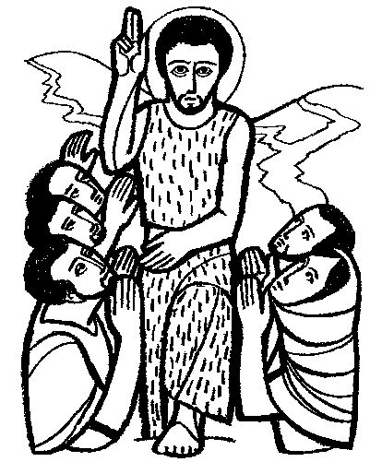
2nd Advent, Year B –
Mark 1:1-8
The beginning of the gospel of Jesus Christ the Son of God.
As it is written in Isaiah the prophet:
Behold, I am sending my messenger ahead of you;
he will prepare your way.
A voice of one crying out in the desert:
“Prepare the way of the Lord, make straight his paths.”
John the Baptist appeared in the desert,
proclaiming a baptism of repentance for the forgiveness of sins.
People of the whole Judean countryside
and all the inhabitants of Jerusalem were going out to him
and were being baptized by him in the Jordan River
as they acknowledged their sins.
John was clothed in camel’s hair, with a leather belt around his waist.
He fed on locusts and wild honey.
And this is what he proclaimed:
“One mightier than I is coming after me.
I am not worthy to stoop and loosen the thongs of his sandals.
I have baptized you with water; he will baptize you with [the] Holy Spirit.”

Slide 74
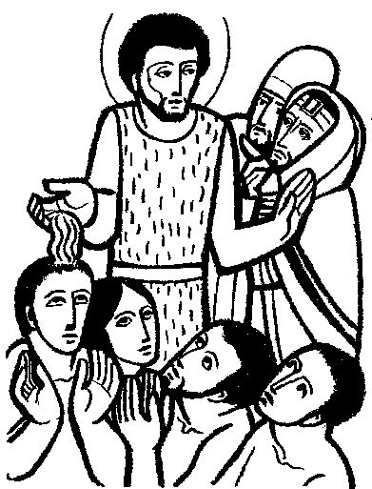
3rd Advent, Year B –
John 1:6-8, 19-28
A man named John was sent from God.
He came for testimony, to testify to the light,
so that all might believe through him.
He was not the light, but came to testify to the light.
And this is the testimony of John.
When the Jews from Jerusalem sent priests and Levites to him, to ask him, “Who are you?”
He admitted and did not deny it, but admitted, “I am not the Christ.”
So they asked him, “What are you then? Are you Elijah?” - And he said, “I am not.”
“Are you the Prophet?” - He answered, “No.”
So they said to him, “Who are you, so we can give an answer to those who sent us?
What do you have to say for yourself?”
He said: “I am the voice of one crying out in the desert,
‘make straight the way of the Lord,’” as Isaiah the prophet said.”
Some Pharisees were also sent. They asked him,
“Why then do you baptize if you are not the Christ or Elijah or the Prophet?”
John answered them, “I baptize with water;
but there is one among you whom you do not recognize,
the one who is coming after me, whose sandal strap I am not worthy to untie.”
This happened in Bethany across the Jordan, where John was baptizing.

Slide 75
2nd & 3rd Sundays: Preaching of John
John WHO?
  …the Baptist? …the baptizer?
  …the fore-runner, precursor?
  …the prophet / preacher of repentance?
  …the witness / testifying about Jesus?
Differing Emphases in the Gospels:
  MARK:
    John fulfills the prophecies of Isaiah
    Preaches repentance
    Baptizes for forgiveness of sins
  JOHN (E. - Fourth Gospel):
    John (B.) mainly points to Jesus, witnesses to Jesus
    Little mention of repentance, nor of baptizing!

Slide 76
Mark 1:1-8 – A Closer Look
The beginning of the gospel of Jesus Christ the Son of God.
As it is written in Isaiah the prophet:
Behold, I am sending my messenger ahead of you;
he will prepare your way.
A voice of one crying out in the desert:
“Prepare the way of the Lord, make straight his paths.”
John the Baptist appeared in the desert,
proclaiming a baptism of repentance for the forgiveness of sins.
Quotation actually from more than Isaiah:
Malachi 3:1 – “Now I am sending my messenger-- he will prepare the way before me; And the lord whom you seek will come suddenly to his temple; The messenger of the covenant whom you desire-- see, he is coming! says the LORD of hosts.”
Isaiah 40:3 – “A voice proclaims: In the wilderness prepare the way of the LORD! Make straight in the wasteland a highway for our God!”
Exodus 23:20 – “See, I am sending an angel before you, to guard you on the way
and bring you to the place I have prepared.”

Slide 77
Mark 1:1-8 – A Closer Look
People of the whole Judean countryside
and all the inhabitants of Jerusalem were going out to him
and were being baptized by him in the Jordan River
as they acknowledged their sins.
[Emphasizes the effects of John’s preaching.]
John was clothed in camel’s hair, with a leather belt around his waist.
He fed on locusts and wild honey.
[Clothed like the prophet Elijah; see 2 Kings 1:8.]
And this is what he proclaimed:
“One mightier than I is coming after me.
I am not worthy to stoop and loosen the thongs of his sandals.
I have baptized you with water; he will baptize you with [the] Holy Spirit.”
[We know the “one mightier” is Jesus. Why doesn’t John say so?]

Slide 78
John 1:6-8, 19-28 – A Closer Look
A man named John was sent from God.
He came for testimony, to testify to the light,
so that all might believe through him.
He was not the light, but came to testify to the light.
From the Prologue, which focuses on Jesus, the logos/word and true light.
And this is the testimony of John.
When the Jews from Jerusalem sent priests and Levites to him, to ask him, “Who are you?”
He admitted and did not deny it, but admitted, “I am not the Christ.”
So they asked him, “What are you then? Are you Elijah?” - And he said, “I am not.”
“Are you the Prophet?” - He answered, “No.”
John says he is NOT the Christ/Messiah, NOT Elijah, NOT “the Prophet.” – WHY Not?
(contrast Synoptics: John IS the Prophet/Elijah, expected to come before the Messiah)
And if not, then WHO is he?

Slide 79
John 1:6-8, 19-28 – A Closer Look
So they said to him, “Who are you, so we can give an answer to those who sent us?
What do you have to say for yourself?”
He said: “I am the voice of one crying out in the desert,
‘make straight the way of the Lord,’” as Isaiah the prophet said.”
Some Pharisees were also sent. They asked him,
“Why then do you baptize if you are not the Christ or Elijah or the Prophet?”
John answered them, “I baptize with water;
but there is one among you whom you do not recognize,
the one who is coming after me, whose sandal strap I am not worthy to untie.”
This happened in Bethany across the Jordan, where John was baptizing.

Slide 80
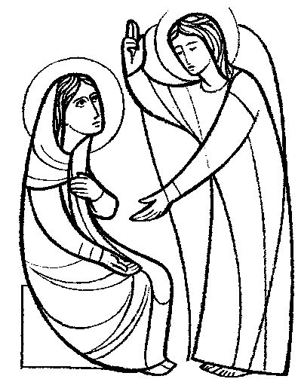
4th Advent, Year B –
Luke 1:26-38 (“The Annunciation”)
The angel Gabriel was sent from God to a town of Galilee called Nazareth,
to a virgin betrothed to a man named Joseph, of the house of David,
and the virgin’s name was Mary.
And coming to her, he said, “Hail, full of grace! The Lord is with you.”
But she was greatly troubled at what was said
and pondered what sort of greeting this might be.
Then the angel said to her, “Do not be afraid, Mary, for you have found favor with God.
“Behold, you will conceive in your womb and bear a son, and you shall name him Jesus.
He will be great and will be called Son of the Most High,
and the Lord God will give him the throne of David his father,
and he will rule over the house of Jacob forever,
and of his kingdom there will be no end.”
But Mary said to the angel, “How can this be, since I have no relations with a man?”
And the angel said to her in reply,
“The Holy Spirit will come upon you, and the power of the Most High will overshadow you.
Therefore the child to be born will be called holy, the Son of God.
And behold, Elizabeth, your relative, has also conceived a son in her old age,
and this is the sixth month for her who was called barren; for nothing will be impossible for God.”
Mary said, “Behold, I am the handmaid of the Lord.
May it be done to me according to your word.”
Then the angel departed from her.

Slide 81
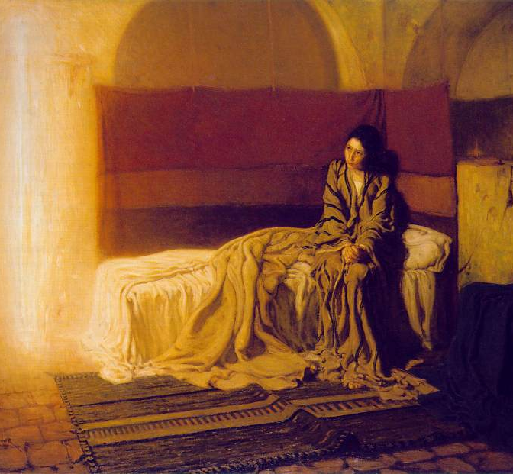
The Annunciation
Henry
Ossawa
Tanner,
1898
Philadelphia Museum

Slide 82
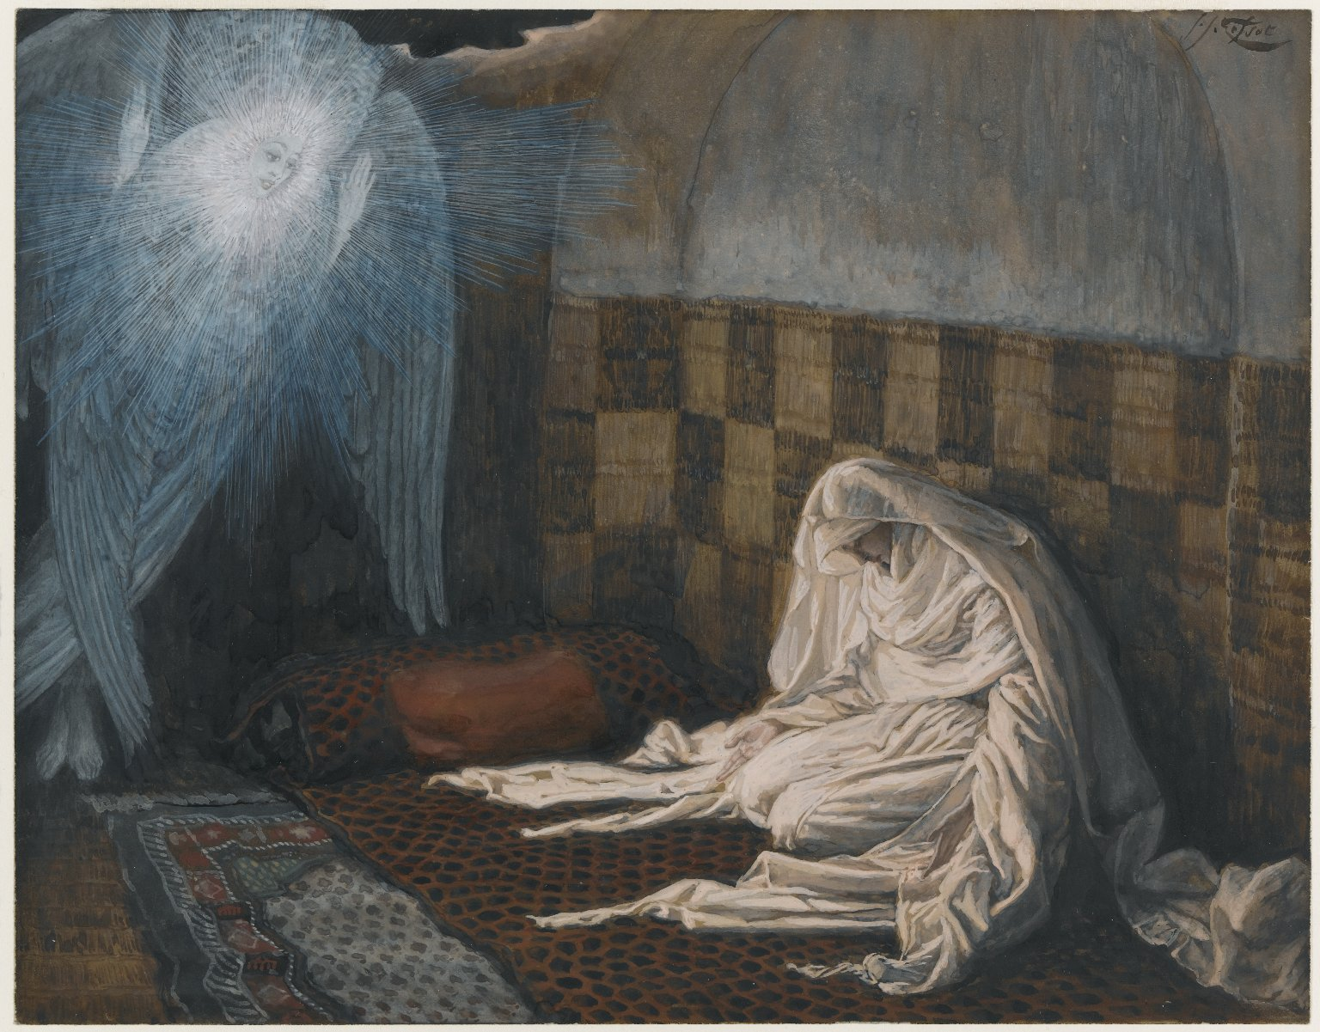
The Annunciation
James
Tissot,
1886-94
Brooklyn
Museum

Slide 83
1st Sunday of Advent – Presider’s Prayers
Collect:
Grant your faithful, we pray, almighty God,
the resolve to run forth to meet your Christ
with righteous deeds at his coming,
so that, gathered at his right hand,
they may be worthy to possess the heavenly Kingdom…
Offertory:
Accept, we pray, O Lord, these offerings we make,
gathered from among your gifts to us,
and may what you grant us to celebrate devoutly here below
gain for us the prize of eternal redemption. Through Christ our Lord.
After Communion:
May these mysteries, O Lord,
in which we have participated, profit us, we pray,
for even now, as we walk amid passing things,
you teach us by them to love the things of heaven
and hold fast to what endures. Through Christ our Lord.

Slide 84
2nd Sunday of Advent – Presider’s Prayers
Collect:
Almighty and merciful God,
may no earthly undertaking hinder those
who set out in haste to meet your Son,
but may our learning of heavenly wisdom
gain us admittance to his company…
Offertory:
Be pleased, O Lord, with our humble prayers and offerings,
and, since we have no merits to plead our cause,
come, we pray, to our rescue with the protection of your mercy.
Through Christ our Lord.
After Communion:
Replenished by the food of spiritual nourishment,
we humbly beseech you, O Lord,
that, through our partaking in this mystery,
you may teach us to judge wisely the things of earth
and hold firm to the things of heaven. Through Christ our Lord.

Slide 85
3rd Sunday of Advent – Presider’s Prayers
Collect:
O God, who see how your people
faithfully await the feast of the Lord’s Nativity,
enable us, we pray,
to attain the joys of so great a salvation
and to celebrate them always
with solemn worship and glad rejoicing….
Offertory:
May the sacrifice of our worship, Lord, we pray,
be offered to you unceasingly,
to complete what was begun in sacred mystery
and powerfully accomplish for us your saving work.
Through Christ our Lord.
After Communion:
We implore your mercy, Lord,
that this divine sustenance may cleanse us of our faults
and prepare us for the coming feasts. Through Christ our Lord.

Slide 86
4th Sunday of Advent – Presider’s Prayers
Collect:
Pour forth, we beseech you, O Lord, your grace into our hearts,
that we, to whom the Incarnation of Christ your Son
was made known by the message of an Angel,
may by his Passion and Cross
be brought to the glory of his Resurrection…
Offertory:
May the Holy Spirit, O Lord,
sanctify these gifts laid upon your altar,
just as he filled with his power
the womb of the Blessed Virgin Mary. Through Christ our Lord.
After Communion:
Having received this pledge of eternal redemption, we pray, almighty God,
that, as the feast day of our salvation draws ever nearer,
so we may press forward all the more eagerly
to the worthy celebration of the mystery of your Son’s Nativity.
Who lives and reigns for ever and ever.

Slide 87
Weekdays of Advent
Please see the separate
Powerpoint Presentation

Slide 88
Wrap-Up
Questions? Comments?
  Please “RAISE YOUR HANDS” (electronically)
  OR Type a Comment/Question in the “Chat”
Overview of Advent, esp. Year B:
  http://catholic-resources.org/Lectionary/1998USL-Advent.htm
More on Biblical Texts:
  http://catholic-resources.org/Bible/
Next Session: Scriptures for the Christmas Season:
  Sat., Dec. 19, 2020

Slide 89
IMAGE CREDITS
https://catholic-resources.org/Art/
http://www.4catholiceducators.com/
http://www.mscperu.org/grafic/graficoslit/adviento_navidad/indexgraf_advnav.htm
http://www.servicioskoinonia.org/cerezo/indexBgraf.html
https://catholicartworks.com/Product_Pages/look_learn/llco076.htm
https://www.usccb.org/prayer-and-worship/liturgical-year-and-calendar/advent
https://www.google.com/search?

Slide 90
“Living Word” Webinar Series
Zoom Webinars on the Catholic Lectionary for Mass
  Saturdays, 9:00 a.m. – 12:30 p.m. (Pacific Time)
  Open to the Public (feel free to invite others)
  FREE (but donations appreciated)
Monthly, from Nov. 2020 to April 2021
  Nov. 21, 2020 – Readings of Advent
  Dec. 19, 2020 – Readings of the Christmas Season
  Jan. 9, 2021 – Gospel of Mark (Liturgical Year B)
  Feb. 13, 2021 – Readings of Lent
  March 27, 2021 – Readings of Holy Week & Triduum
  April 10, 2021 – Readings of the Easter Season

Slide 91
DONATIONS
If you’d like to support MSMU’s Ecclesia program and Living Word Catholic Biblical Ministries, please make a tax-deductible donation, so that we can offer more webinars and other programs to anyone, regardless of their financial circumstances.
  We cannot accept online donations yet, but hope to enable this feature soon.
Please make your check payable to "LMU Jesuit Community."
  Please write "Ecclesia Webinars" or "Living Word Series" in the memo field.
Then mail your check to:
  Fr. Felix Just, SJ
  LMU Jesuit Community
  PO Box 45041
  Los Angeles, CA 90045

Slide 92
Upcoming Pilgrimages
In the Footsteps of Jesus:
Pilgrimage to the Holy Land (Israel & Palestine)
  Dec. 26, 2021 to Jan. 9, 2022
The Oberammergau Passion Play:
Pilgrimage to Austria and Germany
  May 14-22, 2022
May 2023
  In the Footsteps of St. Paul: Pilgrimage to Turkey
May 2024
  In the Footsteps of Jesus: Pilgrimage to the Holy Land
May 2025
  In the Footsteps of St. Paul: Pilgrimage to Greece

Slide 93
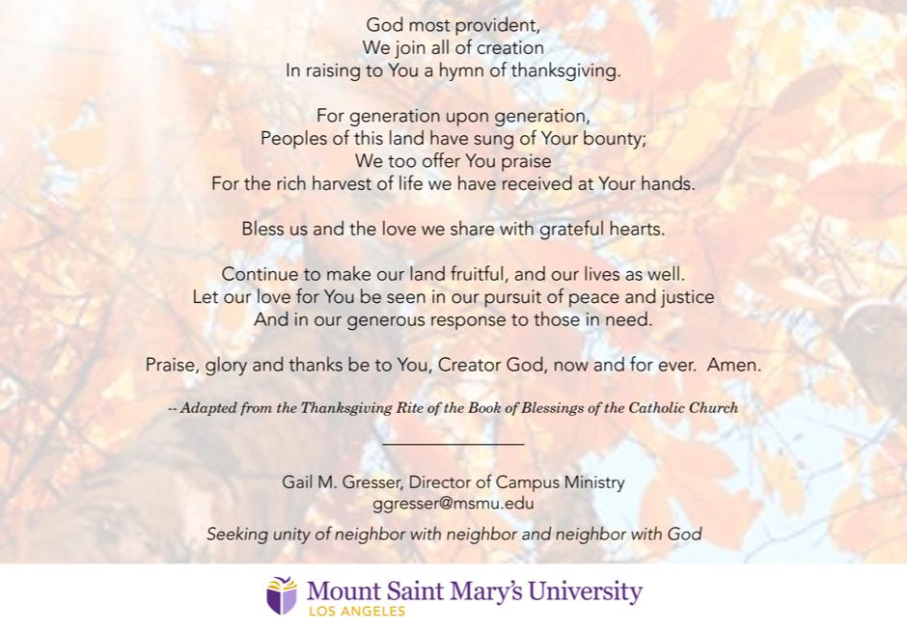
A Thanksgiving Prayer

Slide 94
God Bless You!
Thanks for participating today!
  More Questions or Comments? – Feel Free to Stay Online

