Slide 1
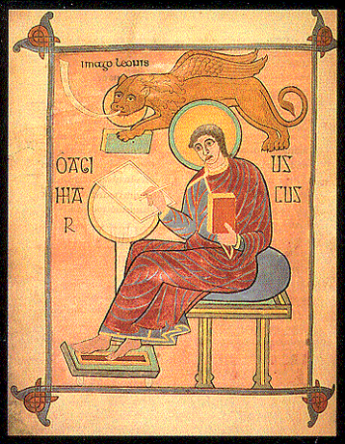
Mount Saint Mary’s University “Ecclesia” Program Presents:
Living Word: Scriptures of the 2021 Liturgical Year
Lectionary Readings from the
Gospel according to MARK
Fr. Felix Just, S.J., Ph.D.
Living Word Catholic Biblical Ministries
http://catholic-resources.org

Slide 2
Welcome to “Living Word” !
Webinar Series co-sponsored by:
  “Ecclesia” Program of Mount Saint Mary’s University, LA
    Gail Gresser, Director of Campus Ministry
    “Serving those who serve the Church”
  “Living Word Catholic Biblical Ministries,” Los Angeles
    New name for Fr. Felix’s adult faith-formation programs
Welcome to All, especially :
  Prior “Living Word” and “Ecclesia” program participants
  Especially: NEW folks, here for the first time!

Slide 3
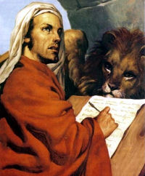
Opening Prayers: Feast of St. Mark
Catholic:
O God, who raised up Saint Mark, your Evangelist,
and endowed him with the grace to preach the Gospel,
grant, we pray, that we may so profit from his teaching
as to follow faithfully in the footsteps of Christ.
Who lives and reigns with you in the unity of the
Holy Spirit, one God, for ever and ever. Amen.
Anglican:
Almighty God, by the hand of Mark the evangelist you have given to your Church the Gospel of Jesus Christ the Son of God: We thank you for this witness, and pray that we may be firmly grounded in its truth; through Jesus Christ our Lord, who lives and reigns with you and the Holy Spirit, one God, for ever and ever. Amen.

Slide 4
“Living Word” Webinar Series
Zoom Webinars on the Lectionary for Mass
  Saturdays, 9:00 a.m. – 12:30 p.m. (Pacific Time)
  Open to the Public (feel free to invite others)
  FREE (but donations appreciated)
Monthly, from Nov. 2020 to April 2021
  Nov. 21, 2020 – Readings of Advent
  Dec. 19, 2020 – Readings of the Christmas Season
  Jan. 9, 2021 – Gospel of MARK (Liturgical Year B)
  Feb. 13, 2021 – Readings of Lent
  March 27, 2021 – Readings of Holy Week & Triduum
  April 17, 2021 – Readings of the Easter Season

Slide 5
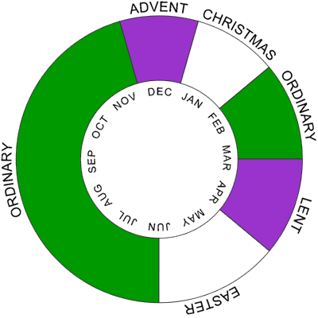
The Liturgical Year

Slide 6
Lectionary Readings
Basic Questions of This Year’s Webinar Series:
WHICH biblical texts are read at Catholic Masses?
  Seasons: Advent; Christmas; Lent; Easter; Ordinary Time
  Sundays/Feasts: 1st Reading, Psalm, 2nd Reading, Alleluia, Gospel
  Weekdays: 1st Reading, Psalm, Alleluia, Gospel
WHY were the assigned readings chosen?
  Brief “Rationale” in Lectionary’s “Introduction” (in printed editions)
    Chap. 2 in 1969 edition; or Chap. 5 in 1981 edition.
    Season by season; first Sundays/Feasts, then Weekdays
For charts, handouts, more info, see my website:
http://catholic-resources.org/Lectionary/
  Also has the full text of the 1981 “Introduction”

Slide 7
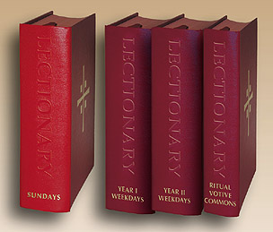
Liturgical Season of ORDINARY TIME
Outline of Today’s Webinar:
  Use of Mark in the Lectionary for Mass;
  Genre: What Are the “Gospels”?
  Historical Issues of Mark’s Composition
  Outline and Structure of Mark’s Gospel;
  Literary Features and Theological Emphases of Mark
  Contents of Mark:
  Closer look at selected sections
  (your requests?)
  Ten minute breaks after each part

Slide 8

DONATIONS
If you’d like to support MSMU’s Ecclesia program and Living Word Catholic Biblical Ministries, please make a tax-deductible donation, so that we can offer more webinars and other programs to anyone, regardless of their financial circumstances.
  We cannot accept online donations yet, but hope to enable this feature soon.
Please make your check payable to "LMU Jesuit Community."
Then mail your check to:
  Fr. Felix Just, SJ
  LMU Jesuit Community
  PO Box 45041
  Los Angeles, CA 90045

Slide 9
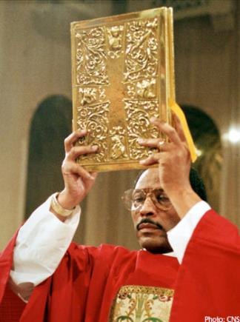
Gospels in the Lectionary for Mass
THREE-Year Cycle for Sundays:
  Year A (2020): mostly Matthew
  Year B (2021): mostly MARK
  Year C (2022): mostly Luke
JOHN interspersed:
  Mostly Lent and Easter
  Some in Advent and Christmas
  Ord. Time: 2nd Sun. ABC & 17th-21st Sun. Yr.B & 34th Sun. Yr.B (Christ the King)
Weekdays (each year)
  Weeks 1-9: Mark; Weeks 10-21: Matthew; Weeks 22-34: Luke
  John: weekdays of Lent & Easter

Slide 10

Mark’s Gospel in the Lectionary
Most of Mark is used
on Sundays, Year B
  See https://catholic-resources.org/Lectionary/Overview-Mark.htm
  See https://catholic-resources.org/Lectionary/1998USL-OrdinaryB.htm
    Covers most of Jesus’ Public Ministry: Mark 1–12
Texts omitted Sundays are mostly used on weekdays.
  See https://catholic-resources.org/Lectionary/2002USL-Weekdays-OT-I.htm
    Very little of Mark is never used at any Mass.

Slide 11
Mark’s Gospel – outside of Ordinary Time
Lect# | Sunday/Feast – Year B | Gospel Passage Prescribed
2B | 1st Sunday of Advent | Mark 13:33-37 – Need for Watchfulness
5B | 2nd Sunday of Advent | Mark 1:1-8 – Preaching of John the Baptist
23B | 1st Sunday of Lent | Mark 1:12-15 – Temptation of Jesus; Beginning of Galilean Ministry
26B | 2nd Sunday of Lent | Mark 9:2-10 – Transfiguration of Jesus
37B | Palm Sunday [before Mass] | Mark 11:1-10 or John 12:12-16 – Jesus’ Entry into Jerusalem
38ABC | Palm Sunday [during Mass] | Mark 14:1—15:47 or 15:1-39 – Markan Passion Narrative
41ABC | Easter Vigil | Mark 16:1-7 ** – Resurrection of Jesus: Empty Tomb Story
58B | Ascension of the Lord | Mark 16:15-20 – Jesus Commissions the Eleven; Ascends to Heaven
168B | Sunday after Trinity Sunday: Body and Blood of Christ | Mark 14:12-16, 22-26 – Preparations for Passover; Last Supper

Slide 12
Only Texts of Mark NOT Used in Lectionary
Mark 1:21a – “When they came to Capernaum” (brief geographical transition)
Mark 9:44, 46 – “where 'their worm does not die, and the fire is not quenched.' ” (later additions; duplicates of v. 48)
Mark 12:28a – “A scribe came forward and heard them...” (brief introduction)
Mark 13:1-23 – Destruction of Temple Foretold, Signs of the End,
Great Tribulation (first 2/3 of the Apocalyptic Discourse)
Mark 16:8 – The women flee from the empty tomb in fear and silence
(was in 1969/1970 Lectionary, but omitted in the current 2nd edition)

Slide 13
Gospel Material ONLY in Mark
1:1 - Introductory Verse
3:20-21 - Jesus' Family Tries to Restrain Him
4:26-29 - The Parable of the Seed Growing of Itself
7:31-37 - Jesus Heals a Deaf Man in the Decapolis
8:22-26 - Jesus Gives Sight to Blind Man of Bethsaida
14:51-52 - Young Man Flees Naked after Jesus' Arrest
[16:14-18] - [The Commissioning of the Eleven]
All of these are included in the Lectionary, mostly on Sundays
  8:22-26 and 16:14 only on weekdays

Slide 14
“Sunday of the Word of God”
Third Sunday of Ord. Time (annual, as of Jan. 2020)
  2nd Sunday: excerpts from JOHN
  3rd: Start of Jesus’ public ministry in Matt/Mark/Luke (ABC)
Instituted by Pope Francis
  Apostolic Letter Aperuit Illis, Sept. 30, 2019
  CDWDS “Note,” Dec. 17, 2020
Celebrate the Word of God
  Procession of Gospel Book / Enthronement on Altar
Highlights Importance of Scripture in Liturgy
  Not just one Sunday, but year-long!
  So why a special Sunday? (cf. Trinity, Body & Blood, etc.)

Slide 15
CDWDS “Note” (12/17/20)
INTRO:
The Sunday of the Word of God… reminds us, pastors and faithful alike, of the importance and value of Sacred Scripture for the Christian life, as well as the relationship between the word of God and the liturgy: “…A day devoted to the Bible should not be seen as a yearly event but rather a year-long event, for we urgently need to grow in our knowledge and love of the Scriptures and of the Risen Lord, who continues to speak his word and to break bread in the community of believers. For this reason, we need to develop a closer relationship with Sacred Scripture…” [2 – Aperuit illis, 8]
This Sunday, therefore, presents an ideal opportunity to reread some of the Church’s documents [3 – Vat2, Dei Verbum; Ben16, Verbum Domini] and especially the Praenotanda of the Ordo Lectionum Missae, which present a synthesis of the theological, ritual and pastoral principles surrounding the word of God proclaimed at Mass, but which is also valid in every other liturgical celebration (Sacraments, Sacramentals, Liturgy of the Hours).
ENDING:
The purpose of this Note is to help reawaken, in the light of the Sunday of the Word of God, an awareness of the importance of Sacred Scripture for our lives as believers, beginning with its resonance in the liturgy which places us in living and permanent dialogue with God. “God’s word, listened to and celebrated, above all in the Eucharist, nourishes and inwardly strengthens Christians, enabling them to offer an authentic witness to the Gospel in daily life”.[30 – Francis, EG 174]

Slide 16
CDWDS “Note”
Importance of the Gospel proclamation: “One of the ritual possibilities suitable for this Sunday could be the entrance procession with the Book of the Gospels or simply placing the Book of the Gospels on the altar.”
Don’t replace or removed Lectionary readings
Singing the Responsorial Psalm
Role of Homily, based on the biblical readings
Importance of silence to allow God’s word to enter the listener.
Preparation of priests, deacons, readers; preface the readings with appropriate/ short introductions.
Pay special attention to the ambo
Books containing the scripture readings: high quality & used properly.
Promote formation meetings to show importance of Scripture in Liturgy.
Deepen the link between Sacred Scripture and the Liturgy of the Hours.
Saint Jerome as example of great love for the word of God.

Slide 17
GOSPELS: Sundays of Ord. Time, Year B
[1st Sun]: Mark 1:7-11 – Baptism of the Lord (this weekend!)
2nd Sun: John 1:35-42
  First 3 disciples: Andrew, anon., Simon Peter
3rd Sunday (Sun. of Word of God): Mark 1:14-20
  Jesus’ initial public preaching, & calling four fishers
4th Sun: Mark 1:21-28
  First exorcism, in synagogue at Capernaum
5th Sun: Mark 1:29-39
  Jesus heals Simon’s Mother-in-law and many others
6th Sun: Mark 1:40-45
  Jesus cleanses a leper

Slide 18
Four Gospels: One Jesus?
Is it the SAME Jesus in all four Gospels?
Best Catholic Answer:
  Not “Yes” or “No” – but “both YES and NO”!
Same historical person: Jesus of Nazareth
Same divine person: Christ, Son of God
  But four very different portraits
  Different theological emphases

Slide 19
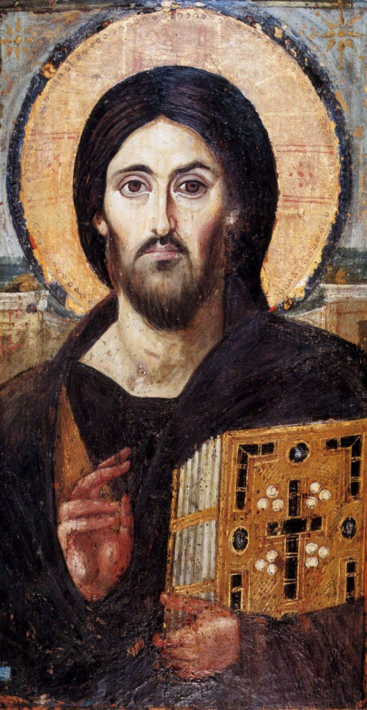
What Is a “Gospel”?
Biography? History?
  Both Yes and No !
Biographical,
but not a modern “biography”
Historical,
but not a contemporary “history”
Euangelion = Proclamation of “Gospel”
or Preaching of “GOOD NEWS”!

Slide 20
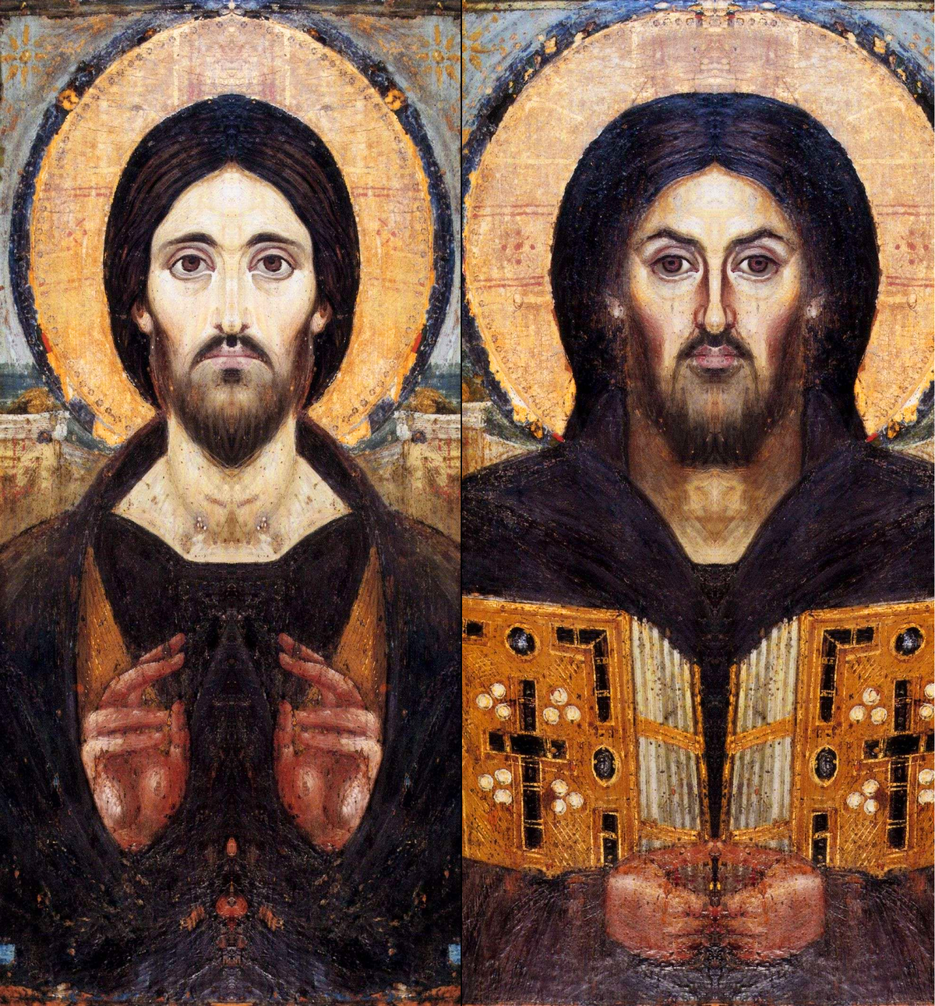

Slide 21

Multiple Stages of Gospel Formation
Based on Vatican II: Dei Verbum
Historical Events
Oral Tradition
Written Texts
Canonization
Most scholars sub-divide step 3:
1) Historical Events 2) Oral Traditions
3a) Written Texts/Sources 3b) Edited Full Gospels
5) Canonical Books (final form of texts)

Slide 22
“Canonization” of the NT
Long Process of Development:
  writing, sharing, collecting, editing, translating,
  debating, interpreting the books/letters now in NT
1st Cent. – individual writings composed
2nd Cent. – writings collected (4 Gospels; Paul’s Letters)
4th Cent. – early canon lists
  some with fewer than books: 2 Peter? Revelation?
  some with more: Didache, Shepherd of Hermas, etc.
  367 – Easter Letter of St. Athanasius – first list of all 27
16th Cent. – Council of Trent
  First "official" listing of all 46 OT & 27 NT books
  In reaction to Protestants (esp. regarding OT Apocrypha)

Slide 23
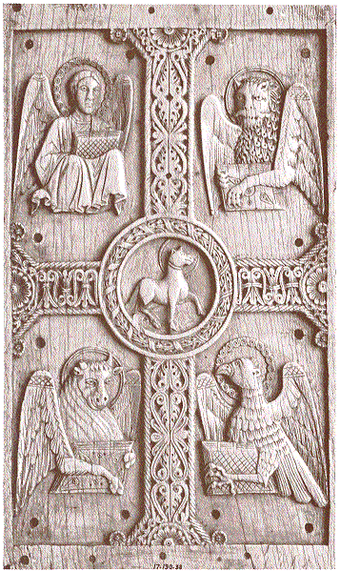
More Gospels?
Four "Canonical Gospels"
  Matthew, Mark, Luke, John
  Dates: 1st century (60's – 90's)
  Order? Mark probably first,
  then Matthew, Luke; John last
"Non-canonical Gospels"
  Many other short books
  mostly from 2nd to 4th cent.
  about Jesus' life and/or his teachings
  not all explicitly entitled “Gospel”

Slide 24
Who Wrote the Gospels?
Four Evangelists? → Human?
God? Holy Spirit? → Divine?
Catholic Answer:
BOTH / AND!
Doctrine of “Inspiration”
Historicity of the Gospels (PBC)

Slide 25
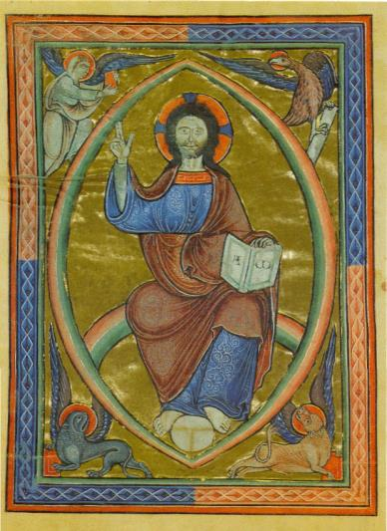
Who Wrote the Gospels?
Greek Titles: Euangelion KATA…
  Not “Gospel OF…”
  but “Gospel ACCORDING TO Mark” (or Matt / Luke / John)
Four Evangelists’ Symbols:
  Matthew: Angel
  Mark: Lion
  Luke: Ox
  John: Eagle

Slide 26
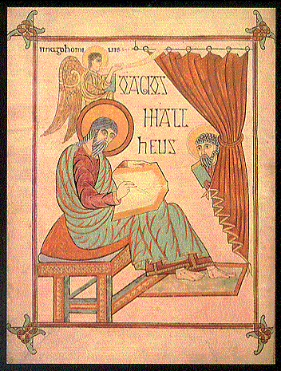
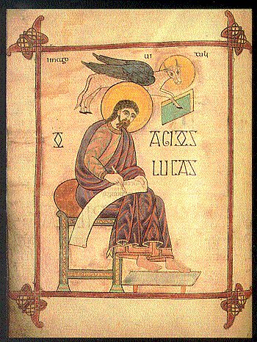

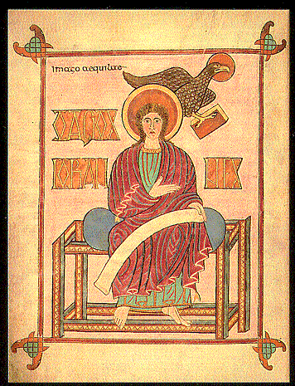

Slide 27
Four-fold Role of Evangelists as Authors
Based on Vatican II: Dei Verbum
Selectors – from among the many things Jesus said and did, they chose which stories they wanted to include and which to omit.
Arrangers – they organized materials in a particular sequence, not necessarily chronologically but often in thematic blocks.
Shapers – they adapted and edited the individual stories from their sources so as to emphasize the themes they wanted to stress.
Proclaimers – they were not objective historians, but preached the “good news” about Jesus in ways appropriate to their audiences.

Slide 28
Rethink Gospel Formation
Is there even an “original text”?
  Ongoing interplay between live preaching
  and written/expanded “performance notes”
One author? Multiple authors? Final author?
  Aramaic Matthew? vs. Final/canonical Mt?
  Proto-Luke? vs. Final/canonical Luke (&Acts)
  Early edition(s) of Mark vs. later editions
  Early edition(s) of John vs. later editions

Slide 29
Synoptics vs. John
Traditional Bias: “Apostolic Witness”
  Matthew and John were apostles, thus the most historical
  Mark and Luke were later, thus slightly less important
Modern Bias: “Markan Priority”
  Mark is earliest, thus most historical
  John is latest, thus least historical
Today: Apply the Both/And Approach:
  All FOUR Gospels contain BOTH History AND Theology
  MARK is both historical and theological

Slide 30
4 Gospels: Comparative Charts
Full-color Scheme (on my website & handouts)
  MARK = Yellow
  Matthew = Red
  Luke = Blue
  John = Grey (or Brown)
Study Vertically and Horizontally
  Vertically: focus on each Gospel separately
  Horizontally: compare features in 4 Gospels

Slide 31

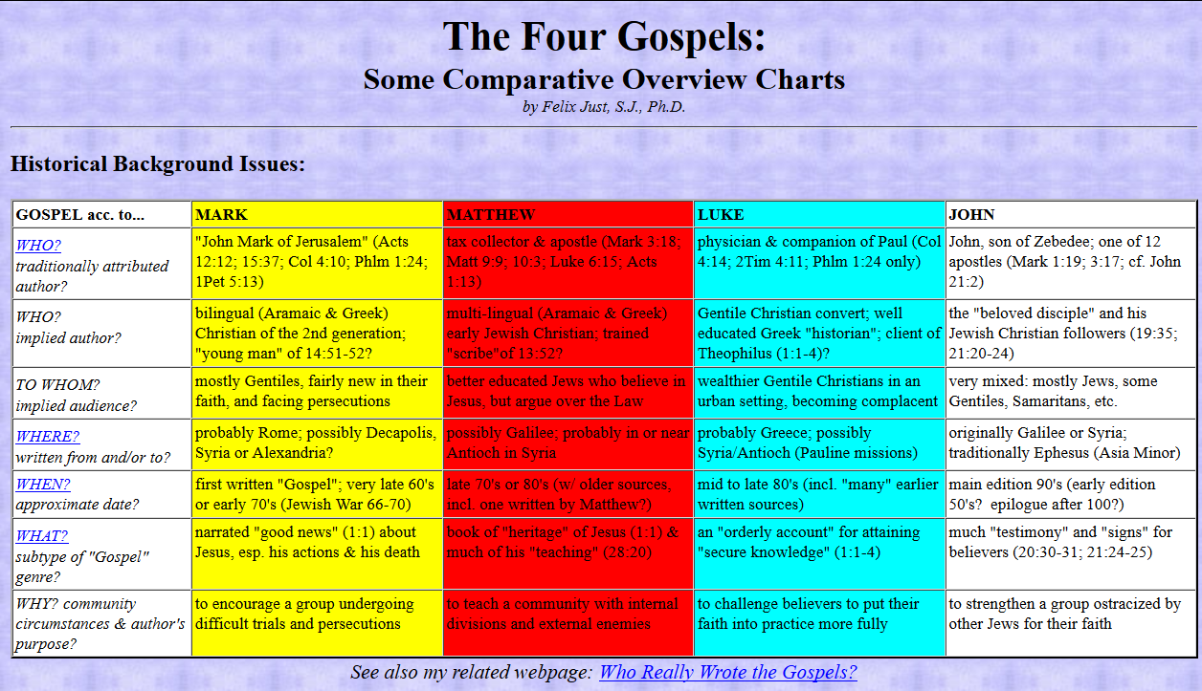
http://catholic-resources.org/Bible

Slide 32
MARK: Literary Historical Issues
Attributed author: "John Mark of Jerusalem" (Acts 12:12; 15:37; Col 4:10; Phlm 1:24; 1Pet 5:13)
Implied author: bilingual (Aramaic/Greek) 2nd generation Xn; the "young man" of 14:51-52?
Audience: mostly Gentile converts, fairly new in their faith,
facing persecutions
Location: probably written in or to Christian cmty in Rome;
possibly Decapolis, Syria or Alexandria?
Date: first written "Gospel"; very late 60's or early 70's (Jewish War 66-70)
Sub-genre: narrated "good news" (1:1) about Jesus,
esp. his powerful actions & his suffering & death
Purpose: to encourage Xns undergoing trials & persecutions

Slide 33
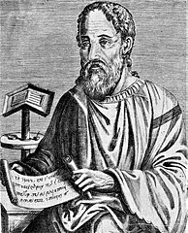
Eusebius, Ecclesiastical History (c. AD 325)
On the Composition of Mark and Matthew, citing Papias
  Bishop of Hierapolis in Asia Minor; lived ca. 60-130 AD
  (Eusebius, EH 3.39.14-17)
On the Composition of Mark, citing Clement of Alexandria
  Bishop of Alexandria in Egypt; lived ca. 150-215
  (Eusebius, EH 2.15.1-2, 2.16.1)
On the Composition and Order
of all Four Gospels, again
citing Clement of Alexandria
  (Eusebius, EH 6.14.5-7)

Slide 34
Papias of Hierapolis, on Mark & Matthew
Papias gives also in his own work other accounts of the words of the Lord on the authority of Aristion who was mentioned above, and traditions as handed down by the presbyter John; to which we refer those who are fond of learning.
But now we must add to the words of his which we have already quoted the tradition which he gives in regard to MARK, the author of the Gospel. It is in the following words:
"This also the presbyter said: Mark, having become the interpreter of Peter, wrote down accurately, though not indeed in order, whatsoever he remembered of the things done or said by Christ. For he neither heard the Lord nor followed him, but afterward, as I said, he followed Peter, who adapted his teaching to the needs of his hearers, but with no intention of giving a connected account of the Lord's discourses, so that Mark committed no error while he thus wrote some things as he remembered them. For he was careful of one thing, not to omit any of the things which he had heard, and not to state any of them falsely."
These things are related by Papias concerning Mark.
But concerning MATTHEW he writes as follows: "So then Matthew wrote the oracles in the Hebrew language, and every one interpreted them as he was able."
And the same writer uses testimonies from the first Epistle of John and from that of Peter likewise. And he relates another story of a woman, who was accused of many sins before the Lord, which is contained in the Gospel according to the Hebrews. These things we have thought it necessary to observe in addition to what has already been stated. (Eusebius, Ecclesiastical History 3.39.14-17)

Slide 35
Clement of Alexandria on Mark
And thus when the divine word had made its home among them [Christians in Rome], the power of Simon [the magician] was quenched and immediately destroyed, together with the man himself. [cf. Act 8:9-24 & Acts of Peter.] And so greatly did the splendor of piety illumine the minds of PETER'S hearers that they were not satisfied with hearing once only, and were not content with the unwritten teaching of the divine Gospel, but with all sorts of entreaties they besought MARK,
a follower of Peter, and the one whose Gospel is extant, that he would leave them a written monument of the doctrine which had been orally communicated to them. Nor did they cease until they had prevailed with the man, and had thus become the occasion of the written Gospel which bears the name of MARK. And they say that Peter when he had learned, through a revelation of the Spirit, of that which had been done, was pleased with the zeal of the men, and that the work obtained the sanction of his authority for the purpose of being used in the churches.
Clement in the eighth book of his Hypotyposes gives this account, and with him agrees the bishop of Hierapolis named Papias.
And Peter makes mention of Mark in his first epistle which they say that he wrote in Rome itself, as is indicated by him, when he calls the city, by a figure, Babylon, as he does in the following words: "The church that is at Babylon, elected together with you, salutes you; and so does Marcus my son" (1 Peter 5:13). And they say that this Mark was the first that was sent to Egypt, and that he proclaimed the Gospel which he had written, and first established churches in Alexandria. (Eusebius, Ecclesiastical History 2.15.1-2, 2.16.1)

Slide 36
Clement of Alexandria on the Four Gospels
Again, in the same books [the Hypotyposes], Clement gives the tradition of the earliest presbyters, as to the order of the Gospels, in the following manner:
"The Gospels containing the genealogies [i.e. Matthew and Luke], he says, were written first. The Gospel according to MARK had this occasion. As Peter had preached the Word publicly at Rome, and declared the Gospel by the Spirit, many who were present requested that Mark, who had followed him for a long time and remembered his sayings, should write them out. And having composed the Gospel he gave it to those who had requested it. When Peter learned of this, he neither directly forbade nor encouraged it.
But, last of all, JOHN, perceiving that the external facts had been made plain in the Gospel, being urged by his friends, and inspired by the Spirit, composed a spiritual Gospel." This is the account of Clement.
(Eusebius, Ecclesiastical History 6.14.5-7).

Slide 37
Author: Mark?
Attributed author: "John Mark of Jerusalem“
  Acts 12:12 – Peter stays at the house of John Mark’s mother
  Acts 15:37 – an early missionary associate of Paul & Barnabas (cf. 12:25; 13:5, 13; 15:37-39)
  Col 4:10 – called the "cousin" of Barnabas
  Phlm 24 – involved in preaching to the Christians in Colossae
  2 Tim 4:11 – Paul calls him "useful in my ministry"
  1 Pet 5:13 – again associated with apostle Peter, who calls him "my son"
Implied author:
  Bilingual in Aramaic & Greek, although his Greek is fairly rough
  Second generation Christian, follower of the first-generation Apostles
  Is he maybe the "young man" of Mark 14:51-52?
    “Now a young man followed him wearing nothing but a linen cloth about his body.
    They seized him, ⁵² but he left the cloth behind and ran off naked.” (after Jesus’ arrest in Gethsemane)

Slide 38
Audience & Location
First Readers/Recipients:
  Seem to be mostly Gentile converts to Christianity,
  who are fairly new in their faith and facing persecutions
Place of Composition:
  Probably written in or to the Christian community in Rome
  Possibly also Decapolis, Syria, or Alexandria?

Slide 39
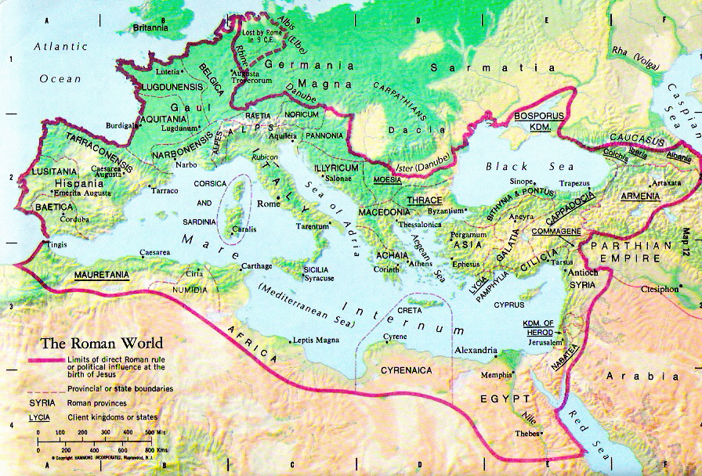
Where & To Whom was Mark’s Gospel Written?

Slide 40
Dating of Mark
Traditional Opinions:
  Written after Matthew (and after Luke, acc. to Clement of Alexandria)
  Thought to be a shortened/condensed version of Matthew
Opinion of Most Scholars Today:
  It was the first "Gospel“ to be completed (at least in it’s present “final” form)
  Probably very late 60's or early 70's (cf. Jewish War vs. Rome, AD 66-70)
  Mark 13:1-37 – “As he [Jesus] was making his way out of the temple area one of his disciples said to him, "Look, teacher, what stones and what buildings!“ ² Jesus said to him, "Do you see these great buildings? There will not be one stone left upon another that will not be thrown down…
  ⁷ When you hear of wars and reports of wars do not be alarmed; such things must happen, but it will not yet be the end. ⁸ Nation will rise against nation and kingdom against kingdom…
  ¹⁴ When you see the desolating abomination standing where he should not (let the reader understand), then those in Judea must flee to the mountains…¹⁸ Pray that this does not happen in winter. ¹⁹ For those times will have tribulation such as has not been since the beginning of God's creation until now, nor ever will be. ²⁰ If the Lord had not shortened those days, no one would be saved; but for the sake of the elect whom he chose, he did shorten the days.”

Slide 41
Literary Genre of Mark?
Narrated "good news" (Mark 1:1)
  Not merely “Biography” or factual “History,” but primarily “Theological”!
  Proclaims Jesus as the Christ and the Son of God,
  esp. in his powerful deeds, but also his faithfulness to God in his suffering & death
    Suffering Servant; Crucified Messiah
    And calls readers to become or remain faithful disciples!
  Mark is often called “a Passion narrative with an extended introduction”!
    Opposition to Jesus is found not only in the Passion narrative (ch. 14 – 15),
    but throughout the Gospel (8:31; 9:31; 10:32-34), and already as early as 3:6!
Purpose:
  to encourage Christians who are undergoing trials and persecutions
  to persevere in their faith and not abandon the Christian community

Slide 42
Important Definitions:
"gospel" = "good news" = oral preaching
  from Gk. Ευ̉αγγέλιον = Evangelion (cf. Eng. "Evangelist")
  eu = "good"; angelos = "messenger"
  "Now after John was arrested, Jesus came to Galilee, proclaiming the good news of God, and saying,
  'The time is fulfilled, and the kingdom of God has come near; repent, and believe in the good news.' "
  (Mark 1:14-15; NRSV)
  "Paul, a servant of Jesus Christ, called to be an apostle, set apart for the gospel of God, which he promised beforehand through his prophets in the holy scriptures, the gospel concerning his Son…" (Romans 1:1-3; NRSV)
  "But the birthday of the god (Caesar Augustus) was… the beginning of the good news for the world…" (Prien inscription)
"Gospel" = "written account about Jesus"
  Mark was first to use "gospel" in this sense:
  "The beginning of the good news of Jesus Christ, the Son of God." (Mark 1:1)
NT Gospel Titles (added in 2nd Cent.):
  "Gospel according to Mark; Gospel according to…"

Slide 43
Mark: Structure / Outline
Introduction: John the Baptist & Jesus (1:1-15)
- incl. the theme of Jesus' preaching (v. 15)
Early Ministry: Jesus heals, preaches, teaches,
in Galilee and beyond (1:16 – 6:6)
Expanded Ministry: Jesus continues preaching, healing,
and encountering opposition (6:7 – 8:21)
Central Section: Jesus & disciples "On the Way" to
Jerusalem (8:22 – 10:52; incl. passion predictions)
Final Ministry: Jesus confronts authorities in Jerusalem;
apocalyptic discourse (11:1 – 13:37)
Passion Narrative: Jesus' Last Supper, arrest, trials,
crucifixion, death, burial (14:1 – 15:47)
Conclusion: women find Jesus' tomb empty (16:1-8)
- vv. 9-20 are not original, but added later

Slide 44
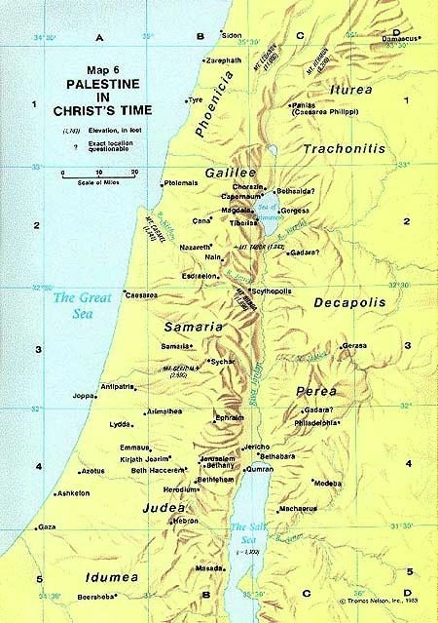
Geographical Settings of Mark:
Southeast:
  Jordan River Valley
  Judean Desert
  Perea (& Idumea)
  Jericho
North:
  Galilee: Region & Its Towns
  Sea of Galilee
  Decapolis (esp. Gerasa)
  Tyre & Sidon
  Caesarea Philippi
South:
  Bethphage & Bethany
  Mount of Olives
  Jerusalem (& Its Environs)

Slide 45
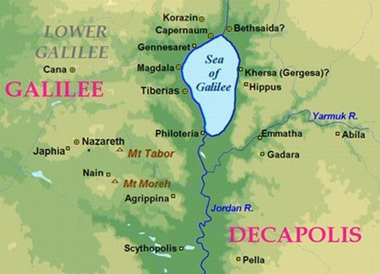
Galilee in Mark: only Nazareth, Capernaum, Gennesaret, Dalmanutha; (Magdala); Bethsaida (NE)

Slide 46
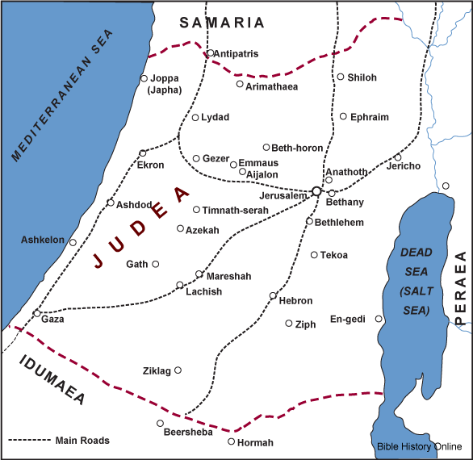
Judea in Mark: only Jericho, Bethphage, Bethany, Jerusalem, Gethsemane, Golgotha, (& Arimathea)

Slide 47
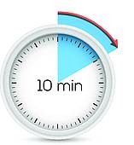
Questions & Break
Questions?
  Please “raise your hands” (electronically)
  Or open your microphone and ask…
Break
  We will continue in 10 minutes.

Slide 48
Mount Saint Mary’s University “Ecclesia” Program Presents:
Living Word: Scriptures of the 2021 Liturgical Year
Lectionary Readings from the
Gospel according to MARK
Fr. Felix Just, S.J., Ph.D.
Living Word Catholic Biblical Ministries
http://catholic-resources.org

Slide 49
Mark: Literary Features & Themes
http://catholic-resources.org/Bible/Mark-Literary.htm
  Paratactic Style
  Thematic Groupings
  Three-fold Patterns, often with Progressive Heightening
  Inclusios and Intercalations
  Use of “Literary Echoes” for retrospectives or foreshadowing
  Repetition of Key Words and Phrases
  Realism in Narrative Details
  Aramaisms & Latinisms
  The “Messianic Secret”
  Special Relationships of Narrator and Reader

Slide 50
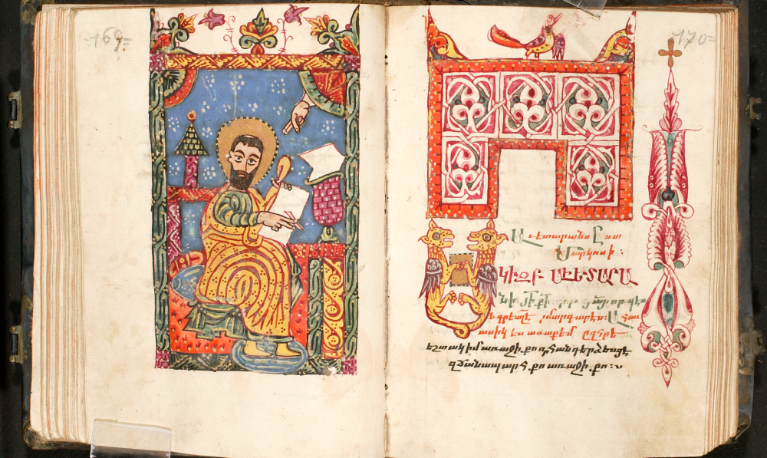
For Reflection & Discussion:
Which of the literary features of Mark’s Gospel most surprise or impress you?

Slide 51
Mark: Other Possible Themes
Christology in Mark
Discipleship in Mark
Holy Spirit in Mark
Prayer in Mark
Miracles in Mark
Women in Mark
Eschatology in Mark (Nov. 21, 2020)
Passion in Mark (March 27, 2021)
Resurrection in Mark (April 17, 2021)

Slide 52
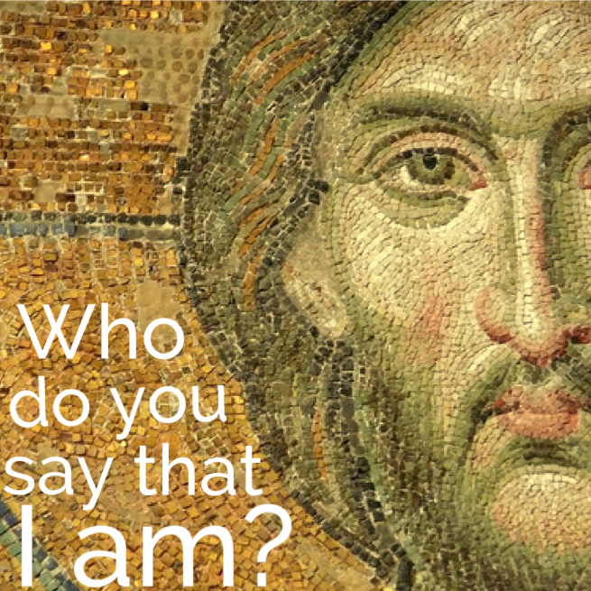
Christology & Discipleship in Mark
Christological Titles in the NT:
  http://catholic-resources.org/
  Bible/Christological_Titles.htm
WHO IS JESUS in Mark?
  http://catholic-resources.org/
  Bible/Mark-Christology.htm
How are WE to follow Jesus?
  http://catholic-resources.org/
  Bible/Mark-Discipleship.htm

Slide 53

Christology in Mark
Titles:
  Son of God (power, authority)
  Son of Man (suffering, crucified)
Teachings:
  Son of Man will be rejected, killed, & rise
  S.M. came not to be served but to serve
Actions:
  Exorcisms, Healings, Nature Miracles
  Calls & trains Disciples
  Challenges Opponents

Slide 54
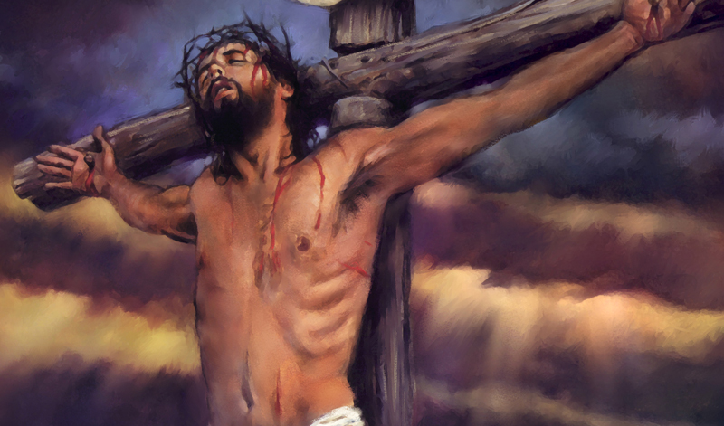
Christology & Discipleship: MARK
Powerful Son of God
  Trust; have faith; be not afraid
Crucified Son of Man
  “Take up your cross and follow me”

Slide 55
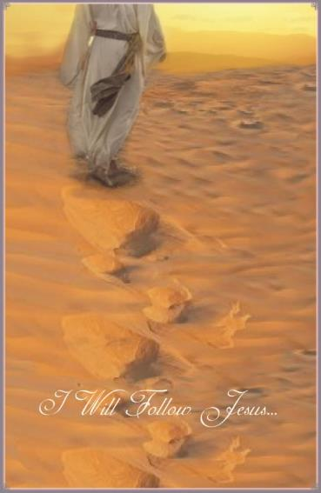
Christology & Discipleship
Christology: Who is Jesus?
  Titles attributed to Jesus
  Teachings of Jesus
  Actions of Jesus
Discipleship: How do WE respond to Him?
  What do we BELIEVE and SAY about Jesus?
  What does Jesus tell us to DO as disciples?
  What Gospel characters are ROLE MODELS?

Slide 56
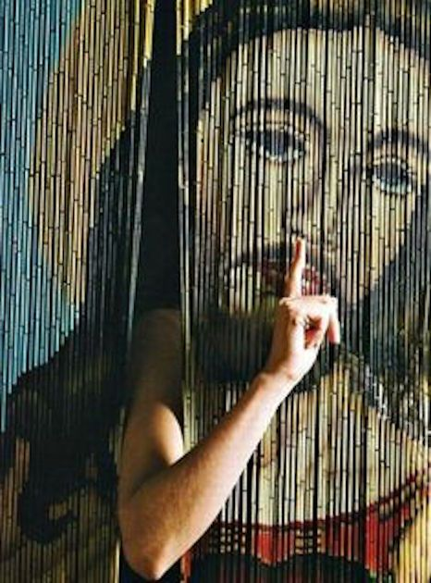
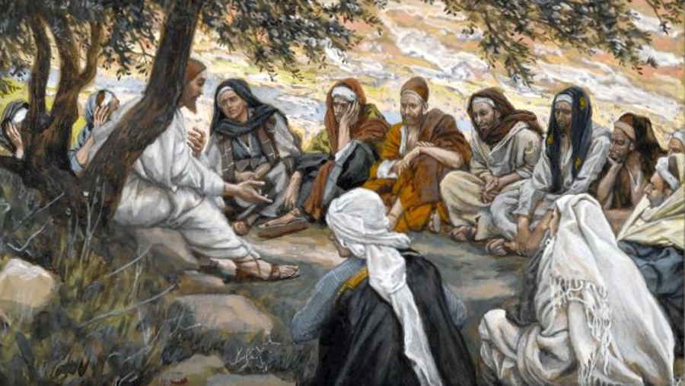
For Reflection & Discussion:
Why does Jesus NOT want most characters in Mark’s Gospel to tell others about him?
Which character in Mark
inspires you the most,
as a positive role model
for your discipleship?
WHY?

Slide 57
Women in the Four Gospels
Mark and Matthew: Fairly Few Women
  Some named, some anonymous, some fictional
  See http://catholic-resources.org/Bible/Synoptics_Women.htm
LUKE: Many More Women Prominent
  See handout (front side) for a complete list
  Luke’s Sources:
    Mk = stories from Mark (and usually also in Matthew)
    Q = stories from “Q” source (also in Matt, but not Mark)
    L = stories found only in Luke (not in Matthew, nor Mark)
JOHN: Fewer Women, but Highly Significant
  Fewer but longer stories in John’s Gospel overall!

Slide 58
Named Women in MARK’s Gospel
Named Women:
  Mother of Jesus:
    Anonymous in Mark 3:19b-21, 31-35 (Jesus’ family comes)
    Mentioned indirectly: Jesus called “Son of Mary” (Mark 6:3)
  Herodias, wife of Herod Philip and of Herod Antipas
    Full story only in Mark 6:17-29 & Matt 14:3-12
  Women at the Cross & Tomb: Mary Magdalene, Mary mother of James & Joses, and Salome
    But not before Mark 15:40-41; 15:47; 16:1-8
    [Jesus appears to Mary Magdalene: 16:9 – later addition]
Anonymous Women: more slides below

Slide 59
Mary, Mother of Jesus, in MARK
Anonymous in Mark 3:19b-21
  “Then he went home / and the crowd came together again, so that they could not even eat. / When his family heard it, they went out to restrain him, for people were saying, ‘He has gone out of his mind.’ ” (not in Matt, Luke, or John!)
Anonymous in Mark 3:31-35
  “Then his mother and his brothers came; and standing outside, they sent to him and called him. / A crowd was sitting around him; and they said to him, "Your mother and your brothers [and sisters] are outside, asking for you." / And he replied, "Who are my mother and my brothers?" / And looking at those who sat around him, he said, "Here are my mother and my brothers! / Whoever does the will of God is my brother, and sister, and mother.’ ”
  Similar in Matt 12:46-50; shorter in Luke 8:19-21
Mentioned only indirectly (“off-stage”) in Mark 6:3
  “Is not this the carpenter, the son of Mary and brother of James and Joses and Judas and Simon, and are not his sisters here with us?”

Slide 60
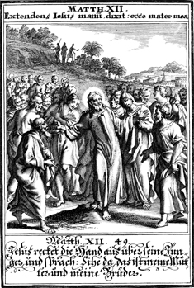
Jesus’ True Family

Slide 61
Herodias & Daughter in MARK
Herodias causes John the Baptist’s arrest
  Mark 6:17-18; similar in Matt 14:3-4; Luke 3:19-20
  “For Herod himself had sent men who arrested John, bound him, and put him in prison on account of Herodias, his brother Philip's wife, because Herod had married her. / For John had been telling Herod, ‘It is not lawful for you to have your brother's wife.’ ”
Herodias & daughter cause John Baptist’s death
  Mark 6:19-29 & Matt 14:5-12 (not in Luke or John)
  Herodias wanted to kill John, but couldn’t
  Herod’s birthday dinner; Herodias’ daughter dances
  Collusion of girl and mother; John B. is beheaded

Slide 62
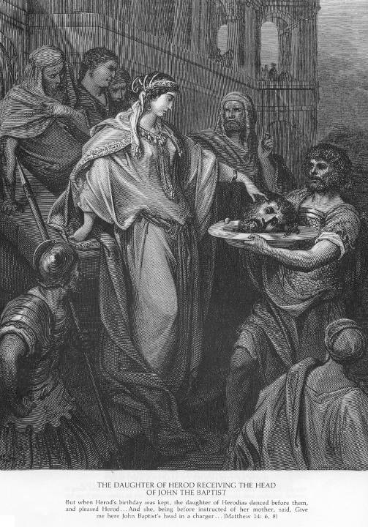
Daughter of
Herodias
(Mark 6:22-29)
Woodcuts by
Gustave Doré
(1890’s)

Slide 63
Women at the Cross in MARK
Mark 15:40-41 – Witnesses of Jesus’ Crucifixion
  “There were also women looking on from a distance; among them were Mary Magdalene, and Mary the mother of James the younger and of Joses, and Salome. / These used to follow him and provided for him when he was in Galilee; and there were many other women who had come up with him to Jerusalem”
  Similar in Matt 27:55-56; John 19:25-27; anon. in Luke 23:49
  Not “near” nor “at the foot of the cross” (only in John)

Slide 64
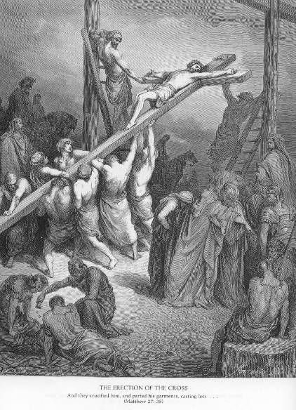
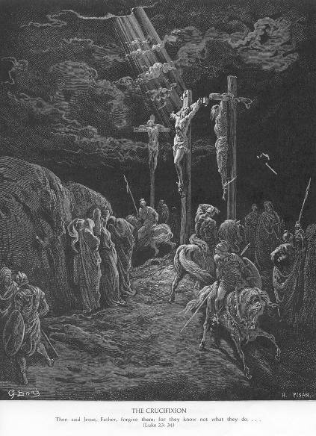
Jesus’ Crucifixion (how close are the women?)
Gustave Doré

Slide 65
Women at the Tomb in MARK
Mark 15:47 – Witnesses of Jesus’ Burial
  “Mary Magdalene and Mary the mother of Joses saw where the body was laid.”
  Similar in Matt 27:61; anon. in Luke 23:55-56
Mark 16:1-8 – Witnesses of the Empty Tomb
  “When the sabbath was over, Mary Magdalene, and Mary the mother of James, and Salome bought spices, so that they might go and anoint him…”
  Similar in Matt 28:1-8; not named until Luke 24:10-11
[Mark 16:9-11 – Jesus appears to two Marys – added 2nd Cent.]

Slide 66
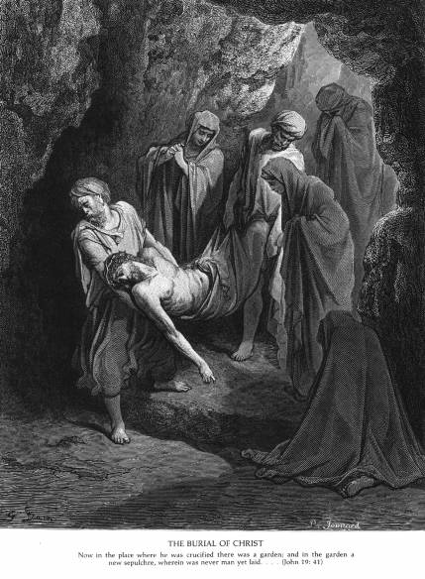
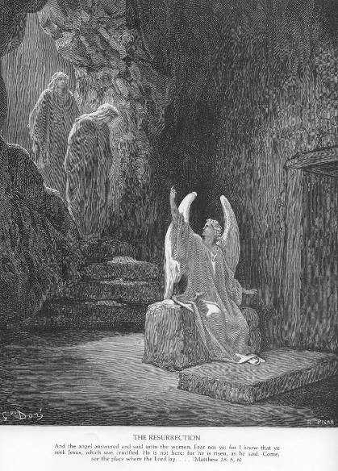
Jesus’ Burial & Empty Tomb
Gustave Doré

Slide 67
ANONYMOUS Women in MARK
Women Healed/Raised by Jesus:
Simon (Peter)’s Mother-in-law
  Mark 1:29-31; also in Matt 8:14-15; Luke 4:38-39
Daughter & Wife of Jairus
  Mark 5:21-43; shorter in Matt 9:18-26; Luke 8:40-56
Woman with a flow of blood
  Mark 5:25-34; shorter in Matt 9:20-22; Luke 8:43-48
Syrophoenician Woman & Daughter
  Mark 7:24-30; “Canaanite” in Matt 15:21-28; not in Luke
Function as “Models of FAITH” in Mark’s Gospel

Slide 68
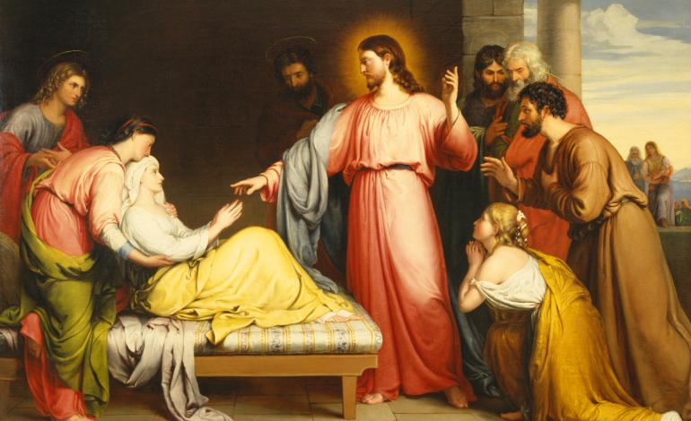
Simon (Peter)’s Mother-in-law
Mark 1:29-31; also in Matt 8:14-15; Luke 4:38-39

Slide 69
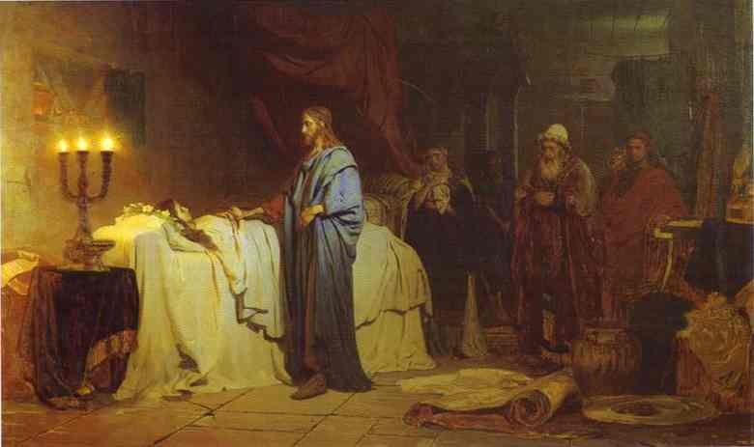
Daughter & Wife of Jairus
Mark 5:21-43; shorter in Matt 9:18-26; Luke 8:40-56

Slide 70
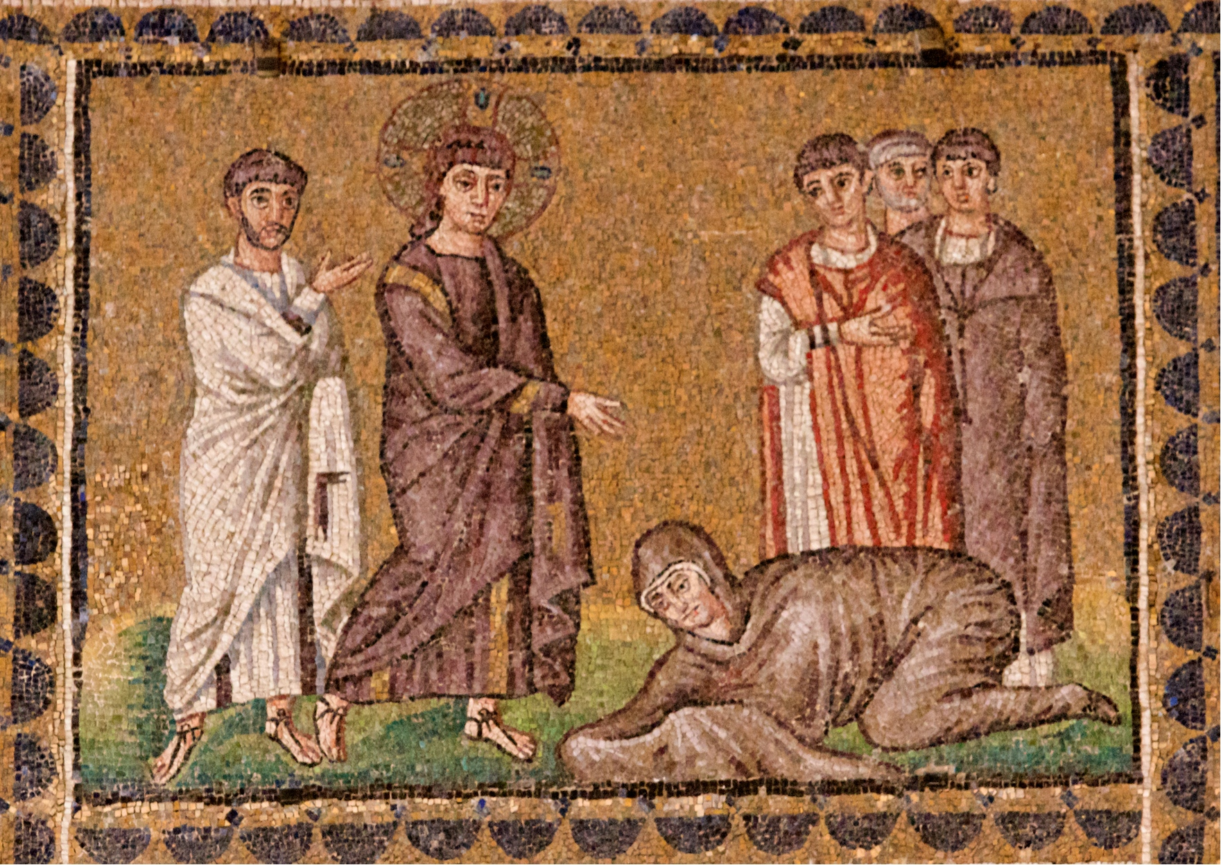
Woman with a flow of blood
Mark 5:25-34; shorter in Matt 9:20-22; Luke 8:43-48

Slide 71
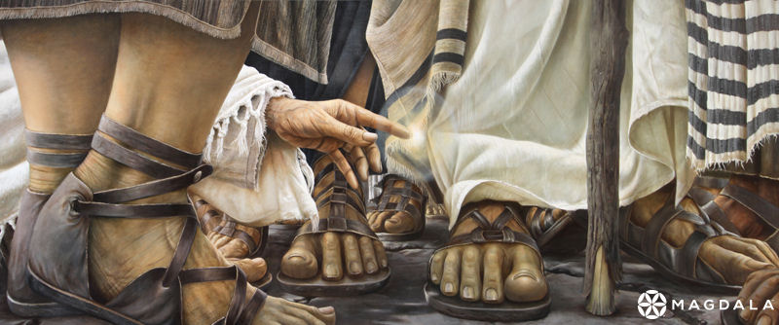
Woman with a flow of blood
Encounter Chapel, Duc in Altum, Magdala
By artist Daniel Cariola

Slide 72
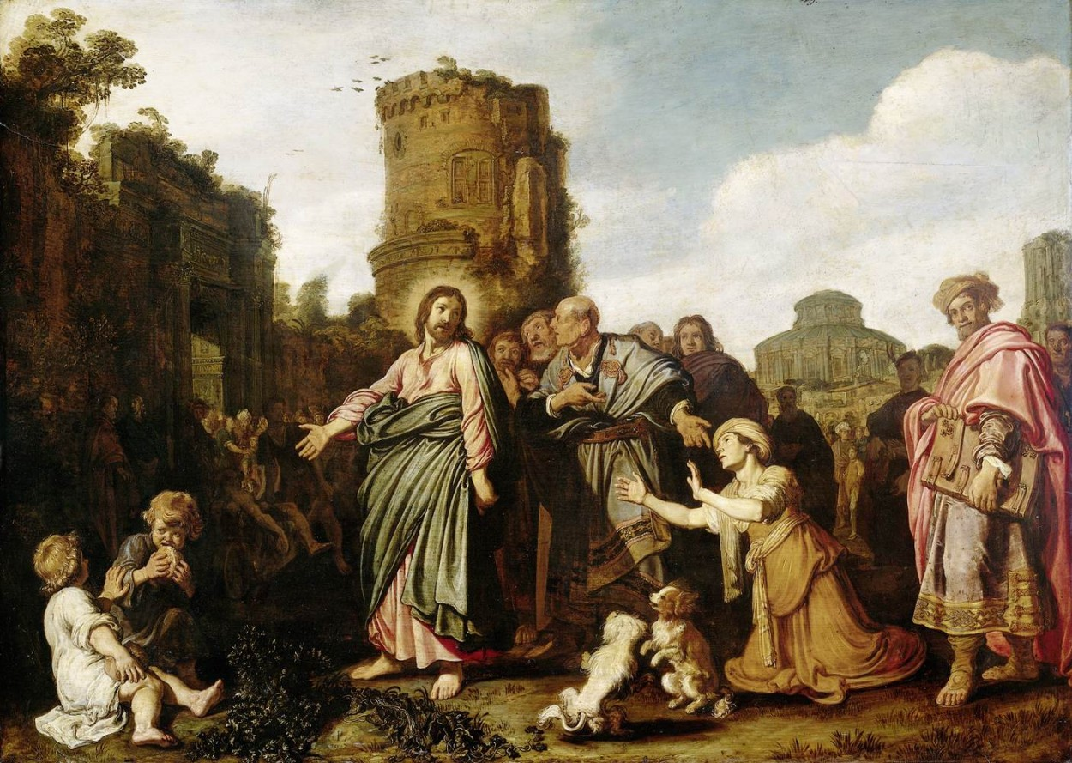
Syrophoenician Woman & Daughter
Mark 7:24-30; “Canaanite” in Matt 15:21-28; not in Luke

Slide 73
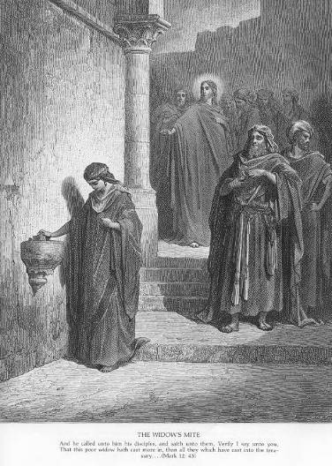
Anonymous Women in MARK (cont.)
Other Women as Positive Role Models:
Poor Widow at the Treasury
“He sat down opposite the treasury, and watched
the crowd putting money into the treasury. Many
rich people put in large sums. / A poor widow came
and put in two small copper coins, which are worth
a penny. / Then he called his disciples and said to
them, ‘Truly I tell you, this poor widow has put in
more than all those who are contributing to the
treasury. / For all of them have contributed out of
their abundance; but she out of her poverty has put
in everything she had, all she had to live on.’ ”
Mark 12:41-44; also Luke 21:1-4;
[but not in Matt or John]

Slide 74
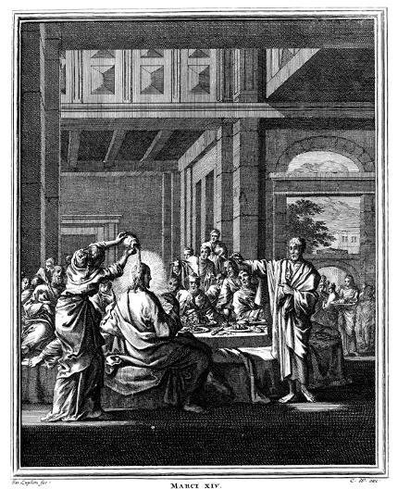
Anonymous Women in MARK (cont.)
Other Women as Positive Role Models:
Woman who anoints
Jesus at Bethany
  Mark 14:3-9; Matt 26:6-13;
  [Luke 7:36-50; John 12:1-8 different]
  Not Mary Magdalene
  Not called a “sinner”
  Anoints Jesus’ head
  Prepares for Jesus’ death
  “What she has done will
  be told in memory of her”

Slide 75
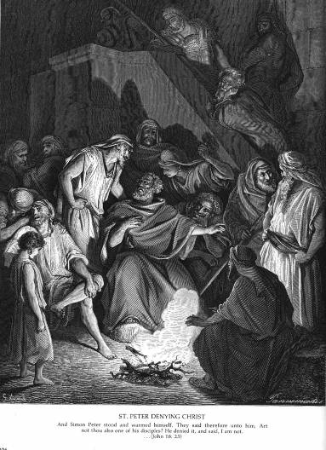
Anonymous Women in MARK (cont.)
Women with Lesser Roles:
Servant girl who challenges
Peter in the courtyard
  Mark 14:66-72; Matt 26:69-75;
  Luke 22:56-57; John 18:16-17
“Sisters” of Jesus
  Mark 6:3; Matt 13:56; not in Luke
Daughter of Herodias
  Mark 6:22-28; Matt 14:6-11; not in Luke

Slide 76
Brief References to Women in MARK
Mark 10:2-12 – Jesus teaches about Divorce
  More extensive in Matt 19:3-12; only briefly in Luke 16:18
Mark 10:19 – Jesus quotes the Decalogue
  “Honor your father and your mother” (also Matt 19:19; Luke 18:20)
Mark 10:29-30 – Jesus promises rewards for his disciples
  “No one who has left house or brothers or sisters or mother or father or children or fields for my sake...” (also Matt 19:29; Luke 18:29)
Mark 12:18-27 – Sadducees question Jesus
  Case of a woman with seven husbands (also Matt 22:23-33; Luke 20:27-40)
Mark 13:12 & 17 – Jesus’ Apocalyptic Discourse
  “Children will rise against parents…” (also Luke 21:16; earlier in Matt 10:21)
  “Alas for those with child or nursing in those days” (also Matt 24:19; Luke 21:23)

Slide 77
Questions & Break
Questions?
  Please “raise your hands” (electronically)
  Or open your microphone and ask…
Break
  We will continue in 10 minutes.

Slide 78
Mount Saint Mary’s University “Ecclesia” Program Presents:
Living Word: Scriptures of the 2021 Liturgical Year
Lectionary Readings from the
Gospel according to MARK
Fr. Felix Just, S.J., Ph.D.
Living Word Catholic Biblical Ministries
http://catholic-resources.org

Slide 79
Mark: Structure / Outline
Introduction: John the Baptist & Jesus (1:1-15)
- incl. the theme of Jesus' preaching (v. 15)
Early Ministry: Jesus heals, preaches, teaches,
in Galilee and beyond (1:16 – 6:6)
Expanded Ministry: Jesus continues preaching, healing,
and encountering opposition (6:7 – 8:21)
Central Section: Jesus & disciples "On the Way" to
Jerusalem (8:22 – 10:52; incl. passion predictions)
Final Ministry: Jesus confronts authorities in Jerusalem;
apocalyptic discourse (11:1 – 13:37)
Passion Narrative: Jesus' Last Supper, arrest, trials,
crucifixion, death, burial (14:1 – 15:47)
Conclusion: women find Jesus' tomb empty (16:1-8)
- vv. 9-20 are not original, but added later

Slide 80
Mark: Section-by-Section Outlines
http://catholic-resources.org/Bible/Mark-Outlines.htm
Close look at Mark 1:1-45
Close look at Mark 8:22–10:52
Other texts of interest to YOU?

Slide 81
Mark 1:1-15 – Gospel Introduction
Evangelist's Literary Intro - "The beginning of the good news
(gospel; euangelion) of Jesus Christ, the Son of God." (v. 1)
As written by prophet Isaiah (& Malachi),
John the Baptist preaches repentance in the wilderness (vv. 2-6)
John speaks about Jesus coming after him:
"I baptize with water; he will baptize with holy Spirit" (vv. 7-8)
Jesus comes from Nazareth and is baptized by John in the Jordan river; heavens open; the Spirit descends (vv. 9-10)
A voice from heaven speaks to Jesus:
"You are my beloved Son; with you I am well pleased." (v. 11)
The Spirit drives Jesus into the wilderness,
where he remains for forty days, tested by Satan (vv. 12-13)
Jesus' Initial Preaching - "The time is fulfilled, and the kingdom of God has come near; repent, and believe in the good news." (vv. 14-15)
[The first words of Jesus in Mark's Gospel proclaim the urgency of his message, his focus on God, and the response expected from the listeners.]

Slide 82
Baptism of the Lord – Year B – Mk 1:7-11
This is what [John the Baptist] proclaimed:
“One mightier than I is coming after me.
I am not worthy to stoop and loosen the thongs of his sandals.
I have baptized you with water;
he will baptize you with the Holy Spirit.” (lit. “with holy spirit”)
It happened in those days that Jesus came from Nazareth of Galilee
and was baptized in the Jordan by John.
(Immediately) On coming up out of the water
he saw the heavens being torn open
and the Spirit, like a dove, descending upon him.
And a voice came from the heavens,
“You are my beloved Son; with you I am well pleased.”

Slide 83
Mark 1:16-45 – Intro to Jesus’ Ministry
First Vocation story (vv. 16-20):
  Jesus calls four fishers, who follow him as his disciples
First Exorcism (vv. 21-28):
  Jesus exorcises an unclean spirit in Capernaum
First Healing narrative (vv. 29-31):
  Jesus heals Simon's mother-in-law of a fever
First Healing summary (vv. 32-34):
  Jesus heals many sick people and drives out many demons
First Prayer (v. 35):
  Jesus goes off by himself early in the morning to pray
First Journey (vv. 36-39):
  Jesus expands his preaching beyond Capernaum
First Restoration story (vv. 40-45):
  Jesus cleanses a leper, restoring him to health and to society

Slide 84
Mark 8:22–10:52 – Central Section
8:22-26 - Two-Stage Restoration of Sight to a Blind Person at Bethsaida
8:27-30 - Peter's Confession near Caesarea Philippi: "You are the Christ";
but Jesus orders them "not to tell anyone about him"
  8:31 - First Passion Prediction (Son of Man must suffer, be rejected, be killed, and rise after three days)
  8:32-33 - Peter misunderstands and "rebukes" Jesus, who "rebukes" Peter in return
  8:34–9:1 - Jesus teaches: "If any want to become my followers, let them deny themselves, take up their cross and follow me. For those who want to save their life will lose it, and those who lose their life for my sake and for the sake of the gospel will save it."
9:2-30 - Transfiguration; Coming of Elijah; Exorcism of an Epileptic Spirit
  9:31-32 - Second Passion Prediction (Son of Man will be betrayed, be killed, but rise after three days)
  9:33-34 - All the disciples misunderstand, arguing who among them was the greatest
  9:35-50 - Jesus teaches: "Whoever wants to be first must be last of all and servant of all."
10:1-31 - Teaching on Divorce; Blessing of Children; the Rich Man
  10:32-34 - Third Passion Prediction (Son of Man will be handed over, condemned to death, mocked, spat upon, scourged, put to death, but will rise after three days)
  10:35-40 - James & John misunderstand, asking for the seats of honor when Jesus is in "glory"
  10:41-45 - Jesus teaches: "Whoever wishes to be great among you will be your servant; whoever wishes to be first among you will be the slave of all. For the Son of Man did not come to be served but to serve and to give his life as a ransom for many."
10:46-52 - Immediate Restoration of Sight to Blind Bartimaeus outside of Jericho

Slide 85
Contrasting Mark’s Two Stories of Jesus Healing Blind People:
Mark 8:22-26 | Mark 10:46-52
22 – Intro: Blind man at Bethsaida; Request to touch | 46 – Intro: Jesus leaving Jericho, Blind beggar Bartimaeus
23 – Jesus touches the man’s eyes (with spittle) | 47 – Bartimaeus cries out, “Jesus, Son of David, have mercy”
24 – The man can see unclearly (trees walking?) | 48a – People rebuke him and try to silence him
25a – Jesus touches the man’s eyes a second time | 48b – Bartimaeus cries again, “Son of David, have mercy”
25b – The man’s sight is restored; now he sees clearly | 49-50 – Jesus stops & calls him; Bartimaeus approaches Jesus
26 – Jesus sends the man home (not into the village) | 51 – Dialogue: “What do you want?” – “Lord, I want to see!”
. | 52 – “Go, your faith has saved you”; Bartimaeus follows Jesus

Slide 86
Mark 13:1-37 – Eschatological Discourse
Double Introduction (13:1-4):
  A) Jesus and a disciple dialogue about the present grandeur and the future destruction of the Temple (13:1-2)
  B) Jesus' closest disciples ask him privately: When? And what will be the signs of the end? (13:3-4)
Jesus' Warnings about Trials and Tribulations on Earth (13:5-23):
  Take heed: let no one lead you astray (13:5-6)
    Wars, earthquakes and famines will come, but the end is not yet (13:7-8)
  Take heed: you will be arrested and put on trial, so you can bear testimony (13:9-11)
    You will be hated and put to death, even by family members; but whoever endures will be saved (13:12-13)
  Let the reader understand: When you see the desolating sacrilege, everyone must flee (13:14-18)
    Tribulations will be greater than ever before, but God has shortened those days for the sake of the elect (13:19-20)
  Take heed: Don't be led astray by false messiahs and false prophets; Jesus has forewarned us (13:21-23)
Jesus' Teachings about the Coming of the Son of Man (13:24-31):
  After the foregoing tribulations, there will be signs in the heavens (13:24-25)
    The Son of Man will come with great power, to gather the elect (13:26-27)
  Learn a lesson from the fig tree, so you know when the Son of Man is near (13:28-29)
    This generation will not pass until all has taken place (13:30-31)
Double Conclusion (13:32-37):
  B') Jesus' answer to the disciples' question, When?: "Amen, this generation won't pass away; but no one knows the day nor hour" (13:32-33)
  A') Jesus' final call for all: Take heed; watch, since you do not know when; illustrated by the Parable of the Doorkeeper; "stay awake!" (13:34-37)

Slide 87
Other Texts from Mark?
What other passages or stories from Mark’s Gospel would you like to look at more closely?
  Please type your requests in the CHAT.
Resources:
  https://catholic-resources.org/Bible/Mark-Outlines.htm
  https://bible.usccb.org/bible/mark/0

Slide 88
Wrap-Up
Further Questions? Comments?
  Type a Comment/Question in the “Chat”
  Extra Q&A Session from 12:30 to 1:00 pm
More on Biblical Texts:
  http://catholic-resources.org/Bible/
More on Lectionary for Mass:
  http://catholic-resources.org/Lectionary/
Next Session: Readings for LENT
  Sat., Feb. 13, 2021

Slide 89

Give Us This Day
Monthly Missalette
  from Liturgical Press (Benedictines, Collegeville, MN)
  Daily MP & EP (2 pages each)
  Daily Mass Readings & Prayers
  Daily Reflections on the Readings (1 page each)
  Daily “Blessed among Us” (1 page each)
  Weekly “Within the Word” Articles (2 pages each)
  Monthly articles on other topics of prayer/spirituality
  In Print and/or smart-phone APP
Free Samples:
  https://giveusthisday.org/frfelix
  Request a print copy of an issue to be mailed to you,
  or download the app with free use for 30 days

Slide 90
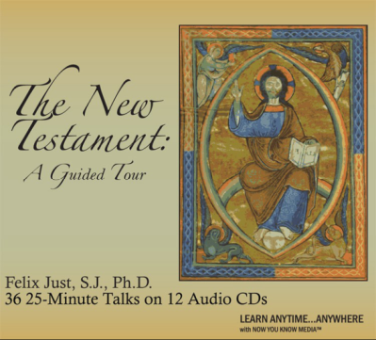
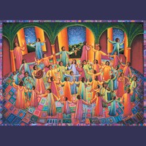
Audio CD Programs by Fr. Felix
New Testament: Guided Tour
The Lectionary for Mass
What Is Faith?
Retreat with Gospel of Mark
Retreat with Gospel Matthew
Retreat with Gospel of Luke
Retreat with Gospel of John
Available on CD from Fr. Felix Just, SJ,
or downloadable files from Learn 25;
prices vary by length of program
Learn 25

Slide 91
“Living Word” Webinar Series
Zoom Webinars on the Lectionary for Mass
  Saturdays, 9:00 a.m. – 12:30 p.m. (Pacific Time)
  Open to the Public (feel free to invite others)
  FREE (but donations appreciated)
Monthly, from Nov. 2020 to April 2021
  Nov. 21, 2020 – Readings of Advent
  Dec. 19, 2020 – Readings of the Christmas Season
  Jan. 9, 2021 – Gospel of Mark in Liturgical Year B
  Feb. 13, 2021 – Readings of Lent
  March 27, 2021 – Readings of Holy Week & Triduum
  April 17, 2021 – Readings of the Easter Season

Slide 92
DONATIONS
If you’d like to support MSMU’s Ecclesia program and Living Word Catholic Biblical Ministries, please make a tax-deductible donation, so that we can offer more webinars and other programs to anyone, regardless of their financial circumstances.
  We cannot accept online donations yet, but hope to enable this feature soon.
Please make your check payable to "LMU Jesuit Community."
Then mail your check to:
  Fr. Felix Just, SJ
  LMU Jesuit Community
  PO Box 45041
  Los Angeles, CA 90045

Slide 93
Upcoming Pilgrimages
In the Footsteps of Jesus:
Pilgrimage to the Holy Land (Israel & Palestine)
  Dec. 26, 2021 to Jan. 9, 2022
The Oberammergau Passion Play:
Pilgrimage to Austria and Germany
  May 14-22, 2022
May 2023
  In the Footsteps of St. Paul: Pilgrimage to Turkey
May 2024
  In the Footsteps of Jesus: Pilgrimage to the Holy Land
May 2025
  In the Footsteps of St. Paul: Pilgrimage to Greece

Slide 94
Closing Prayer
The word of God calls us out of darkness into the light of faith. Having been enlightened by God’s Word, let us ask the Lord to hear our prayers and to bless us:
For all who read the Sacred Scriptures,
that with deep faith and confident voice we may believe and proclaim God’s saving word, we pray to the Lord. Resp.: Lord, hear our prayer.
For all Christian believers, that we may continue to respond
to the word of God that is proclaimed in our midst, we pray…
For all who listen as the Scriptures are proclaimed,
that God’s word may find in them a fruitful field, we pray…
For those who have not heard the message of Christ,
that we may be willing to bring them the good news of salvation, we pray…
Everlasting God, your Son proclaimed the good news of salvation for which he would give up his life. Bless us and all who read the Word of God. As we listen to your words of life, strengthen our faith so that we may proclaim your love and mercy with conviction and boldness, and put into practice in our own lives what we proclaim to others. We ask this through Christ our Lord. Amen.
Adapted from Book of Blessings, Ch. 61: Order for the Blessing of Readers

Slide 95
God Bless You!
Thanks for participating today!
  More Questions or Comments?
  Feel Free to Stay Online
  Pray for Peace in Our Country!
  And may you have a
  Blessed New Year!

