Slide 1
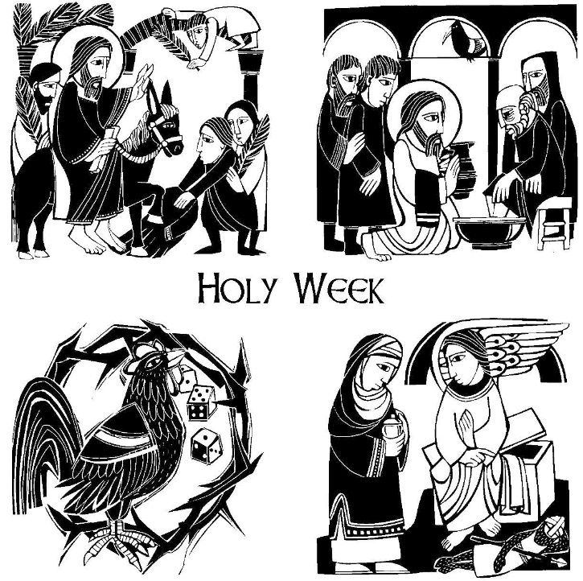
Mount Saint Mary’s University “Ecclesia” Program Presents:
Living Word: Scriptures of the 2021 Liturgical Year
Lectionary Readings for
Holy Week, Easter Triduum & Easter Octave
Fr. Felix Just, S.J., Ph.D.
Living Word Catholic Biblical Ministries
http://catholic-resources.org

Slide 2
Welcome to “Living Word”!
Zoom Webinars Series co-sponsored by:
  “Ecclesia” Program of Mount Saint Mary’s University, LA
    Gail Gresser, Director of Campus Ministry
    “Serving those who serve the Church”
  “Living Word Catholic Biblical Ministries,” Los Angeles
    New name for Fr. Felix’s adult faith-formation programs
Welcome to All, especially :
  Prior “Ecclesia” program participants
  Prior and Future “Holy Land Pilgrims”
  Bible Institute Participants from CA, AZ, Michigan, Illinois…
  Other NEW folks, here for the first time!

Slide 3

Opening Prayer – Entering Holy Week
The fruits of the Lord’s Passion fill this present day with light.
Come then, all who love to keep the feast,
And let us welcome it with songs,
for the Creator draws near to undergo the cross.
(from Byzantine Matins)
Father of life and God not of the dead but of the living —
You sent your Son to proclaim life,
to snatch us from the realm of death,
and to lead us to resurrection.
Free us all, your chosen people,
from the death dealing power of the spirit of evil,
so that we may bear witness to new life
in the risen Christ. Amen.
(adapted from the Rite of Christian Initiation of Adults)

Slide 4
“Living Word” Webinar Series
Zoom Webinars on the Catholic Lectionary for Mass
  Saturdays, 9:00 a.m. – 12:30 p.m. (Pacific Time)
  Open to the Public (feel free to invite others)
  FREE (but donations appreciated)
Monthly, from Nov. 2020 to April 2021
  Nov. 21, 2020 – Readings of Advent
  Dec. 19, 2020 – Readings of the Christmas Season
  Jan. 9, 2021 – Gospel of Mark (Liturgical Year B)
  Feb. 13, 2021 – Readings of Lent
  March 27, 2021 – Readings of Holy Week & Easter Triduum
  April 17, 2021 – Readings of the Easter Season

Slide 5
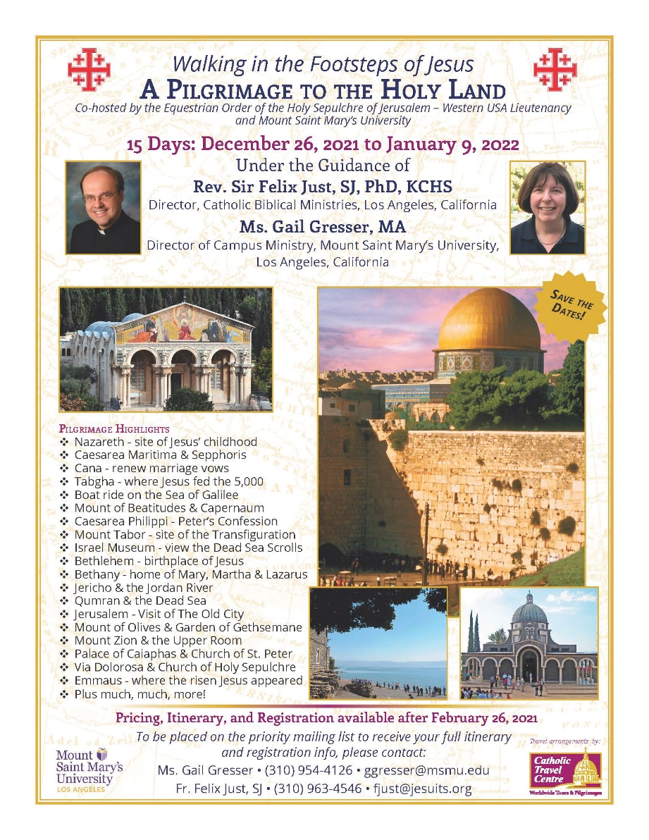
Upcoming Pilgrimages
In the Footsteps of Jesus:
Pilgrimage to the Holy Land
  Dec. 26, 2021 to Jan. 9, 2022
Oberammergau Passion Play:
Pilgrimage to Austria and Germany
  May 14-22, 2022
May 2023
  In the Footsteps of St. Paul:
  Pilgrimage to Turkey
May 2024
  In the Footsteps of Jesus:
  Pilgrimage to the Holy Land
May 2025
  In the Footsteps of St. Paul:
  Pilgrimage to Greece

Slide 6
DONATIONS
Please support MSMU’s Ecclesia program and Living Word Catholic Biblical Ministries. Make a tax-deductible donation, so we can offer more webinars and other programs to anyone, regardless of their financial circumstances.
Online donations can be made through VenMo: @Jesuits-LMU
  and soon hope to accept donations through PayPal also.
Or, make your check payable to "LMU Jesuit Community."
  Please write "Ecclesia Webinars" or "Living Word Series" in the memo field.
Then mail your check to:
  Fr. Felix Just, SJ
  LMU Jesuit Community
  PO Box 45041
  Los Angeles, CA 90045
THANKS!

Slide 7
Lectionary Readings
Basic Questions of This Year’s Webinar Series:
WHICH biblical texts are read at Catholic Masses?
  Seasons: Advent; Christmas; Lent; Easter; Ordinary Time
  Sundays/Feasts: 1st Reading, Psalm, 2nd Reading, Alleluia, Gospel
  Weekdays: 1st Reading, Psalm, Alleluia, Gospel
WHY were the assigned readings chosen?
  Brief “Rationale” in Lectionary’s “Introduction” (in printed editions)
    Chap. 2 in 1969 edition; or Chap. 5 in 1981 edition.
    Season by season; first Sundays/Feasts, then Weekdays
For charts, handouts, more info, see my website:
http://catholic-resources.org/Lectionary/
  Also has the full text of the 1981 “Introduction”

Slide 8
Catholic Lectionary for Mass
https://catholic-resources.org/Lectionary/
  Large section of my website
    Explains both pre-Vatican II and post-Vatican II Lectionaries
    Other websites have “Revised Common Lectionary” (mainline Protestants)
  Charts of Readings for each Liturgical Season
    Advent, Christmas, Lent, Easter, Ordinary Time, Saints, Rituals, etc.
    Study the tables either horizontally or vertically.
Connections between readings
  Horizontal: Connect the various readings used on one day.
    See the “headings” above each reading in a printed Lectionary
  Vertical: Consider all the readings of one type per season.
    All the Gospels of Advent, all the first readings of Easter, etc.

Slide 9


Lectionary Structure: Sundays
Three-Year Cycle:
  Matthew (2020)
  Mark (2021)
  Luke (2022)
  Lent & Easter ABC: JOHN
Three Main Readings:
  OT Reading
  + Responsorial Psalm
  NT Epistles
  + Gospel Acclamation
  NT Gospel
See https://catholic-resources/Lectionary

Slide 10

Lectionary Structure:Weekdays
Two-Year Cycle:
  Odd Years
  Even Years
  Applies only to Ordinary Time
  Same readings each year for Advent, Xmas, Lent, Easter
Two Main Readings:
  First Reading (NT/OT)
  + Responsorial Psalm
  + “Second Reading” on some special days, like Ash Wednesday!
  Gospel
  preceded by “Verse before the Gospel”

Slide 11
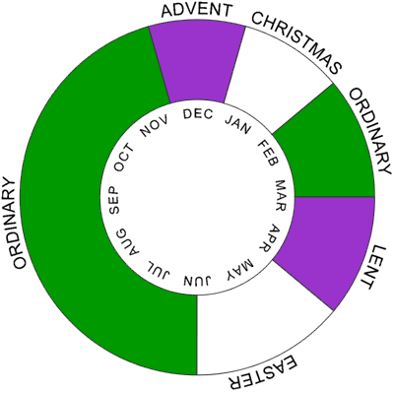
Christian Liturgical Year
Based on Life of Jesus:
  Advent
  CHRISTMAS
  Ordinary Time I
    After Epiphany/Baptism
  Lent
  EASTER
  Ordinary Time II
    After Pentecost
Some Confusions:
  Fitting ~33 years of his life into each calendar year today.

Slide 12
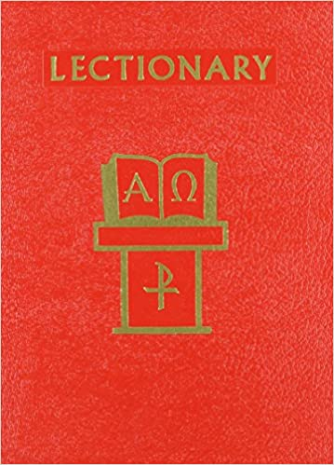
Outline of Today’s Webinar:
Holy Week
  Palm Sunday
  Monday to Thursday
Easter Triduum
  Holy Thursday to Easter Vigil
Easter Octave
  Easter Sunday
  Easter Monday to Saturday
  Second Sunday of Easter
Ten-minute break between each part.
Optional extra Q&A after 12:30 ending.

Slide 13

What is “Holy Week”?
Part I: End of Lent
  Palm Sunday
  Monday
  Tuesday
  Wednesday
  Thursday (daytime)
Part II: Triduum
  Holy Thursday (evening)
  Good Friday
  Holy Saturday
  Easter Sunday

Slide 14
Lectionary, "Intro," chap. 5
Par. 97: Sundays of Lent (cont.)
“On Palm Sunday of the Lord's Passion the texts for the procession are selections from the Synoptic Gospels concerning the Lord's solemn entry into Jerusalem. For the Mass the reading is the account of the Lord's Passion.”
Par. 98: Weekdays of Lent (cont.)
“In the first days of Holy Week the readings are about the mystery of Christ's passion. For the Chrism Mass the readings bring out both Christ's Messianic mission and its continuation in the Church by means of the sacraments.”

Slide 15
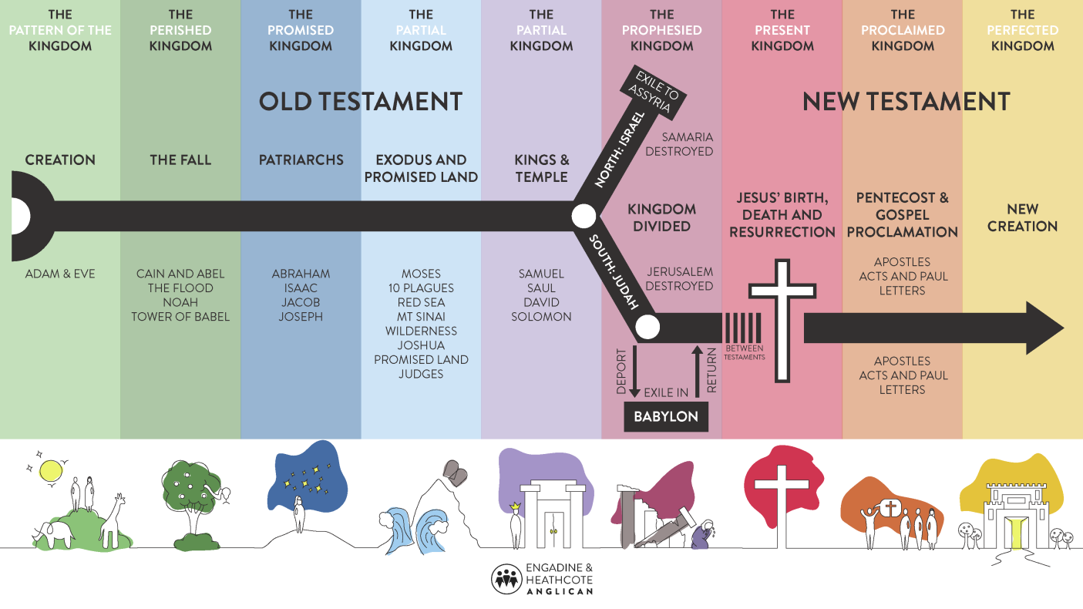
Lectionary, "Intro," chap. 5, par. 97
[Sundays of Lent, cont.]
The Old Testament readings are about the history of salvation, which is one of the themes proper to the catechesis of Lent. The series of texts for each Year presents the main elements of salvation history from its beginning until the promise of the New Covenant.
The readings from the Letters of the Apostles have been selected to fit the Gospel and the Old Testament readings and, to the extent possible, to provide a connection between them.

Slide 16

Palm Sunday: Two Gospels
At the Procession with Palms:
  Year A: Matt 21:1-11
  Year B: Mark 11:1-10
  or John 12:12-16
  Year C: Luke 19:28-40
Gospel / Reading of the Passion:
  Year A: Matt 26:14 – 27:66 or 27:11-54
  Year B: Mark 14:1 – 15:47 or 15:1-39
  Year C: Luke 22:14 – 23:56 or 23:1-49
Note: John 18–19 used on Good Friday, Years ABC

Slide 17
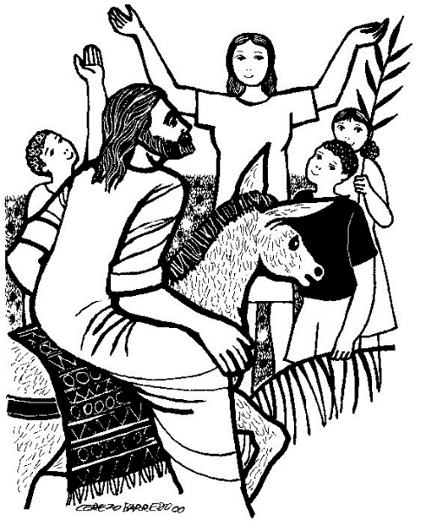
Palm Sunday:
First Gospel
At the Procession with Palms:
  ABC: “Blessed is he who comes
  in the name of the Lord.”
Year A:
  Matt 21:1-11 – like Mark, but 2 animals; adds Zech 9:9
Year B:
  Mark 11:1-10 – “Blessed is the kingdom of our father David that is coming!”
  or John 12:12-16 – only Gospel to mention “palm” trees
Year C:
  Luke 19:28-40 – “Peace in heaven and glory in the highest!”

Slide 18
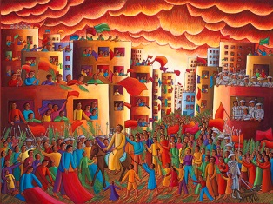
Entry into Jerusalem

Slide 19
Entry into Jerusalem
Mark 11:1-11; Matthew 21:1-11; Luke 19:28-40
  Cf. Zech 9:9 – “Exult greatly, O daughter Zion! Shout for joy,
  O daughter Jerusalem! Behold: your king is coming to you, a just savior is he, Humble, and riding on a donkey, on a colt, the foal of a donkey.”
  Cf. Ps 118:26 – “Blessed is he who comes in the name of the LORD.
  We bless you from the house of the LORD.”
  Followed by the incident in the Temple
  Then several chapters of controversy stories in Jerusalem
John 12:12-19
  Comes AFTER the Raising of Lazarus (Jn 11)
  And AFTER the Anointing at Bethany (Jn 12:1-11)

Slide 20
Palm Sunday (B): Mark 11:1-10
When Jesus and his disciples drew near to Jerusalem,
to Bethphage and Bethany at the Mount of Olives,
he sent two of his disciples and said to them,
“Go into the village opposite you, and immediately on entering it,
you will find a colt tethered on which no one has ever sat.
Untie it and bring it here.
If anyone should say to you, ‘Why are you doing this?’ reply,
‘The Master has need of it and will send it back here at once.’”
So they went off and found a colt tethered at a gate outside on the street,
and they untied it. Some of the bystanders said to them,
“What are you doing, untying the colt?”
They answered them just as Jesus had told them to, and they permitted them to do it.
So they brought the colt to Jesus and put their cloaks over it. And he sat on it.
Many people spread their cloaks on the road,
and others spread leafy branches that they had cut from the fields.
Those preceding him as well as those following kept crying out:
“Hosanna! Blessed is he who comes in the name of the Lord!
Blessed is the kingdom of our father David that is to come!
Hosanna in the highest!”

Slide 21
Palm Sunday (B): John 12:12-19
When the great crowd that had come to the feast
heard that Jesus was coming to Jerusalem,
they took palm branches and went out to meet him, and cried out:
“Hosanna!
“Blessed is he who comes in the name of the Lord,
the king of Israel.”
Jesus found an ass and sat upon it, as is written:
Fear no more, O daughter Zion;
see, your king comes, seated upon an ass’s colt.
His disciples did not understand this at first,
but when Jesus had been glorified
they remembered that these things were written about him
and that they had done this for him.

Slide 22
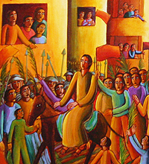
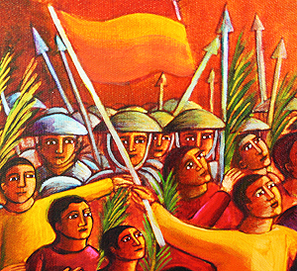
Entry into Jerusalem
by John Aug. Swanson

Slide 23
Palm Sunday – Years ABC
1st Reading: Isa 50:4-7 (3rd “Suffering Servant Song”)
  “My face I did not shield from buffets and spitting
  knowing that I shall not be put to shame.”
Responsorial: Psalm 22:8-9, 17-18, 19-20, 23-24
  “My God, my God, why have you abandoned me?”
2nd Reading: Phil 2:6-11
  “Christ humbled himself. Because of this God greatly exalted him.”
Verse before the Gospel: Phil 2:8-9
  “Christ became obedient to the point of death, even death on a cross.
  Because of this, God greatly exalted him and bestowed on him the name
  which is above every name.”

Slide 24
Palm Sunday – 1st Reading (ABC)
Isa 50:4-7 (part of the 3rd “Suffering Servant Song”)
The Lord GOD has given me
a well-trained tongue,
that I might know how to speak to the weary
a word that will rouse them.
Morning after morning
he opens my ear that I may hear;
and I have not rebelled,
have not turned back.
I gave my back to those who beat me,
my cheeks to those who plucked my beard;
my face I did not shield
from buffets and spitting.
The Lord GOD is my help,
therefore I am not disgraced;
I have set my face like flint,
knowing that I shall not be put to shame.
Note: Isa 50:4-9a is also read on Wednesday of Holy Week

Slide 25
Palm Sunday – Responsorial (ABC)
Psalm 22:8-9, 17-18, 19-20, 23-24
  Ref. “My God, my God, why have you abandoned me?”
All who see me scoff at me;
they mock me with parted lips, they wag their heads:
“He relied on the LORD; let him deliver him,
let him rescue him, if he loves him.”
Indeed, many dogs surround me,
a pack of evildoers closes in upon me;
They have pierced my hands and my feet;
I can count all my bones.
They divide my garments among them,
and for my vesture they cast lots.
But you, O LORD, be not far from me;
O my help, hasten to aid me.
I will proclaim your name to my brethren;
in the midst of the assembly I will praise you:
“You who fear the LORD, praise him;
all you descendants of Jacob, give glory to him;
revere him, all you descendants of Israel!”

Slide 26
Palm Sunday – 2nd Reading (ABC)
2nd Reading: Phil 2:6-11
Christ Jesus, though he was in the form of God,
did not regard equality with God
something to be grasped.
Rather, he emptied himself,
taking the form of a slave,
coming in human likeness;
and found human in appearance,
he humbled himself,
becoming obedient to the point of death,
even death on a cross.
Because of this, God greatly exalted him
and bestowed on him the name
which is above every name,
that at the name of Jesus
every knee should bend,
of those in heaven and on earth and under the earth,
and every tongue confess that
Jesus Christ is Lord,
to the glory of God the Father.

Slide 27

Palm Sunday – Gospel / Passion
  “The Passion of our Lord Jesus Christ.”
Year A: Matt 26:14 – 27:66
  or 27:11-54
Year B: Mark 14:1 – 15:47
  or 15:1-39
Year C: Luke 22:14 – 23:56
  or 23:1-49
  [John 18 – 19, each year on Good Friday]

Slide 28
Mark’s Passion Account
Two Days before Passover (14:1-11)
Passover Feast / Last Supper (14:12-31)
Jesus’ Prayer & Arrest at Gethsemane (14:32-52)
Initial Interrogation of Jesus; Denials of Peter (14:53-72)
Jesus’ Trials before Sanhedrin & before Pilate (15:1-15)
Events before Crucifixion (15:16-23)
Crucifixion of Jesus (15:24-32)
Death of Jesus (15:33-41)
Burial of Jesus (15:42-47)

Slide 29
Emphases in Mark’s Passion
Jesus’ Suffering:
  Betrayed, Mistreated, Rejected (3x), Abandoned
Chronology:
  14:1 – Two days before Passover / Unleavened Bread
  14:12 – On the day before…
  14:17 – In the evening…
  15:1 – In the morning…
  15:25, 33 – third hour (9am), sixth hour (12n), ninth hour (3p)
  15:42 – In the evening…
Jesus’ Identity:
  Messiah & Son of God; King of the Jews
  Witnesses to his Death (3 times) & Burial (3 women)

Slide 30

Passion Accounts
Mark 14—15
  Suffering, Rejection, Abandonment
Matthew 26—27
  Same; with more Political Plotting
Luke 22—23
  Less suffering; more on Jesus’ Innocence
John 18—19
  Jesus remains in charge; directs all the action;
  completes the will of the Father; is Glorified!

Slide 31
Passion Overview
Both/And: Similarities & Differences
  Matthew & Mark & Luke – vs. – John
  Matthew & Mark – vs. – Luke & John
Color Highlighting:
  Yellow = only in Mark
  Red = only in Matthew
    Orange = in Mark & Matthew, but not Luke or John
  Blue = only in Luke
  Grey = only in John

Slide 32
Jesus’ Passion: Overview
Different Emphases in the Four Gospels:
  See Four-color Comparative Charts
This year’s focus is on MARK’s Gospel
Cruel tragic death (Mark 14–15) | Plots & treachery (Matt 26–27)
Jesus’ innocence (Luke 22–23) | Jesus’ exaltation (John 18–19)

Slide 33
Jesus’ Seven Last “Words”
Mark: "My God, my God, why have you forsaken me?" (15:34) | Matthew 27:46 (same as Mark)
Luke: "Father, forgive them, they know not what they do" (23:34) "Amen, I say to you, today you will be with me in Paradise" (23:43 – repentance → salvation) "Father, into your hands I commend my Spirit" (23:46) | John: "Woman, behold, your son"; "Behold, your mother“ (19:26-27) "I am thirsty" (19:28) "It is finished" (19:30)

Slide 34
Psalm 22
¹ For the leader; according to “The deer of the dawn.” A psalm of David.
² My God, my God, why have you abandoned me?
Why so far from my call for help, from my cries of anguish?
³ My God, I call by day, but you do not answer;
by night, but I have no relief.
⁴ Yet you are enthroned as the Holy One;
you are the glory of Israel.
⁵ In you our fathers trusted;
they trusted and you rescued them.
⁶ To you they cried out and they escaped;
in you they trusted and were not disappointed.
⁷ But I am a worm, not a man,
scorned by men, despised by the people.
⁸ All who see me mock me;
they curl their lips and jeer; they shake their heads at me:
⁹ “He relied on the LORD—let him deliver him;
if he loves him, let him rescue him.”

Slide 35
^{22:10} For you drew me forth from the womb,
made me safe at my mother’s breasts.
¹¹ Upon you I was thrust from the womb;
since my mother bore me you are my God.
¹² Do not stay far from me,
for trouble is near, and there is no one to help.
^{22:13} Many bulls surround me; fierce bulls of Bashan encircle me.
¹⁴ They open their mouths against me, lions that rend and roar.
¹⁵ Like water my life drains away; all my bones are disjointed.
My heart has become like wax, it melts away within me.
¹⁶ As dry as a potsherd is my throat; my tongue cleaves to my palate;
you lay me in the dust of death.
¹⁷ Dogs surround me; a pack of evildoers closes in on me.
They have pierced my hands and my feet
¹⁸ I can count all my bones. They stare at me and gloat;
¹⁹ they divide my garments among them; for my clothing they cast lots.
²⁰ But you, LORD, do not stay far off; my strength, come quickly to help me.
²¹ Deliver my soul from the sword, my life from the grip of the dog.
²² Save me from the lion’s mouth, my poor life from the horns of wild bulls.

Slide 36
^{22:23} Then I will proclaim your name to my brethren;
in the assembly I will praise you:
²⁴ “You who fear the LORD, give praise!
All descendants of Jacob, give honor;
show reverence, all descendants of Israel!
²⁵ For he has not spurned or disdained the misery of this poor wretch,
Did not turn away from me, but heard me when I cried out.
²⁶ I will offer praise in the great assembly;
my vows I will fulfill before those who fear him.
²⁷ The poor will eat their fill;
those who seek the LORD will offer praise.
May your hearts enjoy life forever!”
²⁸ All the ends of the earth will remember and turn to the LORD;
All the families of nations will bow low before him.
²⁹ For kingship belongs to the LORD, the ruler over the nations.
³⁰ All who sleep in the earth will bow low before God;
All who have gone down into the dust will kneel in homage.
³¹ And I will live for the LORD; my descendants will serve you.
³² The generation to come will be told of the Lord,
that they may proclaim to a people yet unborn
the deliverance you have brought.

Slide 37
Holy Week: Monday to Wednesday
Holy Week – Monday
  1st Reading: Isaiah 42:1-7
  Responsorial: Psalm 27:1, 2, 3, 13-14
    “The Lord is my light and my salvation.”
  Verse before Gospel: “Hail to you, our King; you alone are compassionate with our faults.”
  Gospel: John 12:1-11 – Mary of Bethany anoints Jesus’ feet
Holy Week – Tuesday
  1st Reading: Isaiah 49:1-6
  Responsorial: Psalm 71:1-2, 3-4a, 5-6ab, 15+17
    “I will sing of your salvation.”
  Verse before Gospel: “Hail to you, our King, obedient to the Father;
  you were led to your crucifixion like a gentle lamb to the slaughter.”
  Gospel: John 13:21-33, 36-38 – Jesus foretells Judas’ Betrayal & Peter’s Denial
Holy Week – Wednesday
  1st Reading: Isaiah 50:4-9a
  Responsorial: Psalm 69:8-10, 21-22, 31+33-34
    “Lord, in your great love, answer me.”
  Verse before Gospel: (either Monday’s or Tuesday’s)
  Gospel: Matt 26:14-25 – Judas arranges to betray Jesus; dialogue at Last Supper

Slide 38
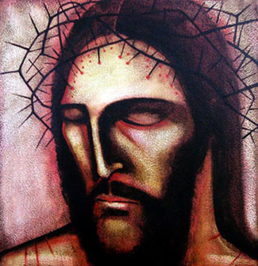
Servant Songs of Isaiah
Monday of Holy Week
  Isaiah 42:1-7
Tuesday of Holy Week
  Isaiah 49:1-6
Wednesday of Holy Week
  Isaiah 50:4-9a
Good Friday
  Isaiah 52:13-15; 53:1-12

Slide 39
Monday of Holy Week: Isa 42:1-7
¹ Here is my servant whom I uphold,
my chosen one with whom I am pleased,
Upon whom I have put my Spirit;
he shall bring forth justice to the nations,
² Not crying out, not shouting,
not making his voice heard in the street.
³ A bruised reed he shall not break,
and a smoldering wick he shall not quench,
⁴ Until he establishes justice on the earth;
the coastlands will wait for his teaching.

Slide 40
Mon. of Holy Week: Isa 42:1-7 (cont.)
⁵ Thus says God, the LORD,
who created the heavens and stretched them out,
who spreads out the earth with its crops,
Who gives breath to its people
and spirit to those who walk on it:
⁶ I, the LORD, have called you for the victory of justice,
I have grasped you by the hand;
I formed you, and set you as a covenant of the people,
a light for the nations,
⁷ To open the eyes of the blind,
to bring out prisoners from confinement,
and from the dungeon, those who live in darkness.

Slide 41
Tuesday of Holy Week: Isa 49:1-6
¹ Hear me, O islands,
listen, O distant peoples.
The Lord called me from birth,
from my mother’s womb he gave me my name.
² He made of me a sharp-edged sword
and concealed me in the shadow of his arm.
He made me a polished arrow,
in his quiver he hid me.
³ You are my servant, he said to me,
Israel, through whom I show my glory.
⁴ Though I thought I had toiled in vain,
and for nothing, uselessly, spent my strength,
Yet my reward is with the Lord,
my recompense is with my God.

Slide 42
Tues. of Holy Week: Isa 49:1-6 (cont.)
⁵ For now the Lord has spoken
who formed me as his servant from the womb,
That Jacob may be brought back to him
and Israel gathered to him;
And I am made glorious in the sight of the Lord,
and my God is now my strength!
⁶ It is too little, he says, for you to be my servant,
to raise up the tribes of Jacob,
and restore the survivors of Israel;
I will make you a light to the nations,
that my salvation may reach to the ends of the earth.

Slide 43
Wed. of Holy Week: Isa 50:4-9a
⁴ The Lord GOD has given me a well-trained tongue,
that I might know how to speak to the weary
a word that will rouse them.
⁵ Morning after morning he opens my ear that I may hear;
and I have not rebelled,
have not turned back.
⁶ I gave my back to those who beat me,
my cheeks to those who plucked my beard;
my face I did not shield from buffets and spitting.

Slide 44
Wed. of Holy Week: Isa 50:4-9a (cont.)
⁷ The Lord GOD is my help,
therefore I am not disgraced;
I have set my face like flint,
knowing that I shall not be put to shame.
⁸ He is near who upholds my right;
if anyone wishes to oppose me,
let us appear together.
Who disputes my right?
Let him confront me.
⁹ See, the Lord GOD is my help;
who will prove me wrong?
Note: “Servant” not mentioned until v. 10:
Who among you fears the LORD, heeds his servant's voice?

Slide 45
Good Friday: Isa 52:13—53:12
¹³ See, my servant shall prosper,
he shall be raised high and greatly exalted.
¹⁴ Even as many were amazed at him –
so marred was his look beyond human semblance
and his appearance beyond that of the sons of man –
¹⁵ So shall he startle many nations,
because of him kings shall stand speechless;
For those who have not been told shall see,
those who have not heard shall ponder it.
^{53:1} Who would believe what we have heard?
To whom has the arm of the LORD been revealed?
² He grew up like a sapling before him,
like a shoot from the parched earth;
there was in him no stately bearing to make us look at him,
nor appearance that would attract us to him.

Slide 46
Good Friday: Isa 52:13—53:12 (cont.)
³ He was spurned and avoided by people,
a man of suffering, accustomed to infirmity,
one of those from whom people hide their faces,
spurned, and we held him in no esteem.
⁴ Yet it was our infirmities that he bore,
our sufferings that he endured,
while we thought of him as stricken,
as one smitten by God and afflicted.
⁵ But he was pierced for our offenses,
crushed for our sins;
upon him was the chastisement that makes us whole,
by his stripes we were healed.
⁶ We had all gone astray like sheep,
each following his own way;
but the LORD laid upon him
the guilt of us all.

Slide 47
Good Friday: Isa 52:13—53:12 (cont.)
⁷ Though he was harshly treated, he submitted
and opened not his mouth;
like a lamb led to the slaughter
or a sheep before the shearers,
he was silent and opened not his mouth.
⁸ Oppressed and condemned, he was taken away,
and who would have thought any more of his destiny?
⁹ When he was cut off from the land of the living,
and smitten for the sin of his people,
a grave was assigned him among the wicked
and a burial place with evildoers,
though he had done no wrong
nor spoken any falsehood.

Slide 48
Good Friday: Isa 52:13—53:12 (cont.)
¹⁰ But the LORD was pleased to crush him in infirmity.
If he gives his life as an offering for sin,
he shall see his descendants in a long life,
and the will of the LORD shall be accomplished through him.
¹¹ Because of his affliction
he shall see the light in fullness of days;
through his suffering, my servant shall justify many,
and their guilt he shall bear.
¹² Therefore I will give him his portion among the great,
and he shall divide the spoils with the mighty,
because he surrendered himself to death
and was counted among the wicked;
and he shall take away the sins of many,
and win pardon for their offenses.

Slide 49
Holy Week GOSPELS: Mon to Wed
Holy Week – Monday
  1st Reading: Isaiah 42:1-7
  Responsorial: Psalm 27:1, 2, 3, 13-14
    “The Lord is my light and my salvation.”
  Verse before Gospel: “Hail to you, our King; you alone are compassionate with our faults.”
  Gospel: John 12:1-11 – Mary of Bethany anoints Jesus’ feet
Holy Week – Tuesday
  1st Reading: Isaiah 49:1-6
  Responsorial: Psalm 71:1-2, 3-4a, 5-6ab, 15+17
    “I will sing of your salvation.”
  Verse before Gospel: “Hail to you, our King, obedient to the Father;
  you were led to your crucifixion like a gentle lamb to the slaughter.”
  Gospel: John 13:21-33, 36-38 – Jesus foretells Judas’ Betrayal & Peter’s Denial
Holy Week – Wednesday
  1st Reading: Isaiah 50:4-9a
  Responsorial: Psalm 69:8-10, 21-22, 31+33-34
    “Lord, in your great love, answer me.”
  Verse before Gospel: (either Monday’s or Tuesday’s)
  Gospel: Matt 26:14-25 – Judas arranges to betray Jesus; dialogue at Last Supper

Slide 50
Monday of Holy Week: John 12:1-11
Six days before Passover Jesus came to Bethany,
where Lazarus was, whom Jesus had raised from the dead.
They gave a dinner for him there, and Martha served,
while Lazarus was one of those reclining at table with him.
Mary took a liter of costly perfumed oil made from genuine aromatic nard
and anointed the feet of Jesus and dried them with her hair;
the house was filled with the fragrance of the oil.
Then Judas the Iscariot, one of his disciples,
and the one who would betray him, said,
“Why was this oil not sold for three hundred days’ wages and given to the poor?”
He said this not because he cared about the poor
but because he was a thief and held the money bag and used to steal the contributions.
So Jesus said, “Leave her alone. Let her keep this for the day of my burial.
You always have the poor with you, but you do not always have me.”
The large crowd of the Jews found out that he was there and came,
not only because of him, but also to see Lazarus, whom he had raised from the dead.
And the chief priests plotted to kill Lazarus too,
because many of the Jews were turning away and believing in Jesus because of him.

Slide 51
Tuesday of Holy Week: John 13:21-33, 36-38
Reclining at table with his disciples, Jesus was deeply troubled and testified,
“Amen, amen, I say to you, one of you will betray me.”
The disciples looked at one another, at a loss as to whom he meant.
One of his disciples, the one whom Jesus loved, was reclining at Jesus’ side.
So Simon Peter nodded to him to find out whom he meant.
He leaned back against Jesus’ chest and said to him, “Master, who is it?”
Jesus answered, “It is the one to whom I hand the morsel after I have dipped it.”
So he dipped the morsel and took it and handed it to Judas, son of Simon the Iscariot.
After Judas took the morsel, Satan entered him.
So Jesus said to him, “What you are going to do, do quickly.”
Now none of those reclining at table realized why he said this to him.
Some thought that since Judas kept the money bag, Jesus had told him,
“Buy what we need for the feast,” or to give something to the poor.
So Judas took the morsel and left at once. And it was night.
When he had left, Jesus said, “Now is the Son of Man glorified, and God is glorified in him.
If God is glorified in him, God will also glorify him in himself, and he will glorify him at once.
My children, I will be with you only a little while longer.
You will look for me, and as I told the Jews, ‘Where I go you cannot come,’ so now I say it to you.”
Simon Peter said to him, “Master, where are you going?”
Jesus answered him, “Where I am going, you cannot follow me now, though you will follow later.”
Peter said to him, “Master, why can I not follow you now? I will lay down my life for you.”
Jesus answered, “Will you lay down your life for me?
Amen, amen, I say to you, the cock will not crow before you deny me three times.”

Slide 52
Wed. of Holy Week: Matt 26:14-25
One of the Twelve, who was called Judas Iscariot, went to the chief priests and said,
“What are you willing to give me if I hand him over to you?”
They paid him thirty pieces of silver, and from that time on he looked for an opportunity to hand him over.
On the first day of the Feast of Unleavened Bread, the disciples approached Jesus and said,
“Where do you want us to prepare for you to eat the Passover?”
He said, “Go into the city to a certain man and tell him,
‘The teacher says, My appointed time draws near;
in your house I shall celebrate the Passover with my disciples.”‘“
The disciples then did as Jesus had ordered, and prepared the Passover.
When it was evening, he reclined at table with the Twelve.
And while they were eating, he said, “Amen, I say to you, one of you will betray me.”
Deeply distressed at this, they began to say to him one after another,
“Surely it is not I, Lord?”
He said in reply, “He who has dipped his hand into the dish with me is the one who will betray me.
The Son of Man indeed goes, as it is written of him,
but woe to that man by whom the Son of Man is betrayed.
It would be better for that man if he had never been born.”
Then Judas, his betrayer, said in reply, “Surely it is not I, Rabbi?”
He answered, “You have said so.”

Slide 53
Holy Week: Chrism Mass
Traditionally celebrated on Thursday Morning of Holy Week
1st Reading: Isaiah 61:1-3a, 6a, 8b-9
  “The Lord anointed me and sent me to bring glad tidings to the lowly,
  and to give them oil of gladness.”
Responsorial: Psalm 89:21-22, 25+27
  “For ever I will sing the goodness of the Lord.”
2nd Reading: Rev 1:5-8
  “Christ has made us into a Kingdom of priests for his God and Father.”
Verse before the Gospel:
  “The Spirit of the Lord is upon me;
  for he has sent me to bring glad tidings to the poor.”
Gospel: Luke 4:16-21
  “The Spirit of the Lord is upon me, because of which he has anointed me.”

Slide 54
Chrism Mass, 1st Reading: Isa 61:1-3a, 6a, 8b-9
The Spirit of the Lord GOD is upon me,
because the LORD has anointed me;
He has sent me to bring glad tidings to the lowly,
to heal the brokenhearted,
To proclaim liberty to the captives
and release to the prisoners,
To announce a year of favor from the LORD
and a day of vindication by our God,
to comfort all who mourn;
To place on those who mourn in Zion
a diadem instead of ashes,
To give them oil of gladness in place of mourning,
a glorious mantle instead of a listless spirit.
You yourselves shall be named priests of the LORD,
ministers of our God shall you be called.
I will give them their recompense faithfully,
a lasting covenant I will make with them.
Their descendants shall be renowned among the nations,
and their offspring among the peoples;
All who see them shall acknowledge them
as a race the LORD has blessed.

Slide 55
Chrism Mass, Psalm 89:21-22, 25+27
Resp. For ever I will sing the goodness of the Lord.
“I have found David, my servant;
with my holy oil I have anointed him.
That my hand may always be with him;
and that my arm may make him strong.” (Resp.)
“My faithfulness and my mercy shall be with him;
and through my name shall his horn be exalted.
He shall say of me, ‘You are my father,
my God, the Rock, my savior!’” (Resp.)

Slide 56
Chrism Mass, 2nd Reading: Rev 1:5-8
Grace to you and peace from Jesus Christ, who is the faithful witness,
the firstborn of the dead and ruler of the kings of the earth.
To him who loves us and has freed us from our sins by his Blood,
who has made us into a Kingdom, priests for his God and Father,
to him be glory and power forever and ever. Amen.
Behold, he is coming amid the clouds,
and every eye will see him,
even those who pierced him.
All the peoples of the earth will lament him.
Yes. Amen.
“I am the Alpha and the Omega,” says the Lord God,
“the one who is and who was and who is to come, the Almighty.”

Slide 57
Chrism Mass, Gospel: Lk 4:16-21
Jesus came to Nazareth, where he had grown up,
and went according to his custom
into the synagogue on the sabbath day.
He stood up to read and was handed a scroll of the prophet Isaiah.
He unrolled the scroll and found the passage where it was written:
The Spirit of the Lord is upon me,
because he has anointed me
to bring glad tidings to the poor.
He has sent me to proclaim liberty to captives
and recovery of sight to the blind,
to let the oppressed go free,
and to proclaim a year acceptable to the Lord.
Rolling up the scroll, he handed it back to the attendant and sat down,
and the eyes of all in the synagogue looked intently at him.
He said to them, “Today this Scripture passage is fulfilled in your hearing.”

Slide 58

Questions & Break
Questions?
  Please “raise your hands” (electronically)
  Or open your mic
Break
  We will continue in 10 minutes.

Slide 59
Mount Saint Mary’s University “Ecclesia” Program Presents:
Living Word: Scriptures of the 2021 Liturgical Year
Lectionary Readings for
Holy Week, Easter Triduum & Easter Octave
Fr. Felix Just, S.J., Ph.D.
Living Word Catholic Biblical Ministries
http://catholic-resources.org

Slide 60
Outline of Today’s Webinar:
Holy Week
  Palm Sunday
  Monday to Thursday
Easter Triduum
  Holy Thursday to Easter Vigil
Easter Octave
  Easter Sunday
  Easter Monday to Saturday
  Second Sunday of Easter
Ten-minute break between each part.
Optional extra Q&A after 12:30 ending.

Slide 61
Triduum = “Three Days”
Thursday + Friday + Saturday + Sunday = 4 days???
When does a “day” begin?
  Western Calendar – midnight
  Personal Experience – wake-up or dawn
  Jewish Calendar – sunset!
Easter Triduum
  Day 1 = Thursday Sunset to Friday Sunset
  Day 2 = Friday Sunset to Saturday Sunset
  Day 3 = Saturday Sunset to Sunday Sunset

Slide 62
Overview: Easter “Tri-duum”
“THREE DAYS” (by Jewish/liturgical counting)
Day 1: Thurs. sunset to Fri. sunset
  Last Supper, Gethsemane, Arrest, Trials, Scourging, Crucifixion, Death, Burial
  Holy Thursday AND Good Friday Services
Day 2: Fri. sunset to Sat. sunset
  Sabbath: NOTHING! No liturgical actions
Day 3: Sat. sunset to Sun. sunset
  RESURRECTION: Empty Tomb, Appearances
See http://catholic-resources.org/Lectionary/LiturgicalYear.htm

Slide 63
Lectionary Intro – Easter Triduum
On Holy Thursday at the evening Mass the remembrance of the meal preceding the Exodus casts its own special light because of the Christ's example in washing the feet of his disciples and Paul's account of the institution of the Christian Passover in the Eucharist.
On Good Friday the liturgical service has as its center John's narrative of the Passion of him who was proclaimed in Isaiah as the Servant of the Lord and who became the one High Priest by offering himself to the Father.
At the Vigil on the holy night of Easter there are seven Old Testament readings which recall the wonderful works of God in the history of salvation. There are two New Testament readings, the announcement of the Resurrection according to one of the Synoptic Gospels and a reading from St. Paul on Christian baptism as the sacrament of Christ's Resurrection.
The Gospel reading for the Mass on Easter day is from John on the finding of the empty tomb. There is also, however, the option to use the Gospel texts from the Easter Vigil or, when there is an evening Mass on Easter Sunday, to use the account in Luke of the Lord's appearance to the disciples on the road to Emmaus. The first reading is from the Acts of the Apostles, which throughout the Easter season replaces the Old Testament reading. The reading from the Apostle Paul concerns the living out of the paschal mystery in the Church.
(Lectionary for Mass, "Introduction," chap. 5, par. 99. – bold emphases added)

Slide 64
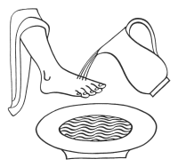
Easter Triduum: Holy Thursday
Evening Mass of the Lord's Supper (ABC)
Exod 12:1-8, 11-14
  The law regarding the Passover meal.
Ps 116:12-13, 15-16, 17-18
  Our blessing-cup is a communion with the Blood of Christ.
1 Cor 11:23-26
  For as often as you eat this bread and drink the cup,
  you proclaim the death of the Lord.
John 13:34
  I give you a new commandment, says the
  Lord: love one another as I have loved you.
John 13:1-15
  Jesus loved them to the end.

Slide 65
Holy Thursday – 1st Reading: Ex 12:1-8, 11-14
The LORD said to Moses and Aaron in the land of Egypt,
“This month shall stand at the head of your calendar; you shall reckon it the first month of the year.
Tell the whole community of Israel:
On the tenth of this month every one of your families
must procure for itself a lamb, one apiece for each household.
If a family is too small for a whole lamb, it shall join the nearest household in procuring one
and shall share in the lamb in proportion to the number of persons who partake of it.
The lamb must be a year-old male and without blemish.
You may take it from either the sheep or the goats.
You shall keep it until the fourteenth day of this month, and then,
with the whole assembly of Israel present, it shall be slaughtered during the evening twilight.
They shall take some of its blood and apply it to the two doorposts and the lintel
of every house in which they partake of the lamb.
That same night they shall eat its roasted flesh with unleavened bread and bitter herbs.
“This is how you are to eat it: with your loins girt, sandals on your feet and your staff in hand,
you shall eat like those who are in flight.
It is the Passover of the LORD. For on this same night I will go through Egypt,
striking down every firstborn of the land, both man and beast,
and executing judgment on all the gods of Egypt—I, the LORD!
But the blood will mark the houses where you are.
Seeing the blood, I will pass over you;
thus, when I strike the land of Egypt, no destructive blow will come upon you.
“This day shall be a memorial feast for you, which all your generations shall celebrate
with pilgrimage to the LORD, as a perpetual institution.”

Slide 66
Holy Thursday – Ps 116:12-13, 15-16bc, 17-18
Resp. Our blessing-cup is a communion with the Blood of Christ.
How shall I make a return to the LORD
for all the good he has done for me?
The cup of salvation I will take up,
and I will call upon the name of the LORD. (Resp.)
Precious in the eyes of the LORD
is the death of his faithful ones.
I am your servant, the son of your handmaid;
you have loosed my bonds. (Resp.)
To you will I offer sacrifice of thanksgiving,
and I will call upon the name of the LORD.
My vows to the LORD I will pay
in the presence of all his people. (Resp.)

Slide 67
Holy Thursday – 2nd Reading: 1 Cor 11:23-26
Brothers and sisters:
I received from the Lord what I also handed on to you,
that the Lord Jesus, on the night he was handed over,
took bread, and, after he had given thanks,
broke it and said, “This is my body that is for you.
Do this in remembrance of me.”
In the same way also the cup, after supper, saying,
“This cup is the new covenant in my blood.
Do this, as often as you drink it, in remembrance of me.”
For as often as you eat this bread and drink the cup,
you proclaim the death of the Lord until he comes.

Slide 68
Holy Thursday – Gospel: Jn 13:1-15
Before the feast of Passover,
Jesus knew that his hour had come to pass from this world to the Father.
He loved his own in the world and he loved them to the end.
The devil had already induced Judas, son of Simon the Iscariot, to hand him over.
So, during supper, fully aware that the Father had put everything into his power
and that he had come from God and was returning to God,
he rose from supper and took off his outer garments.
He took a towel and tied it around his waist.
Then he poured water into a basin and began to wash the disciples’ feet
and dry them with the towel around his waist.
He came to Simon Peter, who said to him, “Master, are you going to wash my feet?”
Jesus answered and said to him,
“What I am doing, you do not understand now, but you will understand later.”
Peter said to him, “You will never wash my feet.”
Jesus answered him, “Unless I wash you, you will have no inheritance with me.”
Simon Peter said to him, “Master, then not only my feet, but my hands and head as well.”
Jesus said to him, “Whoever has bathed has no need except to have his feet washed,
for he is clean all over; so you are clean, but not all.”
For he knew who would betray him; for this reason, he said, “Not all of you are clean.”
So when he had washed their feet and put his garments back on and reclined at table again,
he said to them, “Do you realize what I have done for you?
You call me ‘teacher’ and ‘master,’ and rightly so, for indeed I am.
If I, therefore, the master and teacher, have washed your feet, you ought to wash one another’s feet.
I have given you a model to follow, so that as I have done for you, you should also do.”

Slide 69

Easter Triduum: Good Friday
Good Friday of the Lord's Passion (ABC)
Isa 52:13—53:12 – Fourth Servant Song
Ps 31:2+6, 12-13, 15-16, 17+25
  Father, into your hands I commend my spirit.
Heb 4:14-16; 5:7-9
  Jesus learned obedience and became the
  source of salvation for all who obey him.
Phil 2:8-9
  “Christ became obedient to the point of death…”
John 18:1—19:42 – The Passion of our Lord J.C.

Slide 70
Good Friday – 1st Reading
Isa 52:13—53:12 – Fourth “Servant Song”

Slide 71
Good Friday – Ps 31:2+6, 12-13, 15-16, 17+25
R. (Lk 23:46) Father, into your hands I commend my spirit.
In you, O LORD, I take refuge;
let me never be put to shame.
In your justice rescue me.
Into your hands I commend my spirit;
you will redeem me, O LORD, O faithful God. (Resp.)
For all my foes I am an object of reproach,
a laughingstock to my neighbors, and a dread to my friends;
they who see me abroad flee from me.
I am forgotten like the unremembered dead;
I am like a dish that is broken. (Resp.)
But my trust is in you, O LORD;
I say, “You are my God.
In your hands is my destiny; rescue me
from the clutches of my enemies and my persecutors.” (Resp.)
Let your face shine upon your servant;
save me in your kindness.
Take courage and be stouthearted,
all you who hope in the LORD. (Resp.)

Slide 72
Psalm 31
¹ For the leader. A psalm of David.
² In you, LORD, I take refuge; let me never be put to shame.
In your righteousness deliver me;
³ incline your ear to me; make haste to rescue me!
Be my rock of refuge, a stronghold to save me.
⁴ For you are my rock and my fortress;
for your name’s sake lead me and guide me.
⁵ Free me from the net they have set for me, for you are my refuge.
⁶ Into your hands I commend my spirit;
you will redeem me, LORD, God of truth.
⁷ You hate those who serve worthless idols, but I trust in the LORD.
⁸ I will rejoice and be glad in your mercy,
once you have seen my misery,
[and] gotten to know the distress of my soul.
⁹ You will not abandon me into enemy hands,
but will set my feet in a free and open space.

Slide 73
^{31:10} Be gracious to me, LORD, for I am in distress;
affliction is wearing down my eyes, my throat and my insides.
¹¹ My life is worn out by sorrow, and my years by sighing.
My strength fails in my affliction; my bones are wearing down.
¹² To all my foes I am a thing of scorn,
and especially to my neighbors a horror to my friends.
When they see me in public, they quickly shy away.
¹³ I am forgotten, out of mind like the dead;
I am like a worn-out tool.
¹⁴ I hear the whispers of the crowd; terrors are all around me.
They conspire together against me; they plot to take my life.
¹⁵ But I trust in you, LORD; I say, “You are my God.”
¹⁶ My destiny is in your hands; rescue me from my enemies,
from the hands of my pursuers.
¹⁷ Let your face shine on your servant;
save me in your mercy.
¹⁸ Do not let me be put to shame,
for I have called to you, LORD.
Put the wicked to shame;
reduce them to silence in Sheol.
¹⁹ Strike dumb their lying lips, which speak arrogantly
against the righteous in contempt and scorn.

Slide 74
^{31:20} How great is your goodness, Lord,
stored up for those who fear you.
You display it for those who trust you,
in the sight of the children of Adam.
²¹ You hide them in the shelter of your presence,
safe from scheming enemies.
You conceal them in your tent,
away from the strife of tongues.
²² Blessed be the LORD,
marvelously he showed to me his mercy in a fortified city.
²³ Though I had said in my alarm,
“I am cut off from your eyes.”
Yet you heard my voice, my cry for mercy,
when I pleaded with you for help.
²⁴ Love the LORD, all you who are faithful to him.
The LORD protects the loyal,
but repays the arrogant in full.
²⁵ Be strong and take heart,
all who hope in the LORD.

Slide 75
Good Friday, 2nd Reading: Heb 4:14-16; 5:7-9
Brothers and sisters:
Since we have a great high priest who has passed through the heavens,
Jesus, the Son of God,
let us hold fast to our confession.
For we do not have a high priest
who is unable to sympathize with our weaknesses,
but one who has similarly been tested in every way,
yet without sin.
So let us confidently approach the throne of grace
to receive mercy and to find grace for timely help.
In the days when Christ was in the flesh,
he offered prayers and supplications with loud cries and tears
to the one who was able to save him from death,
and he was heard because of his reverence.
Son though he was, he learned obedience from what he suffered;
and when he was made perfect,
he became the source of eternal salvation for all who obey him.

Slide 76
Good Friday – Gospel
Verse before the Gospel:
“Christ became obedient to the point of death, even death on a cross.
Because of this, God greatly exalted him and bestowed on him the name which is above every other name.” (Phil 2:8-9)
Gospel: Jn 18:1—19:42

Slide 77
Passion Narrative: John 18–19
Passion Narrative Begins (18:1-27)
  The Arrest (18:1-11)
  Interrogations & Peter’s Denials (18:12-27)
Jesus' Trial before Pilate (18:28-40; 19:1-16a)
Crucifixion, Death, and Burial (19:16b-42)

Slide 78
Jesus’ Prayer & Arrest in John
PASSION BEGINS: Night in the Garden
  18:1-2 Intro: Nighttime in the Garden
  18:3-6 Overcoming the Enemies
  18:7-9 Protecting the Disciples
  18:10-11 Concl: Peter’s Sword vs. Father’s Cup
What’s Missing in John’s Version?
  No Agonizing Prayer of Jesus (already John 17)
  No “Kiss of Judas” (Jesus gives himself up!)

Slide 79
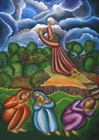
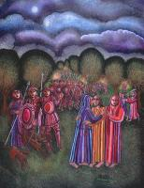
J.A. Swanson

Slide 80
Jesus on Trial: Synoptics & John
Jewish Hearings & Trials:
  Mark & Matt: long pre-dawn hearing; short trial
  Luke: brief night hearing; official trial at dawn
  John: questioning by High Priests
Roman (& Herodian) Trials:
  Mark & Matt: short trial before Pilate
  Luke: longer trials before Pilate & Herod Antipas
  John: longest trial before Pilate (7 scenes)

Slide 81
Jesus’ Trials Begin in John
18:12-14 Intro: High Priests Annas & Caiaphas
18:15-18 Peter’s First Denial
18:19-24 Annas’ Questions & Jesus’ Responses
18:25-27 Peter’s Second and Third Denials

Slide 82
Trial before Pilate: 7 scenes
18:28-32 (outside)
18:33-38a (inside)
18:38b-40 (outside)
19:1-3 (implicitly inside)
19:4-7 (outside)
19:8-12 (inside)
19:13-16 (outside)
Missing: No “Way of the Cross”

Slide 83
Crucifixion & Burial in John
19:16b-18 – Crucifixion scene overall
  19:19-22 – Inscription: I.N.R.I.
  19:23-25a – Soldiers divide Jesus’ garments
  19:25b-27 – Jesus’ Mother & Beloved Disciple
  19:28-30 – Jesus thirsts; he “finishes” his work and gives up his spirit
  19:31-34 – Legs not broken, but side pierced
19:38-42 – Burial of Jesus’ body

Slide 84
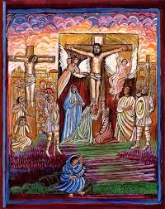
Crucifixion

Slide 85
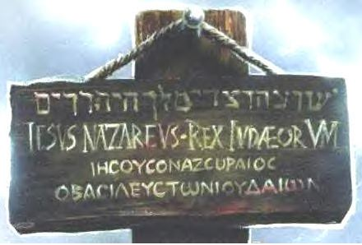
Close-Up: Inscription

Slide 86
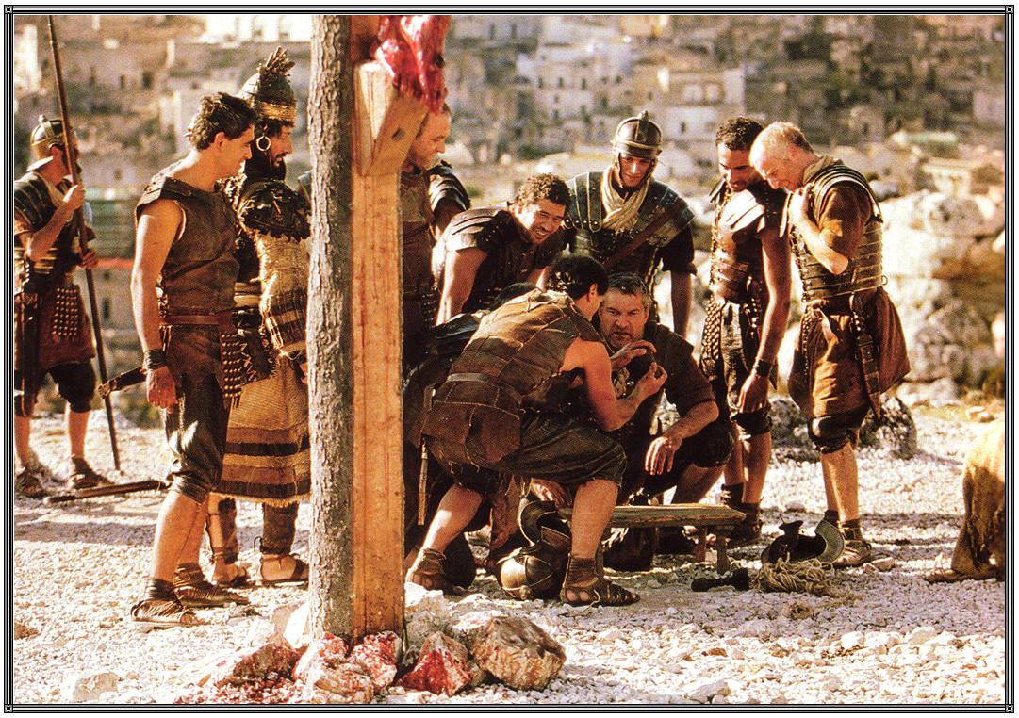
Close-Up: Garments

Slide 87
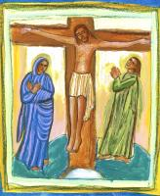
Close-Up: Mother & Disciple

Slide 88
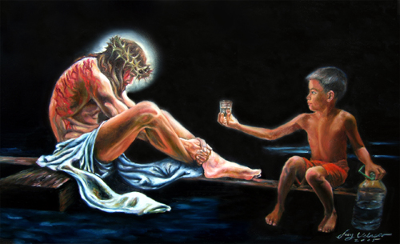
Close-Up: “I Thirst”

Slide 89

Close-Up: “It Is Finished”

Slide 90

Close-Up: “It Is Finished”

Slide 91
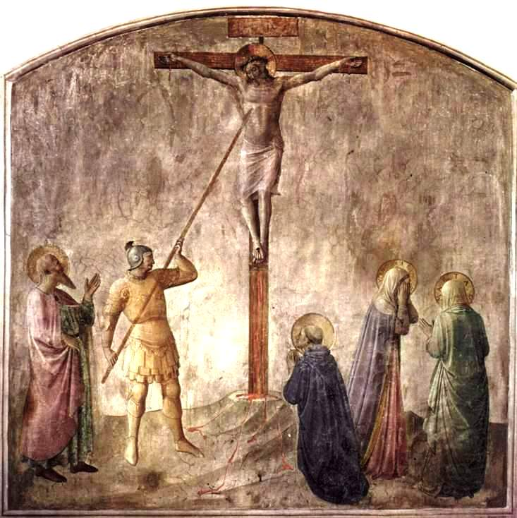
Close-Up: Jesus’ Side Pierced

Slide 92
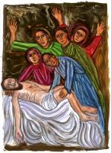
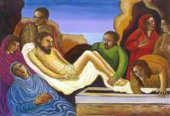
Burial

Slide 93
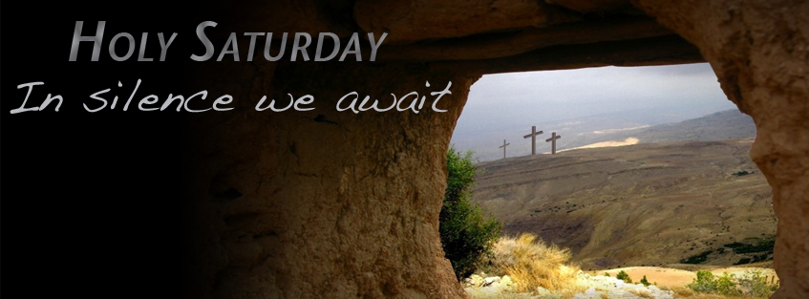
Holy Saturday

Slide 94
Easter Sunday: Vigil (ABC)
OT Readings & Psalms
  7 options (minimum 3, or at least 2; always Exod 14:15—15:1)
NT Epistle: Rom 6:3-11
  Christ, raised from the dead, dies no more
Psalm 118:1-2, 16-17, 22-23
  Triple “Alleluia”
Gospel:
  A: Matt 28:1-10
  B: Mark 16:1-7
  C: Luke 24:1-12

Slide 95
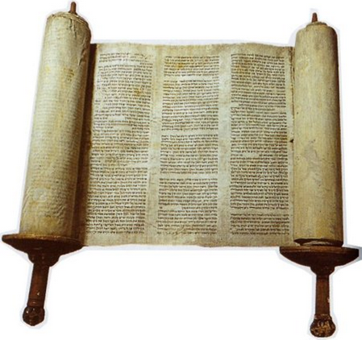
Easter Vigil – OT Readings
Gen 1:1—2:2 or 1:1, 26-31a
Gen 22:1-18 or 22:1-2, 9a, 10-13, 15-18
Exod 14:15—15:1
Isa 54:5-14
Isa 55:1-11
Bar 3:9-15, 32-4:4
Ezek 36:16-17a, 18-28
Lectionary Note:
  “Nine readings are assigned to the Easter Vigil: seven from the Old Testament,
  and two from the New. If circumstances demand in individual cases, the number of prescribed readings may be reduced. Three selections from the Old Testament, however, should be read before the epistle and Gospel, although when necessary, two may be read. In any case, the reading from Exodus about the escape through the Red Sea (reading 3) should never be omitted.”

Slide 96
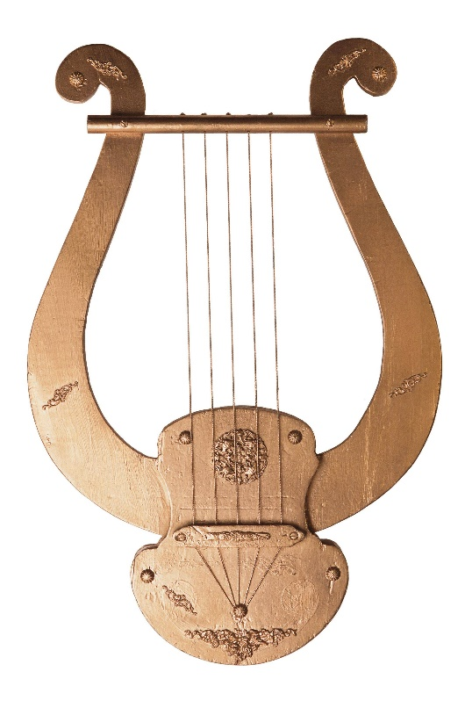
Easter Vigil – Psalms after OT Readings
Ps 104:1-2, 5-6, 10+12, 13-14, 24+35
or Ps 33:4-5, 6-7, 12-13, 20-22
Ps 16:5+8, 9-10, 11
Exod 15:1-2, 3-4, 5-6, 17-18
Ps 30:2+4, 5-6, 11-12a+13b
Isa 12:2-3, 4bcd, 5-6
Ps 19:8, 9, 10, 11
Ps 42:3, 5; 43:3, 4
or Ps 51:12-13, 14-15, 18-19

Slide 97

Easter Vigil – OT Readings
1) Gen 1:1—2:2 or 1:1, 26-31a
“God looked at everything he had made, and he found it very good.”
1) Ps 104:1-2, 5-6, 10+12, 13-14, 24+35
“Lord, send out your Spirit, and renew the face of the earth.”
or Ps 33:4-5, 6-7, 12-13, 20-22
“The earth is full of the goodness of the Lord.”

Slide 98
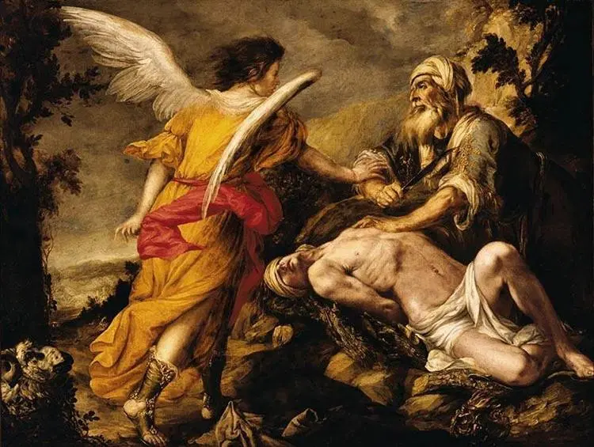
Easter Vigil – OT Readings
2) Gen 22:1-18 or 22:1-2, 9a, 10-13, 15-18
“The sacrifice of Abraham, our father in faith.”
2) Ps 16:5+8, 9-10, 11
“You are my inheritance, O Lord.”

Slide 99
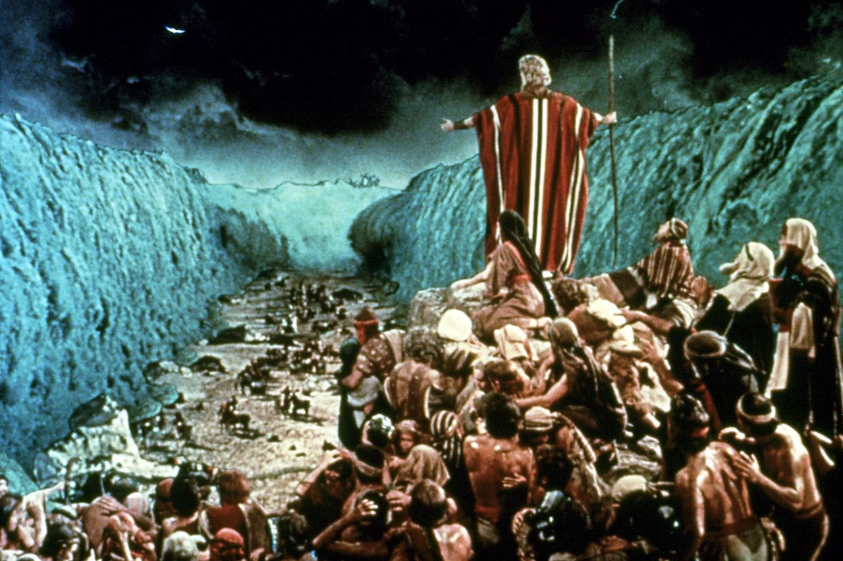
Easter Vigil – OT Readings
3) Exod 14:15—15:1
“The Israelites marched on dry land through the midst of the sea.”
3) Exod 15:1-2, 3-4, 5-6, 17-18
“Let us sing to the Lord; he has covered himself in glory.”

Slide 100
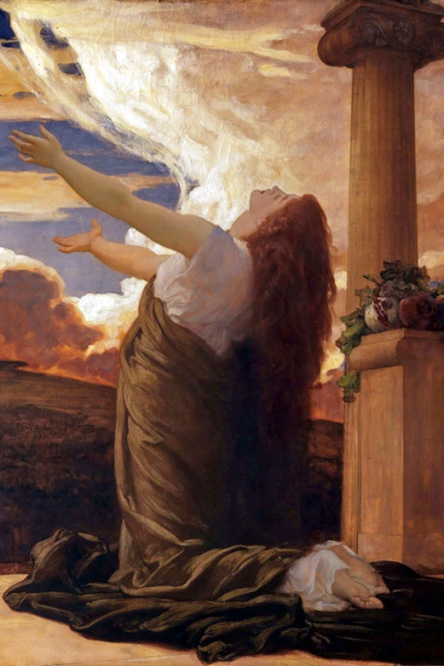
Easter Vigil – OT Readings
4) Isa 54:5-14
“With enduring love, the Lord
your redeemer takes pity on you.”
4) Ps 30:2+4, 5-6, 11-12a+13b
“I will praise you, Lord,
for you have rescued me.”

Slide 101

Easter Vigil – OT Readings
5) Isa 55:1-11
“Come to me that you may have life.
I will renew with you an everlasting covenant.”
5) Isa 12:2-3, 4bcd, 5-6
“You will draw water
joyfully from the
springs of salvation.”

Slide 102

Easter Vigil – OT Readings
6) Bar 3:9-15, 32 – 4:4
“Walk toward the splendor
of the Lord.”
6) Ps 19:8, 9, 10, 11
“Lord, you have the words
of everlasting life.”

Slide 103
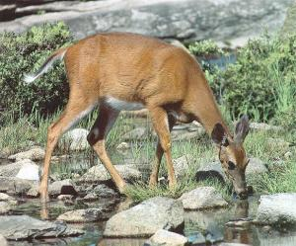
Easter Vigil – OT Readings
7) Ezek 36:16-17a, 18-28
“I shall sprinkle clean water upon you
and I shall give you a new heart.”
7) Ps 42:3, 5bcd; 43:3, 4 (when baptism is celebrated)
“Like a deer that longs for running streams,
my soul longs for you, my God.”
or Isa 12:2-3, 4bcd, 5-6
(when baptism is not celebrated)
“You will draw water joyfully from the springs of salvation.”
or Ps 51:12-13, 14-15, 18-19
(when baptism is not celebrated)
“Create a clean heart in me, o God.”

Slide 104
Easter Vigil, Epistle – Rom 6:3-11
Brothers and sisters: Are you unaware that we who were baptized into Christ Jesus
were baptized into his death?
We were indeed buried with him through baptism into death,
so that, just as Christ was raised from the dead by the glory of the Father,
we too might live in newness of life.
For if we have grown into union with him through a death like his,
we shall also be united with him in the resurrection.
We know that our old self was crucified with him,
so that our sinful body might be done away with,
that we might no longer be in slavery to sin.
For a dead person has been absolved from sin.
If, then, we have died with Christ, we believe that we shall also live with him.
We know that Christ, raised from the dead, dies no more;
death no longer has power over him.
As to his death, he died to sin once and for all; as to his life, he lives for God.
Consequently, you too must think of yourselves as being dead to sin
and living for God in Christ Jesus.

Slide 105
Easter Vigil, Ps 118:1-2, 16-17, 22-23
R. Alleluia, alleluia, alleluia.
Give thanks to the LORD, for he is good,
for his mercy endures forever.
Let the house of Israel say,
“His mercy endures forever.”
The right hand of the LORD has struck with power;
the right hand of the LORD is exalted.
I shall not die, but live,
and declare the works of the LORD.
The stone the builders rejected
has become the cornerstone.
By the LORD has this been done;
it is wonderful in our eyes.

Slide 106
Easter Vigil, Gospel (A) – Matt 28:1-10
After the sabbath, as the first day of the week was dawning,
Mary Magdalene and the other Mary came to see the tomb.
And behold, there was a great earthquake;
for an angel of the Lord descended from heaven,
approached, rolled back the stone, and sat upon it.
His appearance was like lightning and his clothing was white as snow.
The guards were shaken with fear of him and became like dead men.
Then the angel said to the women in reply,
“Do not be afraid! I know that you are seeking Jesus the crucified.
He is not here, for he has been raised just as he said.
Come and see the place where he lay.
Then go quickly and tell his disciples,
‘He has been raised from the dead, and he is going before you to Galilee;
there you will see him.’ Behold, I have told you.”
Then they went away quickly from the tomb, fearful yet overjoyed,
and ran to announce this to his disciples.
And behold, Jesus met them on their way and greeted them.
They approached, embraced his feet, and did him homage.
Then Jesus said to them, “Do not be afraid.
Go tell my brothers to go to Galilee, and there they will see me.”

Slide 107
Easter Vigil, Gospel (B) – Mark 16:1-7
When the sabbath was over,
Mary Magdalene, Mary, the mother of James, and Salome
bought spices so that they might go and anoint him.
Very early when the sun had risen, on the first day of the week, they came to the tomb.
They were saying to one another,
“Who will roll back the stone for us from the entrance to the tomb?”
When they looked up, they saw that the stone had been rolled back; it was very large.
On entering the tomb they saw a young man
sitting on the right side, clothed in a white robe,
and they were utterly amazed.
He said to them, “Do not be amazed!
You seek Jesus of Nazareth, the crucified.
He has been raised; he is not here.
Behold the place where they laid him.
But go and tell his disciples and Peter,
‘He is going before you to Galilee;
there you will see him, as he told you.’”

Slide 108
Easter Vigil, Gospel (C) – Luke 24:1-12
At daybreak on the first day of the week
the women who had come from Galilee with Jesus
took the spices they had prepared and went to the tomb.
They found the stone rolled away from the tomb;
but when they entered, they did not find the body of the Lord Jesus.
While they were puzzling over this, behold,
two men in dazzling garments appeared to them.
They were terrified and bowed their faces to the ground.
They said to them, "Why do you seek the living one among the dead?
He is not here, but he has been raised.
Remember what he said to you while he was still in Galilee,
that the Son of Man must be handed over to sinners
and be crucified, and rise on the third day."
And they remembered his words.
Then they returned from the tomb
and announced all these things to the eleven and to all the others.
The women were Mary Magdalene, Joanna, and Mary the mother of James;
the others who accompanied them also told this to the apostles,
but their story seemed like nonsense and they did not believe them.
But Peter got up and ran to the tomb, bent down, and saw the burial cloths alone;
then he went home amazed at what had happened.

Slide 109
Empty Tomb Stories – Diff. Details
Women:
  Mark: 3
  Matt: 2
  Luke: 3 named, along with others
  John: 1, Mary of Magdala (alone?)
Messenger(s):
  Mark: a young man… clothed in a white robe
  Matt: an angel of the Lord
  Luke: two men in dazzling garments
  John: [two angels]

Slide 110
Questions & Break
Questions?
  Please “raise your hands” (electronically)
  Or open your mic
Break
  We will continue in 10 minutes.

Slide 111
Mount Saint Mary’s University “Ecclesia” Program Presents:
Living Word: Scriptures of the 2021 Liturgical Year
Lectionary Readings for
Holy Week, Easter Triduum & Easter Octave
Fr. Felix Just, S.J., Ph.D.
Living Word Catholic Biblical Ministries
http://catholic-resources.org

Slide 112
Outline of Today’s Webinar:
Holy Week
  Palm Sunday
  Monday to Thursday
Easter Triduum
  Holy Thursday to Easter Vigil
Easter Octave
  Easter Sunday
  Easter Monday to Saturday
  Second Sunday of Easter
Ten-minute break between each part.
Optional extra Q&A after 12:30 ending.

Slide 113

Easter Sunday (ABC)
1st Reading: Acts 10:34a, 37-43
Resp. Psalm 118:1-2, 16-17, 22-23
2nd Reading:
  Col 3:1-4
  or 1 Cor 5:6b-8
Gospel:
  John 20:1-9
  or Luke 24:13-35b (afternoon Masses)
  or Gospel from the Easter Vigil (A/B/C)

Slide 114
Easter: 1st Reading: Acts 10:34a, 37-43
“We ate and drank with him after he rose from the dead.”
Peter proceeded to speak [to Cornelius’ household] and said:
“You know what has happened all over Judea,
beginning in Galilee after the baptism that John preached,
how God anointed Jesus of Nazareth
with the Holy Spirit and power.
He went about doing good
and healing all those oppressed by the devil,
for God was with him.
We are witnesses of all that he did
both in the country of the Jews and in Jerusalem.

Slide 115
Easter Sunday: 1st Reading (cont.)
They put him to death by hanging him on a tree.
This man God raised on the third day
and granted that he be visible,
not to all the people, but to us,
the witnesses chosen by God in advance,
who ate and drank with him after he rose from the dead.
He commissioned us to preach to the people
and testify that he is the one appointed by God
as judge of the living and the dead.
To him all the prophets bear witness,
that everyone who believes in him
will receive forgiveness of sins through his name.”

Slide 116
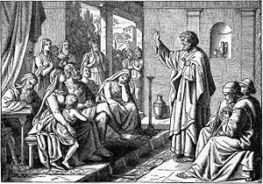

Slide 117
Easter Sunday: Resp. Psalm 118
R. This is the day the Lord has made;
let us rejoice and be glad. or: R. Alleluia.
Give thanks to the LORD, for he is good,
for his mercy endures forever.
Let the house of Israel say,
“His mercy endures forever.” Resp.
“The right hand of the LORD has struck with power;
the right hand of the LORD is exalted.
I shall not die, but live,
and declare the works of the LORD.” Resp.
The stone which the builders rejected
has become the cornerstone.
By the LORD has this been done;
it is wonderful in our eyes. Resp.

Slide 118
Easter : 2nd Reading (opt.1): Col 3:1-4
Brothers and sisters:
If then you were raised with Christ,
seek what is above,
where Christ is seated at the right hand of God.
Think of what is above,
not of what is on earth.
For you have died,
and your life is hidden with Christ in God.
When Christ your life appears,
then you too will appear with him in glory.

Slide 119
Easter : 2nd Reading (opt.2): 1 Cor 5:6b-8
Brothers and sisters:
Do you not know that a little yeast leavens all the dough?
Clear out the old yeast,
so that you may become a fresh batch of dough,
inasmuch as you are unleavened.
For our paschal lamb, Christ, has been sacrificed.
Therefore, let us celebrate the feast,
not with the old yeast,
the yeast of malice and wickedness,
but with the unleavened bread of sincerity and truth.

Slide 120
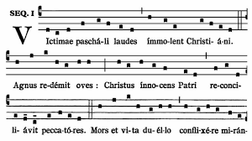
SEQUENCE: Victimae paschali laudes
Christians, to the Paschal Victim
Offer your thankful praises!
A Lamb the sheep redeems;
Christ, who only is sinless,
Reconciles sinners to the Father.
Death and life have contended in that combat stupendous:
The Prince of life, who died, reigns immortal.
Speak, Mary, declaring
What you saw, wayfaring.
“The tomb of Christ, who is living,
The glory of Jesus’ resurrection;
Bright angels attesting,
The shroud and napkin resting.
Yes, Christ my hope is arisen;
to Galilee he goes before you.”
Christ indeed from death is risen, our new life obtaining.
Have mercy, victor King, ever reigning!
Amen. Alleluia.

Slide 121

Easter Sunday: Gospel Acclamation
R. Alleluia, alleluia.
  Christ, our paschal lamb, has been sacrificed;
  Let us then feast with joy in the Lord.
R. Alleluia, alleluia.
  Cf. 1 Cor 5:7b-8a (part of 2nd reading, 2nd option)

Slide 122
Easter Sunday: Gospel Options
First Option: John 20:1-9
Afternoon/Evening: Luke 24:13-35
“The Gospel from the Easter Vigil may also be read… at any time of the day.”
  Year A: Matt 28:1-10
  Year B: Mark 16:1-7
  Year C: Luke 24:1-12

Slide 123
Easter Sunday Gospel: John 20:1-9
On the first day of the week,
Mary of Magdala came to the tomb early in the morning,
while it was still dark,
and saw the stone removed from the tomb.
So she ran and went to Simon Peter
and to the other disciple whom Jesus loved, and told them,
“They have taken the Lord from the tomb,
and WE don’t know where they put him.”
So Peter and the other disciple went out and came to the tomb.
They both ran, but the other disciple ran faster than Peter
and arrived at the tomb first;
he bent down and saw the burial cloths there, but did not go in.

Slide 124
Easter Sunday Gospel (cont.)
When Simon Peter arrived after him,
he went into the tomb and saw the burial cloths there,
and the cloth that had covered his head,
not with the burial cloths but rolled up in a separate place.
Then the other disciple also went in,
the one who had arrived at the tomb first,
and he saw and believed.
For they did not yet understand the Scripture
that he had to rise from the dead.

Slide 125
Believing in the Resurrection
Core/Central belief of Christianity!
  Not just about Jesus (2000 years ago and now)
  also about US, our life (present & future)
But NOT so easy! Not so fast!
  Have Patience/Mercy with those who struggle
Opportunity to Evangelize: GOOD NEWS
  Life is stronger than Death
  Good overcomes Evil; God gives LIFE

Slide 126
Lectionary Intro – Easter Octave
“As on the Sundays, the first reading is a semicontinuous reading from the Acts of the Apostles.
The Gospel readings during the Easter octave are accounts of the Lord's appearances.
After that there is a sernicontinuous reading of the Gospel of John, but with texts that have a paschal character, in order to complete the reading from John during Lent. This paschal reading is made up in large part of the Lord's discourse and prayer at the end of the Last Supper.”
(Lectionary for Mass, "Introduction," chap. 5, par. 101.)

Slide 127
Easter Octave: 1st Readings
Mon: Acts 2:14, 22-33
Tues: Acts 2:36-41
Wed: Acts 3:1-10
Thurs: Acts 3:11-26
Fri: Acts 4:1-12
Sat: Acts 4:13-21
2nd Sun: Acts (diff. in Years ABC)

Slide 128
Easter Octave: Gospel Readings
Mon: Matt 28:8-15
Tues: John 20:11-18
Wed: Luke 24:13-35
Thurs: Luke 24:35-48
Fri: John 21:1-14
Sat: Mark 16:9-15
2nd Sun: John 20:19-31
Alleluia Verse (each day):
    “This is the day the Lord has made; let us be glad and rejoice in it.”

Slide 129
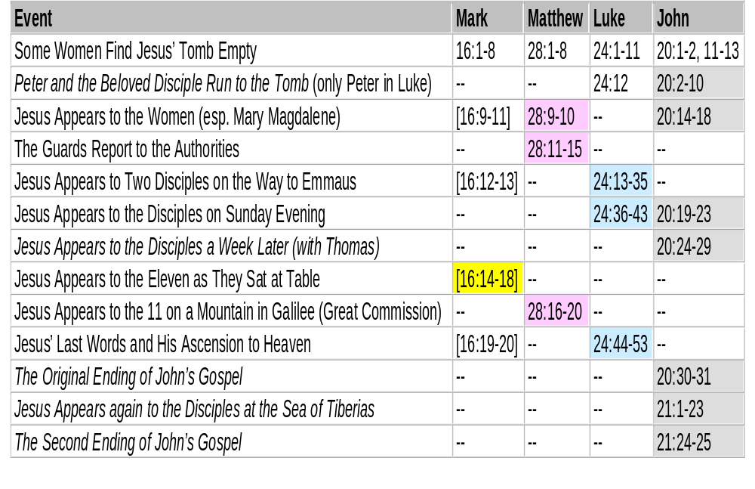
Appearances of the Risen Jesus

Slide 130
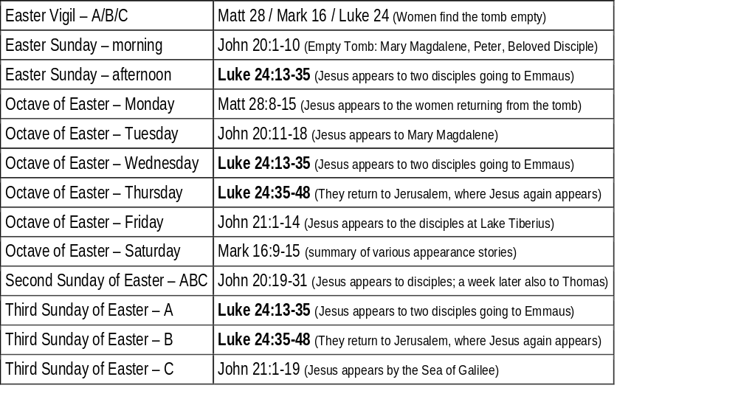
Appearance Stories in the Lectionary

Slide 131
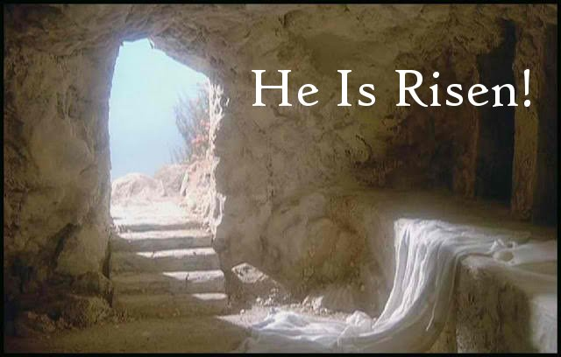
HAPPY EASTER !

Slide 132
RECAP: Upcoming Pilgrimages
In the Footsteps of Jesus:
Pilgrimage to the Holy Land
  Dec. 26, 2021 to Jan. 9, 2022
Oberammergau Passion Play:
Pilgrimage to Austria and Germany
  May 14-22, 2022
May 2023
  In the Footsteps of St. Paul:
  Pilgrimage to Turkey
May 2024
  In the Footsteps of Jesus:
  Pilgrimage to the Holy Land
May 2025
  In the Footsteps of St. Paul:
  Pilgrimage to Greece

Slide 133
“Living Word” Webinar Series
Zoom Webinars on the Catholic Lectionary for Mass
  Saturdays, 9:00 a.m. – 12:30 p.m. (Pacific Time)
  Open to the Public (feel free to invite others)
  FREE (but donations appreciated)
Monthly, from Nov. 2020 to April 2021
  Nov. 21, 2020 – Readings of Advent
  Dec. 19, 2020 – Readings of the Christmas Season
  Jan. 9, 2021 – Gospel of Mark (Liturgical Year B)
  Feb. 13, 2021 – Readings of Lent
  March 27, 2021 – Readings of Holy Week & Easter Triduum
  April 17, 2021 – Readings of the Easter Season

Slide 134

Closing Prayer
Let those of us who finish the course of fasting
celebrate with love the beginning
of the suffering of the Passion of the Lord.
Passing from one divine feast to another,
from palms and branches,
let us now make haste,
to the solemn and saving celebration
of Christ’s passion.
Let us behold him undergo voluntary suffering for our sake,
and let us sing to him with thanksgiving:
Fountain of tender mercy and haven of salvation –
O Lord of Life, glory to you!
(adapted from Byzantine Matins)

Slide 135
Have a Blessed Holy Week, and a HAPPY EASTER!
Thanks for participating today!
  More Questions or Comments? – Feel Free to Stay Online

Slide 136
